Slide 1
陕旅版小学英语三年级上册
Unit8 What Color Is It？
第1课时
WWW.PPT818.COM

Slide 2
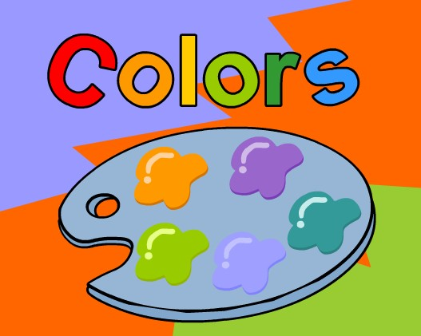
Listen to a song: Colors

Slide 3
What’s this?

Slide 4
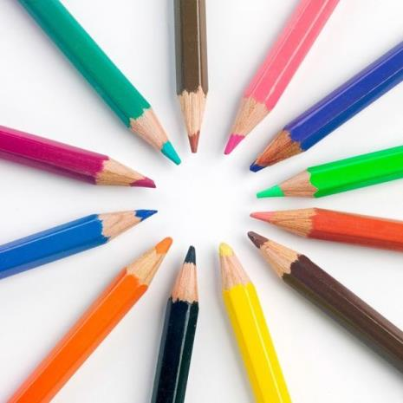
Ask and answer
A: How many crayons do you have?
B: I have…

Slide 5
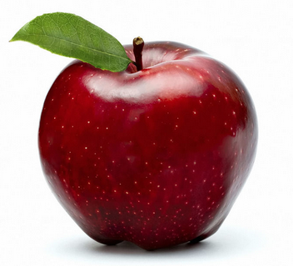
Let’s learn
red

Slide 6
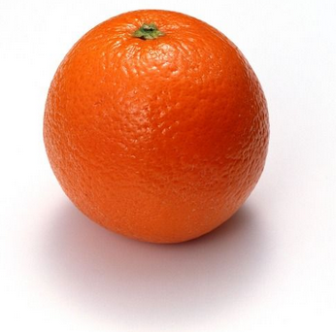
orange

Slide 7
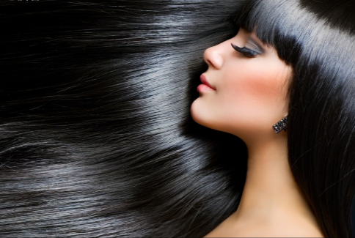
black

Slide 8
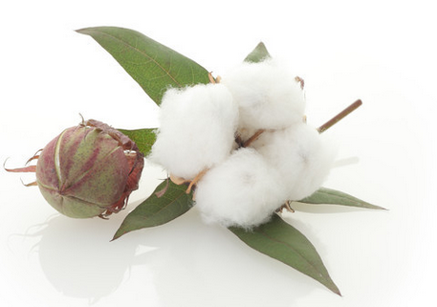
white

Slide 9
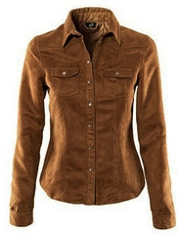
brown

Slide 10
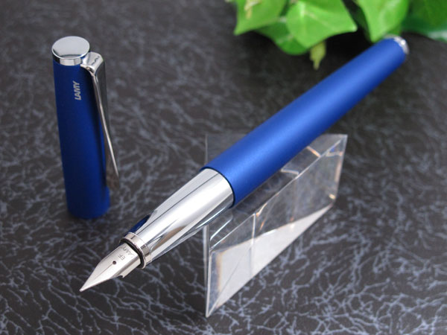
blue

Slide 11
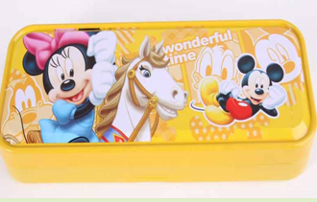
yellow

Slide 12
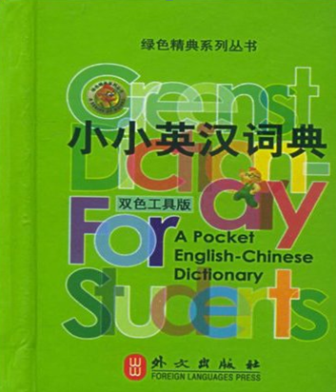
green

Slide 13
找一找教室中哪些是学过的颜色的物品？

Slide 14
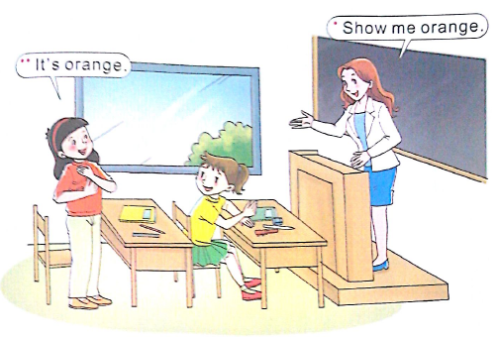
Let’s play

Slide 15
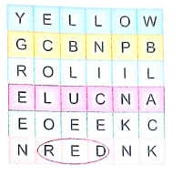
Find and circle

Slide 16
练一练
3
2
4
1
blue
yellow
red
green

