Slide 1
Unit1 May I Speak to Kitty?
第3课时
WWW.PPT818.COM

Slide 2
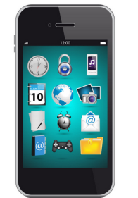
>>Lead-in
Free talk
take photos
read e-books
watch news
play games
call your friends
listen to music

Slide 3
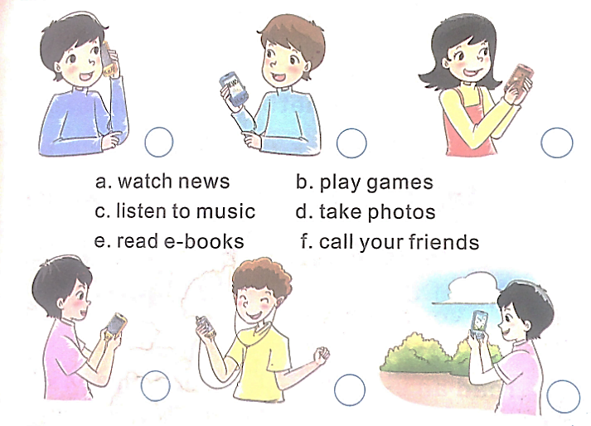
>>Lead-in
Look and choose
f
a
b
e
c
d

Slide 4
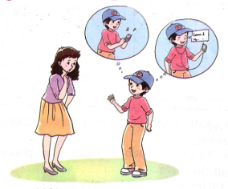
>>Presentation
Let’s talk
(1) Are mobile phones very useful?
(2) Does Liu’s mom want to buy him a
mobile phone? Why?
(3) What does Liu want to use
the mobile phone to do?

Slide 5
>>Presentation
Let’s talk
(1) Are mobile phones very useful?
Yes, it is.
(2) Does Liu’s mom want to buy him a
mobile phone? Why?
No, she doesn’t. Young students
shouldn’t have mobile phones.
(3) What does Liu want to use
the mobile phone to do?

Slide 6
>>Presentation
Listen and follow
Liu: Mom, could I have a mobile phone?
Mom: I’m afraid you can’t. Young students shouldn’t have mobile phones.
Liu: Why? Mobile phones are very useful. My friends use them to learn English and send e-mails.

Slide 7
>>Presentation
Listen and follow
Mom: But they also use mobile phones to go on the Internet and read e-books. It takes too much time and it’s bad for their eyes.
Liu: I won’t use it to go on the Internet or read e-books. I’ll only use it to make phone calls and learn English.
Mom: OK. Let me think about it.

Slide 8
>>Presentation
Read again and tick or cross
1. Liu wants a mobile phone.
2. Liu wants to use the mobile phone to learn English.
3. Liu’s friends play games on mobile phones.
4. Liu will read e-books on the mobile phone.
5. Mobile phones are not useful.

Slide 9
>>Presentation
Listen and follow
If you have a mobile phone, what will you do on it?
Can/Will | Shouldn’t

Slide 10
>>Summary
打电话用语：
---Hello, may I speak to …?
---Sorry, … is out. This is … speaking. Can I take a message?
---Hello! Is that …?
---Yes. This is … speaking. Who is that?

Slide 11
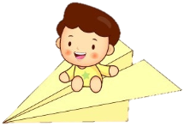
>>Homework
1.观看课文动画，按照正确的语音、语调朗读课文对话。
2.用今天所学打电话用语，与你的伙伴玩“打电话”的游戏。
3.预习“Let’s talk”。
close

