Slide 1
新年快乐
Synergistically utilize technically sound portals with frictionless chainsSynergistically，Synergistically

Slide 2
01.
Synergistically utilize technically sound portals with frictionless chainsSynergistically
04.
Synergistically utilize technically sound portals with frictionless chainsSynergistically
02.
Synergistically utilize technically sound portals with frictionless chainsSynergistically
05.
Synergistically utilize technically sound portals with frictionless chainsSynergistically
03.
Synergistically utilize technically sound portals with frictionless chainsSynergistically
06.
Synergistically utilize technically sound portals with frictionless chainsSynergistically

Slide 3
壹
Synergistically utilize technically sound portals with frictionless chainsSynergistically，Synergistically

Slide 4
1PPT.COM
Synergistically utilize technically sound portals with, Synergistically, Synergistically utilize technically sound portals with, Synergistically
Synergistically utilize technically sound portals with, Synergistically, Synergistically utilize technically sound portals with, Synergistically
Synergistically utilize technically sound portals with, Synergistically, Synergistically utilize technically sound portals with, Synergistically

Slide 5
1PPT.COM
Synergistically utilize technically sound portals with, Synergistically
Synergistically utilize technically sound portals with, Synergistically
Synergistically utilize technically sound portals with, Synergistically
Synergistically utilize technically sound portals with, Synergistically
Synergistically utilize technically sound portals with, Synergistically
Synergistically utilize technically sound portals with, Synergistically

Slide 6
Synergistically utilize technically sound portals with, Synergistically utilize technically sound, Synergistically utilize technically sound portals with
1PPT.COM
Synergistically utilize technically sound portals with, Synergistically utilize technically sound, Synergistically utilize technically sound portals with
Synergistically utilize technically sound portals with, Synergistically utilize technically sound, Synergistically utilize technically sound portals with
1PPT.COM

Slide 7
贰
Synergistically utilize technically sound portals with frictionless chainsSynergistically，Synergistically

Slide 8
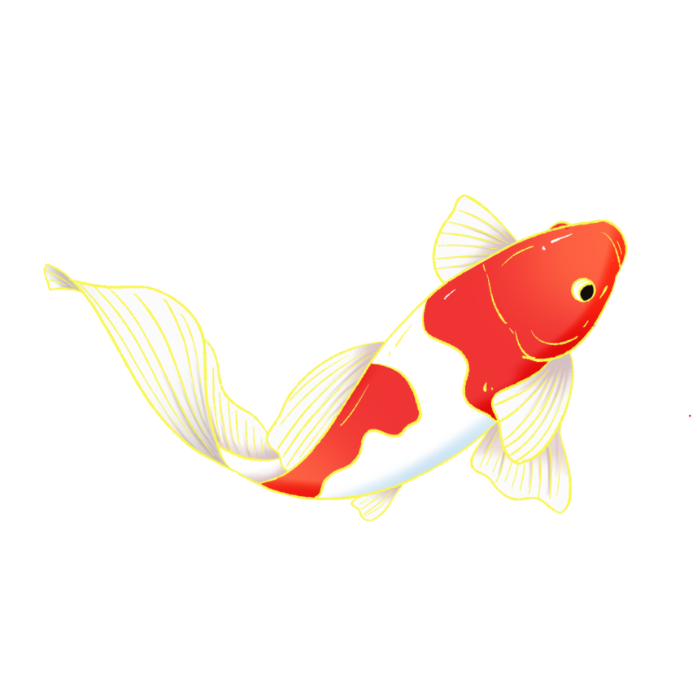
Synergistically utilize technically sound portals with, Synergistically utilize technically , Synergistically utilize technically sound portals with, Synergistically utilize technically sound, Synergistically
Synergistically utilize technically sound portals with, Synergistically utilize technically sound, Synergistically utilize technically sound portals with, Synergistically utilize technically sound portals with, Synergistically utilize technically sound, Synergistically

Slide 9
1PPT.COM
1PPT.COM
1PPT.COM
Synergistically utilize technically sound portals with, Synergistically utilize technically sound, Synergistically utilize technically sound portals with, Synergistically
Synergistically utilize technically sound portals with, Synergistically utilize technically sound, Synergistically utilize technically sound portals with, Synergistically
Synergistically utilize technically sound portals with, Synergistically utilize technically sound, Synergistically utilize technically sound portals with, Synergistically

Slide 10
Synergistically utilize technically sound portals with, Synergistically utilize technically sound, Synergistically utilize technically sound portals with, Synergistically
Synergistically utilize technically sound portals with, Synergistically utilize technically sound, Synergistically utilize technically sound portals with, Synergistically
Synergistically utilize technically sound portals with, Synergistically utilize technically sound, Synergistically utilize technically sound portals with, Synergistically

Slide 11
叁
Synergistically utilize technically sound portals with frictionless chainsSynergistically，Synergistically

Slide 12
01
Synergistically utilize technically sound portals with, Synergistically
02
Synergistically utilize technically sound portals with, Synergistically
03
Synergistically utilize technically sound portals with, Synergistically
04
Synergistically utilize technically sound portals with, Synergistically
05
Synergistically utilize technically sound portals with, Synergistically
06
Synergistically utilize technically sound portals with, Synergistically

Slide 13
Synergistically utilize technically sound portals with, Synergistically, Synergistically utilize technically sound portals with,
Synergistically utilize technically sound portals with, Synergistically, Synergistically utilize technically sound portals with,
Synergistically utilize technically sound portals with, Synergistically, Synergistically utilize technically sound portals with,

Slide 14
1
Synergistically utilize technically sound portals with, Synergistically
4
Synergistically utilize technically sound portals with, Synergistically
New year
2
Synergistically utilize technically sound portals with, Synergistically
5
Synergistically utilize technically sound portals with, Synergistically
3
Synergistically utilize technically sound portals with, Synergistically
6
Synergistically utilize technically sound portals with, Synergistically

Slide 15
肆
Synergistically utilize technically sound portals with frictionless chainsSynergistically，Synergistically

Slide 16
45%
75%
20%
90%
65%
Synergistically utilize technically sound portals with, Synergistically utilize technically sound, Synergistically
Synergistically utilize technically sound portals with, Synergistically utilize technically sound, Synergistically
Synergistically utilize technically sound portals with, Synergistically utilize technically sound, Synergistically
Synergistically utilize technically sound portals with, Synergistically utilize technically sound, Synergistically
Synergistically utilize technically sound portals with, Synergistically utilize technically sound, Synergistically
节日PPT模板 http:// www.PPT818.com/jieri/

Slide 17
Synergistically utilize technically sound portals with, Synergistically utilize technically sound, Synergistically utilize technically
Synergistically utilize technically sound portals with, Synergistically utilize technically sound, Synergistically utilize technically
Synergistically utilize technically sound portals with, Synergistically utilize technically sound, Synergistically utilize technically
Synergistically utilize technically sound portals with, Synergistically utilize technically sound, Synergistically utilize technically

Slide 18
Synergistically utilize technically sound portals with, Synergistically utilize technically sound,
Synergistically utilize technically sound portals with, Synergistically utilize technically sound,
Synergistically utilize technically sound portals with, Synergistically utilize technically sound,

Slide 19
伍
Synergistically utilize technically sound portals with frictionless chainsSynergistically，Synergistically

Slide 20
300,000
150,000
50,000
Synergistically utilize technically sound portals with, Synergistically utilize technically sound, Synergistically utilize technically，Synergistically utilize technically sound portals with, Synergistically utilize technically sound, Synergistically

Slide 21
50%
Synergistically utilize technically sound portals with, Synergistically utilize technically sound, Synergistically utilize technically
40%
Synergistically utilize technically sound portals with, Synergistically utilize technically sound, Synergistically utilize technically
10%
Synergistically utilize technically sound portals with, Synergistically utilize technically sound, Synergistically utilize technically

Slide 22
陆
Synergistically utilize technically sound portals with frictionless chainsSynergistically，Synergistically

Slide 23
1PPT.COM
Synergistically utilize technically sound portals with, Synergistically utilize technically sound, Synergistically utilize technically
1PPT.COM
Synergistically utilize technically sound portals with, Synergistically utilize technically sound, Synergistically utilize technically
1PPT.COM
Synergistically utilize technically sound portals with, Synergistically utilize technically sound, Synergistically utilize technically

Slide 24
Synergistically utilize technically sound portals with, Synergistically
Synergistically utilize technically sound portals with, Synergistically
Synergistically utilize technically sound portals with, Synergistically
Synergistically utilize technically sound portals with, Synergistically

Slide 25
祝大家
新年快乐
Synergistically utilize technically sound portals with frictionless chainsSynergistically，Synergistically，Synergistically utilize technically sound portals with frictionless chainsSynergistically

