Slide 1
Unit2 Travelling
WWW.PPT818.COM

Slide 2
Travelling
= going on a trip
1 Do you like travelling?
2 How do you feel when you go on a trip?
3 When do you usually go on a trip?
4 Where do you want to go?

Slide 3
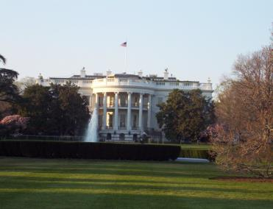
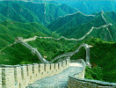
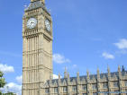
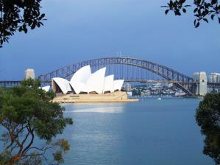
Do you know them?
Notes:
3

Slide 4
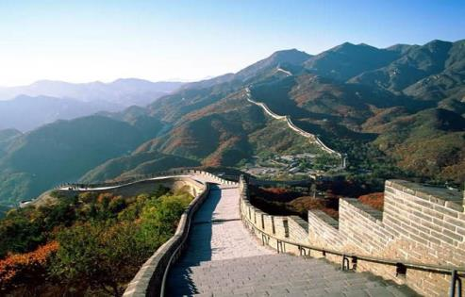
Places of interest
What’s this?
the Great Wall
Where is it?
(in Beijing, China )
What can people do there?
climb the Great Wall, take photos,
enjoy its beauty
Have you ever been there? ...

Slide 5
The Statue of Liberty
New York , the USA
take photos
the Tower Bridge
London, England
Take photos and
see the beautiful view

Slide 6
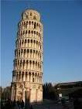
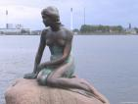
the Leaning Tower of Pisa
Pisa, Italy
a symbol of...
take photos
The little Mermaid
Copenhagen, Denmark
a symbol of...
tail
Take photos and see the beautiful view

Slide 7
Sydney, Australia
the Opera House
&
the Harbour Bridge

Slide 8
Do you know?
the Little Mermaid Italy
the Great Wall America
the Statue of Liberty Denmark
the Tower Bridge the UK
the Leaning Tower of Pisa China

Slide 9
Work in pairs.
Talk to your partners about these places in Part A
A: What is this ?
B: It’s the Little Mermaid.
A:Where is it?
B:It’s in Copenhagen, the capital of
Denmark.
A:What’s special about it?
It comes from the story by Hans
Christian Andersen.
A:Have you ever been there?
B:No,I haven't.

Slide 10
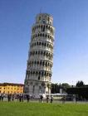
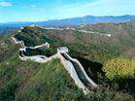
Make a dialogue in pairs.

Slide 11
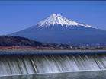
Which place of interest do youwant to visit ? Why?
Do you want to know where Eddie is going?

Slide 12
Listen and answer
Where is Eddie going?
Does Hobo want to go too?
Will Eddie have a happy holiday? Why?
He is going on a trip to South Hill.
Yes ,he does. He wants to join Eddie.
No, he won’t.Because he has to carry a heavy bag.

Slide 13
Read the dialogue.

Slide 14
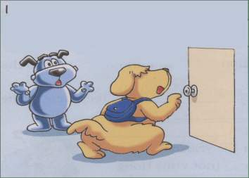
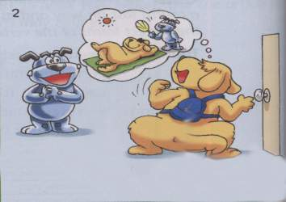
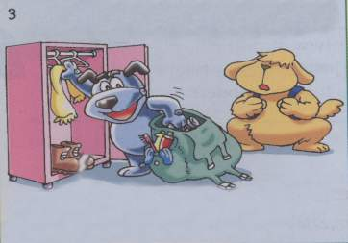
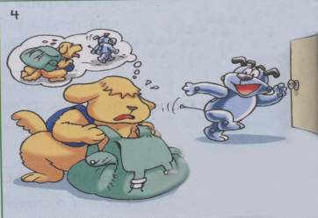
Act it out
have been there before /join
Go to South Hill
Get... /excited
Take the bag / I don’t think...

Slide 15
Fill in the blanks.
Eddie is going on a _____ .Hobo thinks it must be fun and wants to ____ Eddie. They will go ____for a few days .So Hobo is so _____and he _____ everything .But Eddie won’t have a happy ______because he has to _____ Hobo’s heavy bag!
trip
join
out
excited
gets
holiday
take

Slide 16
Exercise
按要求填空
You can take many photos in Italy because ____________________ is so great!
In Denmark, __________________ is about a lovely and kind princess.
3.In China,____________ is one of wonders (奇迹)of the world and we can see ____________
the leaning Tower of Pisa
the Little Mermaid
the Great Wall
the beautiful view

Slide 17
一 根据句意首字母或中文完成单词
1.Is the Tower Bridge the ______(象
征) of Britain?
2.people can go ______(滑雪）there.
3.How do you spend your ________
(假期).
4.Where can you see the beautiful
v_______？
symbol
skiing
holiday
iew

Slide 18
二 用所给词的正确形式填空
1.The ______(excite) people are waiting
for the ________(excite) news outside
the gate.
2.I have _____(be) there many times.
3.what about _______(go) hiking
tomorrow?
4.we are happy ______(see) the view.
excited
exciting
been
going
to see

Slide 19
三 翻译下列句子
我想这个不会是我的假期。
他想随身带一些苹果。
长城是中国的象征。
I don’t think it’ll be a holiday for me .
He wants to bring/take some apples with
him.
The Great Wall is the symbol of China.

Slide 20
Homework
Try to find more popular tourist attractions around the world on the Internet after class.

Slide 21
Thank you!

