Slide 1
Unit 3 Welcome to our school!
Integrated skills & Study skills
WWW.PPT818.COM

Slide 2
Period 4 Integrated skills & Study skills
课前自主预习
单 词 闯 关 | 1．只，只有，仅 / 'əʊnlɪ/________ 2．(口)当然 /ʃʊə(r)/________ 3．种类 /kaɪnd/________ 4．需要……时间，费时 /teɪk/________
only
sure
kind
take

Slide 3
Period 4 Integrated skills & Study skills
短 语 互 译 | 1. all kinds of ____________ 2. borrow…from… ____________ 3. on your way back ____________ 4. about half an hour ____________
各种各样的
向……借……
在你回来的路上
大约半小时

Slide 4
Period 4 Integrated skills & Study skills
短 语 互 译 | 5. 去上学____________ 6. 阅览室 ____________ 7. 起床____________ 8. 从……到…… ____________
go to school
reading room
get up
from…to…

Slide 5
Period 4 Integrated skills & Study skills
句 型 在 线 | 1．My friend Amy ________ ________ our school. 我的朋友埃米住在我们学校附近。 2．It ________ her about an hour ________ ________ ________ school. 到学校大约花费她一小时。
lives near
takes to
get to

Slide 6
Period 4 Integrated skills & Study skills
句 型 在 线 | 3．It's ________ ________ 8 a.m. ________ 5:30 p.m. 它从上午八点到下午五点半开放。 4．There are ________ ________ ________ books in our library. 我们的图书馆里有各种各样的书。
open from to
all kinds of

Slide 7
Period 4 Integrated skills & Study skills
课堂互动探究
词汇点睛
1 from…to… 从……到……
[观察] It's open from 8:00 a.m. to 5:30 p.m.
它从上午八点到下午五点半开放。
We often walk from our home to the school.
我们经常从家里走到学校。

Slide 8
Period 4 Integrated skills & Study skills
[探究] from…to…为介词短语，后面跟名词或代词宾格作宾语，用来表述时间、地点等范围。
My father goes to work from Monday to Friday.
我爸爸从星期一到星期五上班。
It takes me 10 minutes to walk from my home to the park.
从我家步行到公园花费10分钟。

Slide 9
Period 4 Integrated skills & Study skills
活学活用
2016·上海The local community centre is open ________ Monday to Saturday.
A. in B. from
C. for D. on
B
【解析】考查介词的用法。from…to…意为“从……到……”。根据句意“当地的社区中心从周一到周六开放”可知答案为B。

Slide 10
Period 4 Integrated skills & Study skills
2 sure adv. (口)当然
[观察] —Do you often read there?
你经常在那里读书吗？
—Sure.
当然。

Slide 11
Period 4 Integrated skills & Study skills
[探究] sure作副词，是常见的交际用语，意为“________”。sure以肯定语气回答对方所述的问题，相当于____________， certainly, all right等。
当然
of course
[拓展] sure还可作形容词，意为“确信的，肯定的，一定的”。常用搭配：be sure to do sth 一定做某事 be sure of/about sth 对某事有把握
Study hard, and then you are sure to be good at all your subjects.
努力学习，然后你一定会擅长所有的学科。

Slide 12
Period 4 Integrated skills & Study skills
活学活用
2016·云南—Jeff, could you tell me how to order a taxi through “Didi”？
—________．
A．You're welcome B．Sure
C．Take it easy D．It doesn't matter
B
【解析】考查情景交际。“You're welcome.”意为“不客气”，常用于回答别人的感谢；“Sure.”意为“当然可以”；“Take it easy.”意为“别急，沉住气”；“It doesn't matter.”意为“没关系，不要紧”。句意：“杰夫，你能告诉我怎么通过‘滴滴’打车吗？”“当然可以。”故答案为B。

Slide 13
Period 4 Integrated skills & Study skills
3 kind n. 种类
[观察] There are all kinds of books in our library.
我们的图书馆里有各种各样的书。
I like all kinds of vegetables.
我喜欢各种各样的蔬菜。

Slide 14
Period 4 Integrated skills & Study skills
[探究] kind作________，意为“种类”。常用短语：
a kind of…一种……
____________各种各样的……
different kinds of…不同种类的……
名词
all kinds of…
[拓展] kind还可作形容词，意为“友好的”。be kind to sb 意为“对某人友好”。
Lin Tao is always kind to his classmates.
林涛总是对他的同学很友好。

Slide 15
Period 4 Integrated skills & Study skills
活学活用
(1)课后我们进行各种活动。
We have ________ ________ ________ activities after class.
(2)他的朋友们对他很友好。
His friends ________ very ________ ________ him.
all kinds of
are kind to

Slide 16
Period 4 Integrated skills & Study skills
4 open adj. 开放的；营业
[观察] The reading room is only open in the afternoon.
阅览室只在下午开放。
The new store will be open in the spring.
新商店将在春天开业。

Slide 17
Period 4 Integrated skills & Study skills
[探究] open作形容词，意为“开放的；营业”，其反义词为________，意为“关闭的，不开放的”。
closed
[拓展] open还可作动词，意为 “开，打开；开门，开始营业”，它的反义词是close，意为“关，关闭；关门”。
The shop opens at 7：00 a．m. and closes at 9 p．m. every day.
这家商店每天早上7点开门，晚上9点关门。

Slide 18
Period 4 Integrated skills & Study skills
活学活用
我们学校图书馆通常从上午8点到下午4点开放。
Our school library ________ usually ________ from 8:00 a.m. to 4:00 p.m.
is open

Slide 19
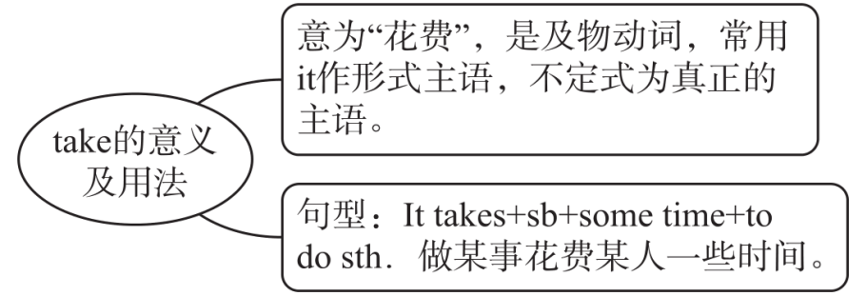
Period 4 Integrated skills & Study skills
句型透视
1 It takes her about an hour to get to school.
到学校大约花费她一小时。
[探究]

Slide 20
Period 4 Integrated skills & Study skills
[拓展]“sb spends some time on sth/(in) doing sth”可以与“It takes＋
sb＋some time＋to do sth.”进行同义句转换。
＝ He spends about half an hour (in) reading English every morning.
It takes him about half an hour to read English every morning.
每天早上他大约花费半小时读英语。

Slide 21
Period 4 Integrated skills & Study skills
活学活用
2016·黄石Mount Xiaolei is not far away from here, but it will still take us a few hours ________ there by bike.
A. getting B. to get
C. got D. get
B
【解析】考查非谓语动词。it作形式主语，后面的动词不定式作真正的主语。

Slide 22
Period 4 Integrated skills & Study skills
2 Do you borrow books from the library?
你从图书馆借书吗？
[辨析] borrow, lend与keep
词条 | 意义 | 常见搭配
borrow | 借(入) | borrow sth from sb 向某人借某物
lend | 借(出) | lend sb sth＝lend sth to sb借给某人某物
keep | 保留 | keep sth＋for＋时间段借某物多长时间

Slide 23
Period 4 Integrated skills & Study skills
You can borrow this book from the library.
你可以从图书馆借这本书。
You mustn't lend this book to others.
＝You mustn't lend others this book.
你禁止把这本书借给别人。
You can keep the book for two weeks.
这本书你可以借两周。

Slide 24
Period 4 Integrated skills & Study skills
活学活用
She likes reading. She usually ________ some books from the library.
A. buys B. lends
C. borrows D. use
C

