Slide 1
Unit 4 Lesson2
I read in my bedroom.
WWW.PPT818.COM

Slide 2
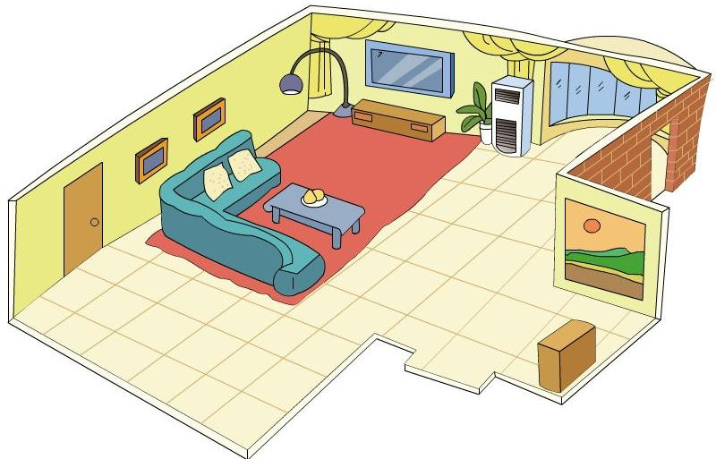
Li Ming’s new home

Slide 3
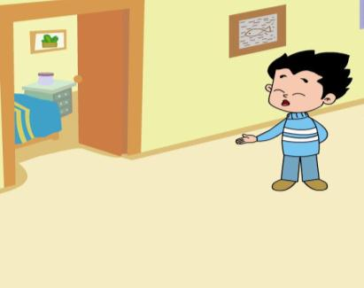
What’s in Li Ming’s bedroom?

Slide 4
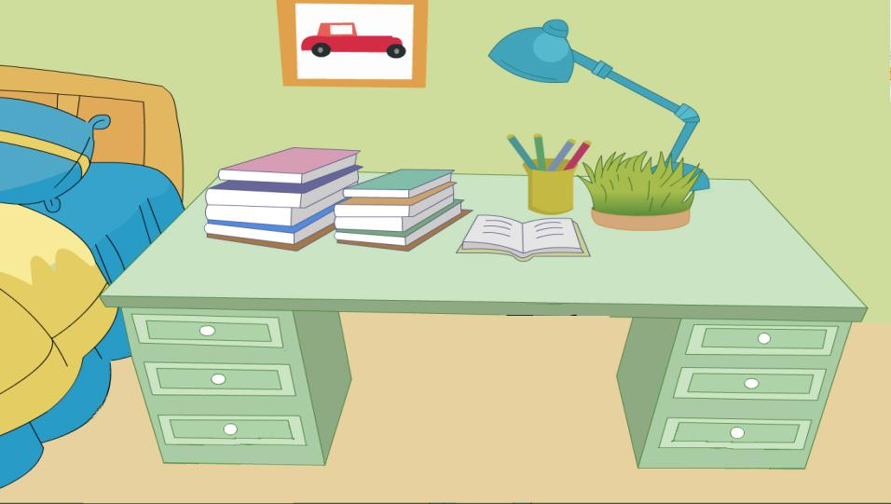
so many books

Slide 5
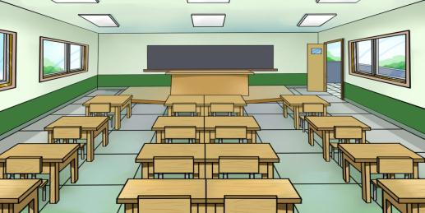
so many chairs
in the classroom
so many apples
on the desk

Slide 6
Can you fill in the blanks?(填空）
read
I in my bedroom.
watch TV
I in the living room.

Slide 7
Try to read
r
cher
t
ea
d

Slide 8
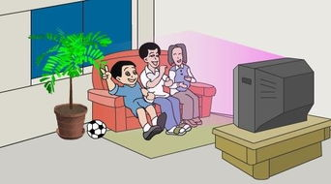
Try to read
what
watch
watch TV

Slide 9
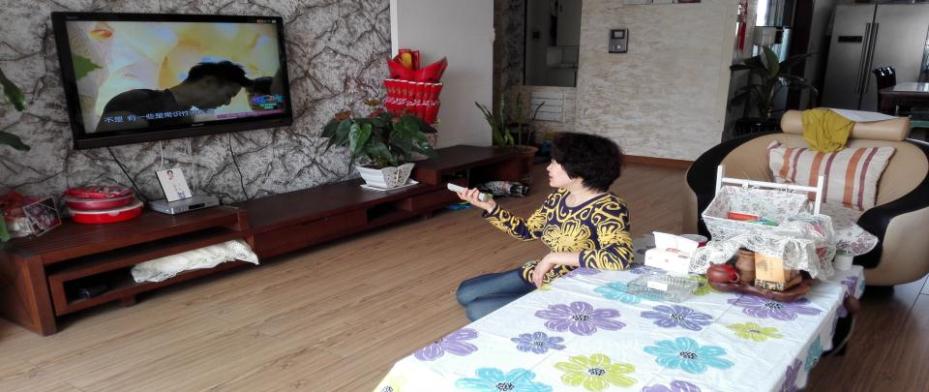
I watch TV in the living room.

Slide 10
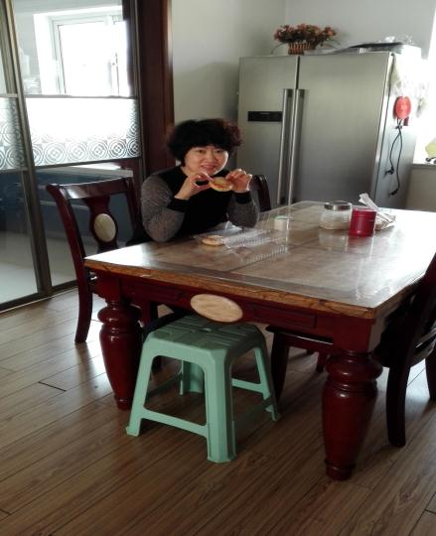
I have breakfast in the dining room.

Slide 11
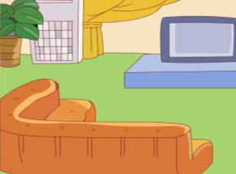
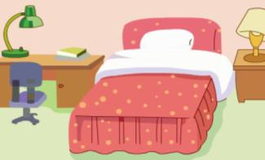
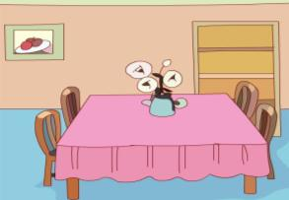
read play
watch TV
have lunch have dinner have breakfast
I in .

Slide 12
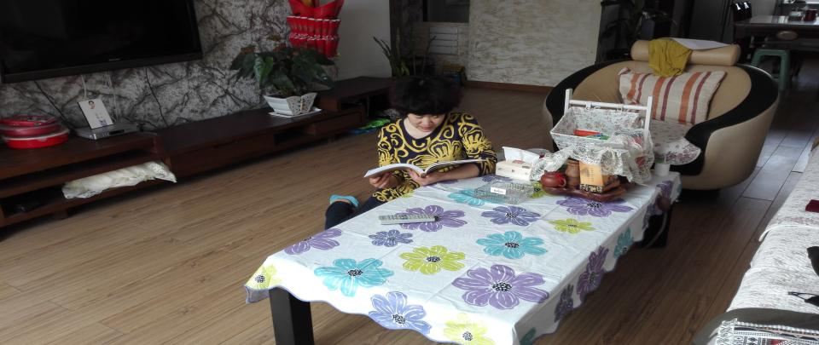
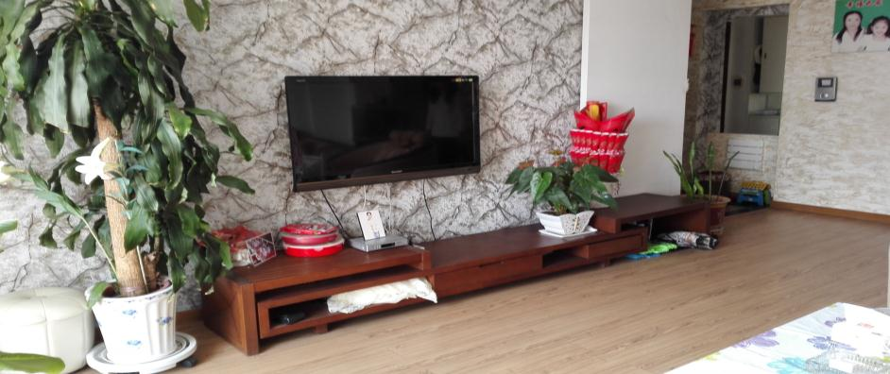
Guessing game

Slide 13
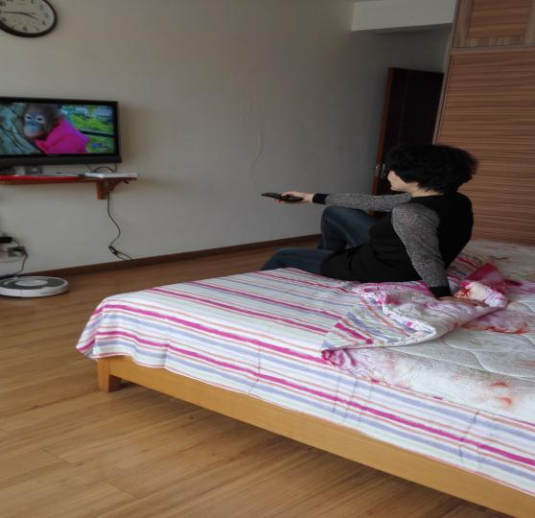
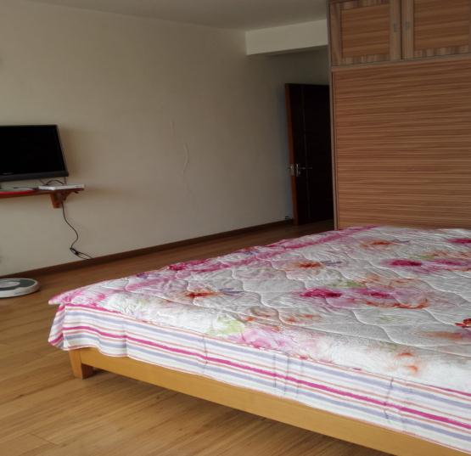

Slide 14
Let’s chant
Go to the living room.
Watch TV.
Go to the kitchen.
Have some chicken.
Go to the bedroom.
Have a nice dream.

Slide 15
Let’s read
I’m Li Ming. I have a nice and big home. I watch TV in the living room. I have a big desk in my bedroom. So many books are on the desk. I read in my bedroom. I love my home. I love my family.

Slide 16
Let’s say
Hello! I’m .I have a （big/new/nice
beautiful）home.
I (read/have lunch/watch TV/play)in the living room.
I (read/have dinner/watch TV/play)in the dining room.
I (read/ /watch TV/play)in my bedroom.
I love my home. I love my family.

Slide 17
Homework
Listen to the tape and read the text fluently.
Talk about your home and your action at home in English.

