Slide 1
陕旅版四年级下册
Unit1 Our New House
WWW.PPT818.COM

Slide 2
Sing a song

Slide 3
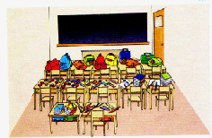
Look and count
There is/are …

Slide 4
Hello/Hi, boys and girls! Welcome back to school!

Slide 5
Look, think and match
Whose home is it?

Slide 6
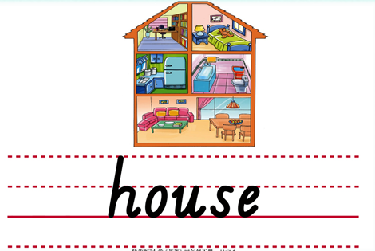

Slide 7
house

Slide 8
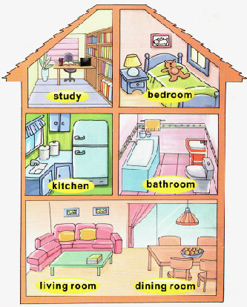
What is in the house?
study
bedroom
kitchen
bathroom
living room
dining room

Slide 10
Look and say
study

Slide 11
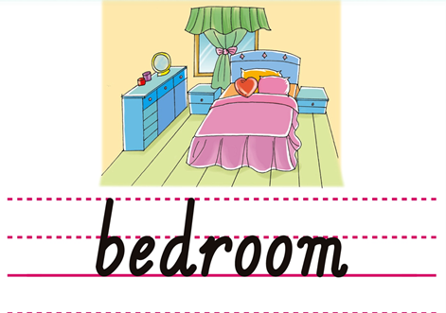

Slide 12
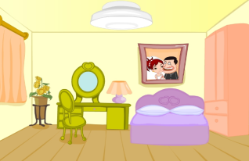
Look and say
bedroom

Slide 13
Magic fingers
house study bedroom

Slide 14
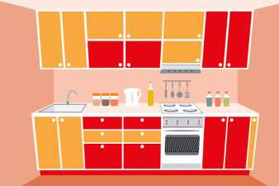
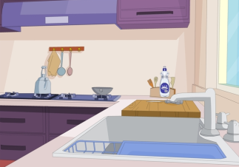
kitchen

Slide 15
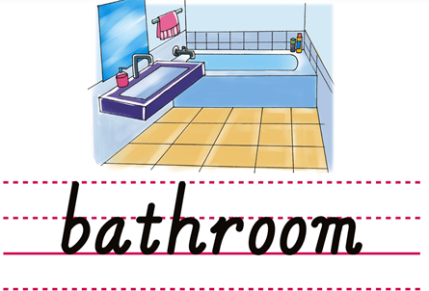

Slide 17
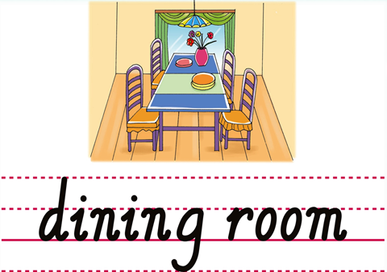

Slide 18
Magic Eyes
kitchen
bedroom
study
dinning room
living room
bathroom

Slide 19
Game1
我是小小描述家
I have…

Slide 20
Game2
句子接龙
Hello, There is ...
Hi, There is ...

Slide 21
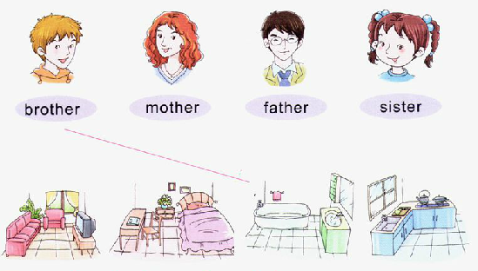
Listen and match

Slide 22
如何用以下单词介绍自己的家：
study bedroom kitchen bathroom
living room dining room
怎样向别人介绍家里的房间设施?
There is ... in my house.

Slide 23
1.听课文录音并跟读，按照正确的语音、语调朗读并表演课文对话。 2.用本节课所学单词向家人介绍自己的住所。
3.预习A Let’s talk。

