Slide 1
Unit 2 Feelings
You look worried
WWW.PPT818.COM

Slide 2
Talk about your feeling dairy.
My feeling dairy
Saturday
Sunday, Monday, Tuesday, Wednesday, Thursday, Friday, Saturday…
It was__________.
It was__________.
cloudy
cloudy, windy, sunny, rainy…
I_______________.
played basketball, played football, played computer games, played the piano, played the erhu, played
games, cleaned the floor…
played basketball
excited
I was__________.
Excited, sad, angry, happy, worried…

Slide 3
Let’s fill and read.
Yesterday Wanghong was ___.
Her mum was _______. She was
____ that Wanghong was back.
Wanghong was in the _____ with
Liming, Danny,and Jenny. Danny
danced in the____ . They______
games. Wanghong was ______.
But Danny was very ____ .
He ____ his cap.
late
worried
glad
park
rain
played
happy
sad
lost

Slide 4
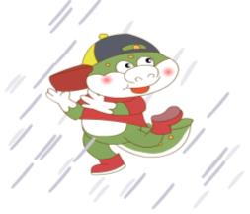
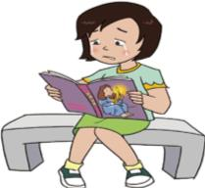
Was he/ she... ?
No, he/ she wasn’t.
He/ She was...

Slide 5
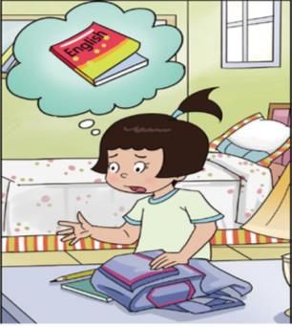
Is Wang Hong happy?
No, she isn’t.
She is worried.
Why?

Slide 6
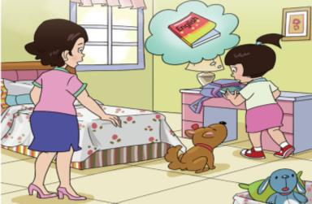
It’s time for school, but
Wang Hong is worried.
Why? She can’t find her
English book.

Slide 7
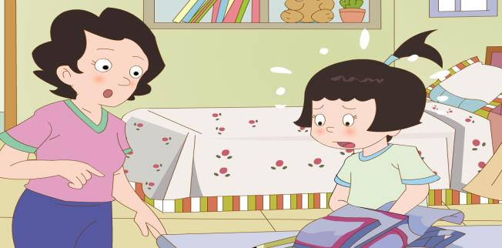
Don’t worry.
We can find it.
I saw it on the desk yesterday.

Slide 8
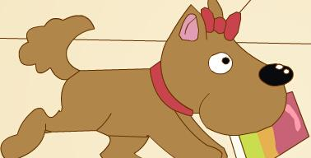
comes
Huanhuan ______ in.
excited
She is ______.
has
in
She ____ a book ___ her mouth.

Slide 9
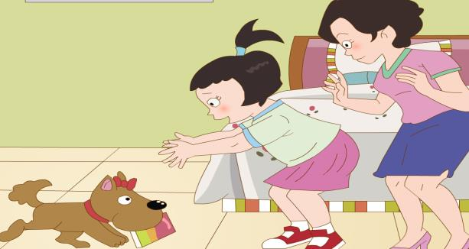
Thank you, Huanhuan!
You’re _______!
helpful

Slide 10
Let’s write.
worry happy find excited worried
find
I can’t _______my English book.
I’m _______.
worried
I saw it on the desk yesterday.
Don’t _______.
worry
excited
Huanhuan is ____ . She has
the book in her mouth.
happy
Now I’m _____. Huanhuan is helpful.

Slide 11
Thank You

