Slide 1
陕旅版英语六年级上册 Unit6 What Did You Do Last Weekend? 第3课时
WWW.PPT818.COM

Slide 2
教学目标：
1.能听懂、会说What happened to…?并能用一般过去时态描述某人曾经发生的事。
2.进一步学习行为动词一般过去时的特殊疑问句及其回答，初步了解一般疑问句和否定句并认识when引导的状语从句。能灵活自如地运用所掌握的一般过去时态在生活中与人进行交流。

Slide 3
Review
cook —
wash —
look —
go —
see —
jump —
take —
fly —
swim —
do —
listen —
say —
play —
want —
cooked
flew
washed
swam
looked
did
went
listened
saw
said
jumped
played
took
wanted

Slide 4
Ask and answer
Where is your school bag?
Where was it last night?
What do you often do on weekends?
What did you do last weekend / yesterday / last night?

Slide 5
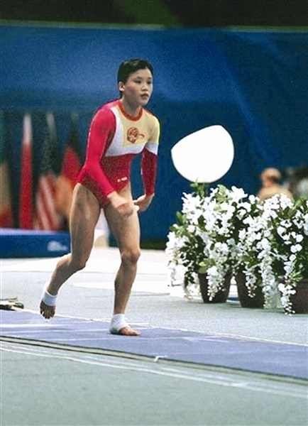

Slide 6
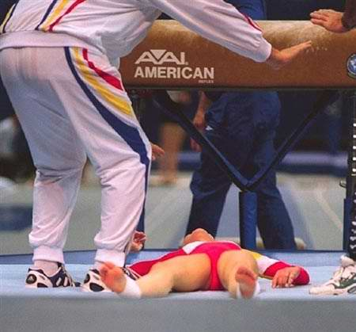
What happened to her?
She hurt her neck in the match.

Slide 7
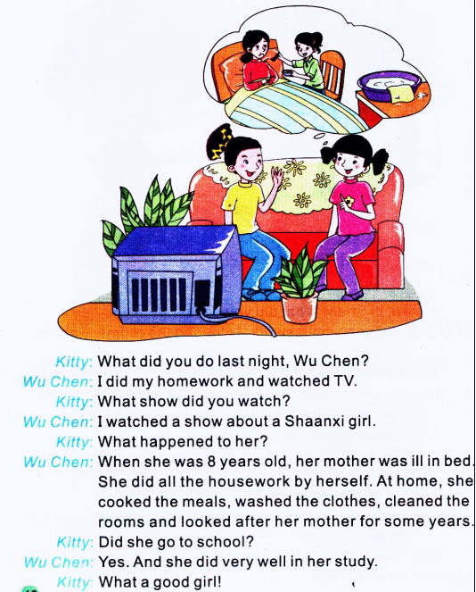
Let’s learn more

Slide 8
1. Who’s in the picture?
2. Where are they?

Slide 9
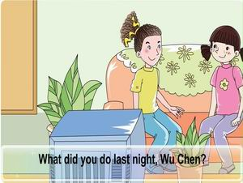
观看课文动画并大声跟读

Slide 10
Can you answer the questions?
1. What did Wu Chen do last night?
2. What show did Wu Chen watch?
3. What happened to the Shaanxi girl?
4. What did the Shaanxi girl do at home?
5. Did the Shaanxi girl go to school?
6. Did the Shaanxi girl study well?

Slide 11
小贴士
过去时态的特殊疑问句同一般现在时中的一样，都需要借助助动词，所不同的是在过去时态里，助动词只有did。它没有人称和数的变化，而—般现在时要根据人称和数的变化合理使用do或does。一般疑问句也需要在主语前加助动词did，如：
Did she go to school? Did you watch the show ? 否定句直接在did后加not，也可以用其的缩写形式didn’t，如：
My mother didn’t wash the clothes yesterday.
We didn’t water the plants.

Slide 12
Role play
分角色扮演文中的Kitty和Wu Chen。
同学们对话的时候要注意动词过去式的发音哦！

Slide 13
教师出示所准备的几个人物以及他们的生活背景关键词，让学生根据所出示的关键词仿照Let’s learn more部分创编一个新的对话。要求使用功能结构：What happened to…?并使用一般过去时态进行描述。如：… was ill.... cleaned the room /...
编一编，演一演

Slide 14
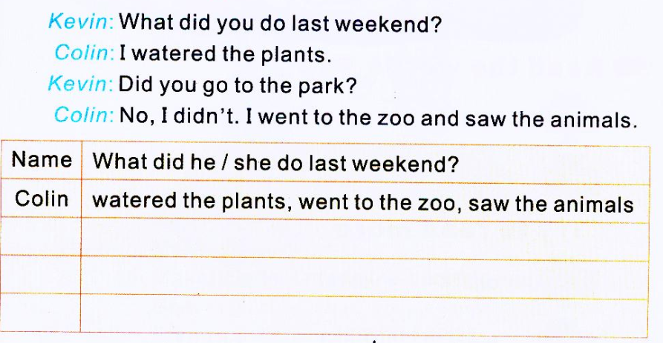
Part B Do a survey
师可以将学生分为若干小组，请学生在组内调查；或者要求学生通过采访各自的好朋友展开调查：What did you do last weekend?学生采访完毕后，要将被采访同学的姓名写在书中P49表格左边Name一栏中，并将活动词组写在右边What did he/she do last weekend?—栏中。

Slide 15
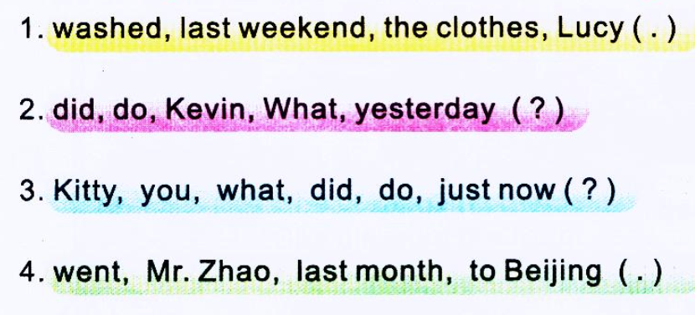
Part C Make up the sentences and say
教师拿出所准备的单词卡片，带领学生认读各小题的单词，并引导学生尝试组句子。
Lucy washed the clothes last weekend.
What did Kevin do yesterday?
Kitty, what did you do just now?
Mr. Zhao went to Beijing last month.

