Slide 1
Section B Reading and Thinking
人教版高中英语必修二
UNIT 4 History and traditions
WWW.PPT818.COM

Slide 2
Ⅰ
Ⅱ
Ⅲ
kingdom
chief
puzzle
nearby
belong
military
defence
legal
surround
evidence
achievement
location
battle
port

Slide 3
Ⅰ
Ⅱ
Ⅲ
把……和……连接或联结起来
脱离;背叛;逃脱
导致
属于
同(一样也);和;还
留心;留意
把……看作
被……包围
留下;留在后面
追溯到

Slide 4
Ⅰ
Ⅱ
Ⅲ
Ⅱ.释义匹配
1.nearby A.something important that you succeed in doing by your own efforts
2.defence B.a particular place,especially in relation to other areas,buildings,etc.
3.evidence C.the act of protecting something or someone from attack
4.achievement D.facts or signs that show clearly that something exists or is true
5.location E.not far away
答案:1.E 2.C 3.D 4.A 5.B

Slide 5
Ⅰ
Ⅱ
Ⅲ
Ⅲ.阅读导学
根据P40—41课文内容,选择正确答案。
1.How do many people feel when they see the three names?
A.Satisfied. B.Confused.
C.Disappointed. D.Curious.
2.When was the name Great Britain given to the country?
A.When Wales became part of England.
B.When King James became the ruler of Scotland.
C.When Scotland and Wales were united.
D.When England and Wales were joined to Scotland.
答案:B
答案:D

Slide 6
Ⅰ
Ⅱ
Ⅲ
3.What resulted in the name “the United Kingdom of Great Britain and Northern Ireland”?
A.That the Kingdom of Ireland was added to the country.
B.That Northern Ireland broke away from the country.
C.That Southern Ireland broke away from the country.
D.That Scotland was separated from the country.
4.Why does the English language have so many French words?
A.Because of the influence of the Romans.
B.Because of the influence of the Anglo-Saxons.
C.Because of the influence of the Vikings.
D.Because of the influence of the Normans.
答案:C
答案:D

Slide 7
重点词汇
重点句式
随堂练习
1.puzzle n.谜;智力游戏;疑问 vt.迷惑;使困惑
【课文原句】Getting to know a little bit about British history will help you solve this puzzle.
了解一下英国历史会帮助你解决这个谜题。
【词汇精讲】puzzle作名词,意为“谜;智力游戏;疑问”,作动词,意为“迷惑;使困惑”。
What puzzles you is actually a puzzle for many parents in China.
使你困惑的事实际上对很多中国父母来说也是个谜题。
I’m in a puzzle as to what to do next.
我不知道下一步该做什么。

Slide 8

重点词汇
重点句式
随堂练习
【词汇拓展】
The firemen were puzzled about the cause of the fire.
消防员对这场火灾的起因困惑不解。
To be honest,I sometimes feel puzzled about my future career.
说实话,有时我对我以后的职业生涯感到困惑。
【温馨提示】过去分词形式的形容词,如puzzled,confused,frightened,excited,surprised等,除了可以用来描述人的心理活动以外,还可以用来修饰与人有关的一些名词,如look,voice,smile,expression,face等。

Slide 9
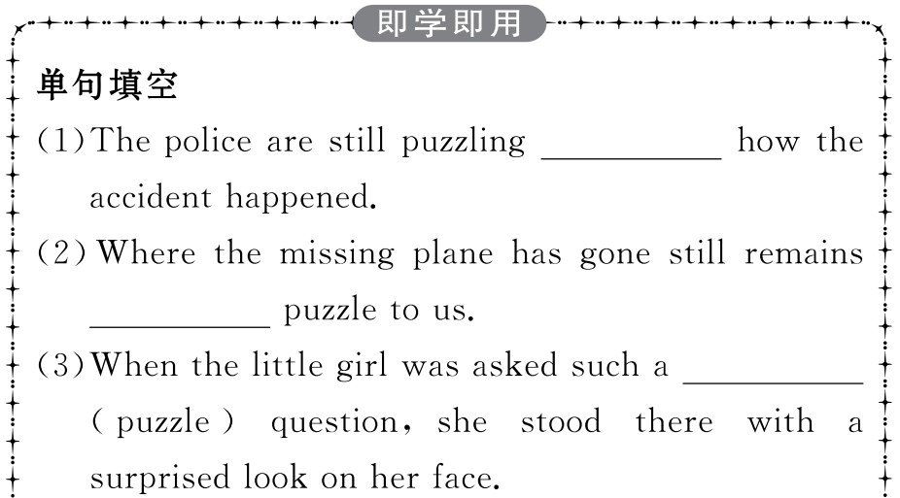
重点词汇
重点句式
随堂练习

Slide 10
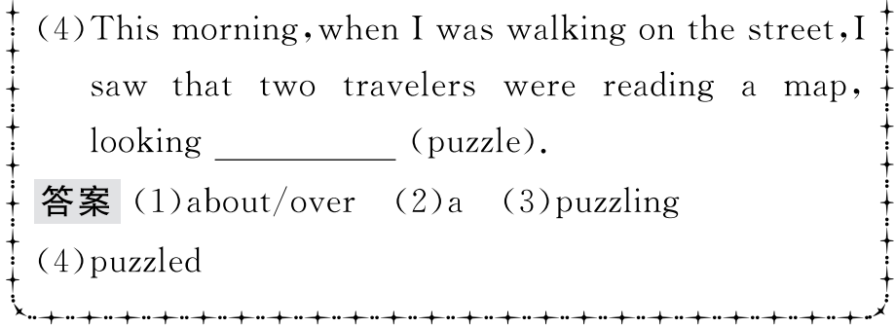
重点词汇
重点句式
随堂练习

Slide 11

重点词汇
重点句式
随堂练习
2.break away(from sb/sth)脱离;背叛;逃脱
【课文原句】Finally,in the 20th century,the southern part of Ireland broke away from the UK,which resulted in the full name we have today:the United Kingdom of Great Britain and Northern Ireland.
最后,在20世纪,爱尔兰南部脱离了英国,这形成了我们今天的全名:大不列颠及北爱尔兰联合王国。
【词汇精讲】break away from...是动词短语,意为“脱离;背叛;逃脱”。
It was wrong of him to break away from all his good friends.
他和他所有的好朋友决裂是错误的。
What can we do to help them break away from the difficult position?
我们能做什么来帮助他们摆脱困境呢?
The prisoner broke away from his guards.
犯人挣脱了看守。

Slide 12
重点词汇
重点句式
随堂练习
【词汇拓展】
Close the door and windows carefully to prevent some strangers breaking into your house.
仔细关好门窗,避免陌生人闯入你的家中。

Slide 13
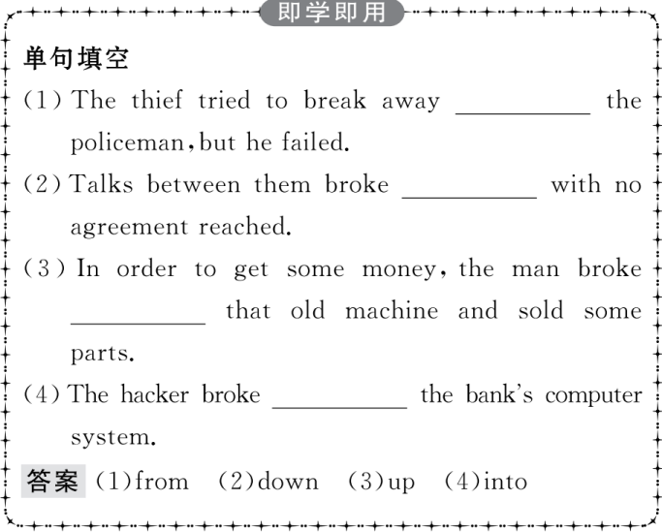
重点词汇
重点句式
随堂练习

Slide 14
重点词汇
重点句式
随堂练习
3.belong vi.应在(某处);适应
【课文原句】The four countries that belong to the United Kingdom work together in some areas.
属于联合王国的四个国家在某些领域共同努力。
【词汇精讲】belong to是动词短语,意为“属于,应在某处;适应”。
Where do these plates belong?
这些盘子该放在哪里?
Those books belong to the library but this is my own.
那些书是图书馆的,但这本是我自己的。

Slide 15

重点词汇
重点句式
随堂练习
【温馨提示】belong to中to为介词,后接名词或代词宾格。作后置定语时常用现在分词形式。
Anyone has no right to take the land belonging to the state as their own.
任何人都没有权力占有属于国家的土地。

Slide 16
重点词汇
重点句式
随堂练习
【词汇拓展】
【误】The computers inside the classroom are belonged to our school.
【正】The computers inside the classroom belong to our school.
教室里的电脑属于我们学校。

Slide 17
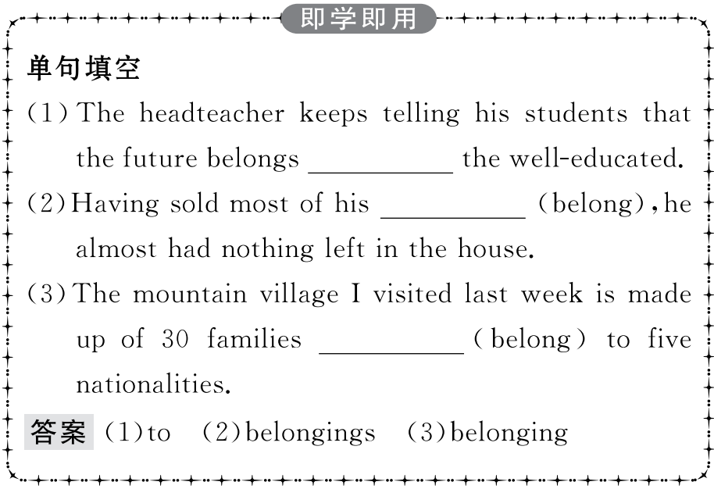
重点词汇
重点句式
随堂练习

Slide 18
重点词汇
重点句式
随堂练习
4.as well as同(一样也);和;还
【课文原句】They use the same flag,known as the Union Jack,as well as share the same currency and military defence.
像拥有同样的货币和国防一样,他们也使用同一面国旗,称为米字旗。
【词汇精讲】as well as意为“同(一样也);和;还”,在句中连接相同的成分。
Science can be a force for evil as well as for good.
科学可以促成好事,也可以导致坏事。
She intends to fight to make it a woman’s as well as a man’s world.
她打算努力奋斗使它不但成为男人的世界,也成为女人的世界。

Slide 19
重点词汇
重点句式
随堂练习
【温馨提示】当“A as well as B”结构作主语时,谓语动词应与A在人称和数方面保持一致。
The teacher as well as his classmates likes playing basketball.
老师和学生们都喜欢打篮球。
Mary’s parents as well as her sister are listening to a concert.
玛丽的父母和她的妹妹在听音乐会。

Slide 20
重点词汇
重点句式
随堂练习
【词汇拓展】
My little brother can speak English and French as well.
我弟弟会说英语,也会说法语。
Since you have started the job,you might as well finish it.
既然你开了头,索性把这工作做完吧。

Slide 21
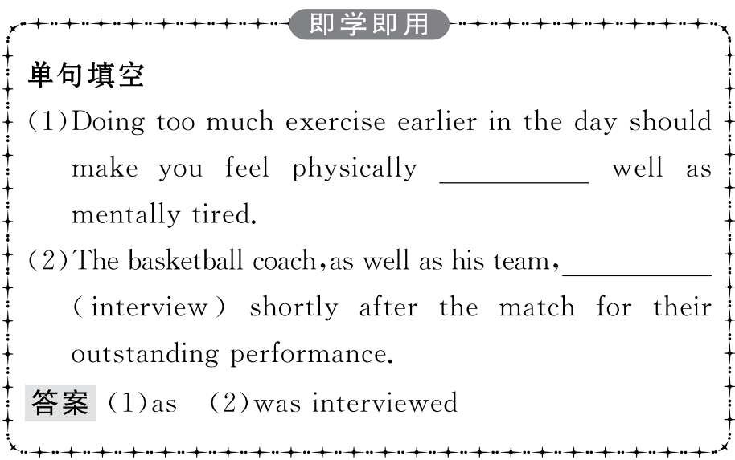
重点词汇
重点句式
随堂练习

Slide 22
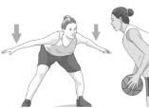
重点词汇
重点句式
随堂练习
5.defence n.防御;保卫
【课文原句】They use the same flag,known as the Union Jack,as well as share the same currency and military defence.
像拥有同样的货币和国防一样,他们也使用同一面国旗。
【词汇精讲】defence是名词,意为“防御;保卫”。
The town walls were built as a defence against enemy attacks.
城墙是为防御敌人袭击而修建的。
Humour is a more effective defence than violence.
幽默是比暴力更有效的防御武器。

Slide 23
重点词汇
重点句式
随堂练习
【词汇拓展】
What points can be raised in defence of this argument?
有什么论点能提出来为这个说法辩护呢?
They needed more troops to defend the border against possible attacks.
他们需要更多的部队来保卫边境免受可能的攻击。

Slide 24
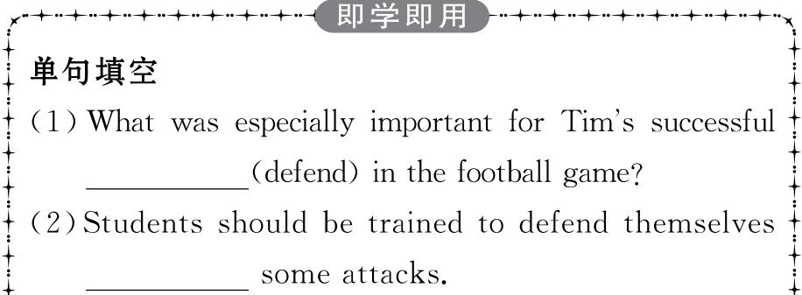
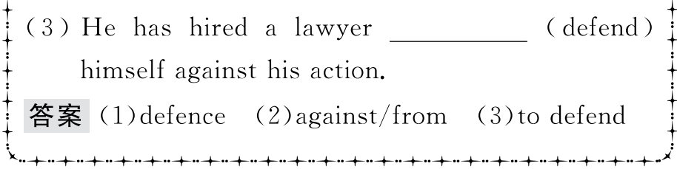
重点词汇
重点句式
随堂练习

Slide 25
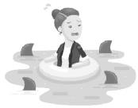
重点词汇
重点句式
随堂练习
6.surround vt.围绕;包围
【课文原句】Almost everywhere you go in the UK,you will be surrounded by evidence of four different groups of people who took over at different times throughout history.
几乎你去英国的任何地方,你都会被在不同的历史时期四个不同群体统治这个地方的证据所包围。
【词汇精讲】surround是及物动词,意为“围绕;包围”。
A lake is an area of water surrounded by land.
湖泊就是被一片陆地包围的水域。
Make sure the people you surround yourself with are supportive.
确保自己身边环绕的是有乐观向上的人。

Slide 26
重点词汇
重点句式
随堂练习
【词汇拓展】
The teacher sat on the grass,surrounded with/by his students.
那位老师坐在草地上,四周围着他的学生。
The boy grew up in beautiful surroundings but not in a happy home environment.
这个男孩在美丽的环境中长大,但缺少一个幸福的家庭环境。

Slide 27
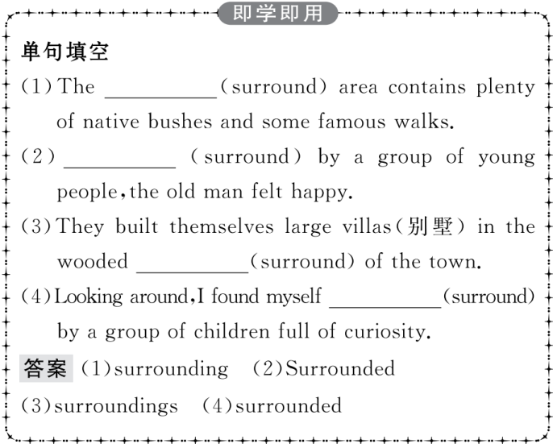
重点词汇
重点句式
随堂练习

Slide 28
重点词汇
重点句式
随堂练习
1.So what is the difference between them,if any?
那么,如果有的话它们之间有什么区别呢?
【句式剖析】if any如果有的话,是省略形式,句子补全应为:If there is any difference between them。
Please correct my mistakes if any.
如果有错误,请帮我改正。
Problems,if any,should be solved without delay.
有问题要及时解决。

Slide 29
重点词汇
重点句式
随堂练习
【句式拓展】
The garbage is then taken away and,if possible,recycled.
然后垃圾被带走,如果可能的话会进行回收利用。
She seldom,if ever,goes to the opera.
她很少去看歌剧。

Slide 30
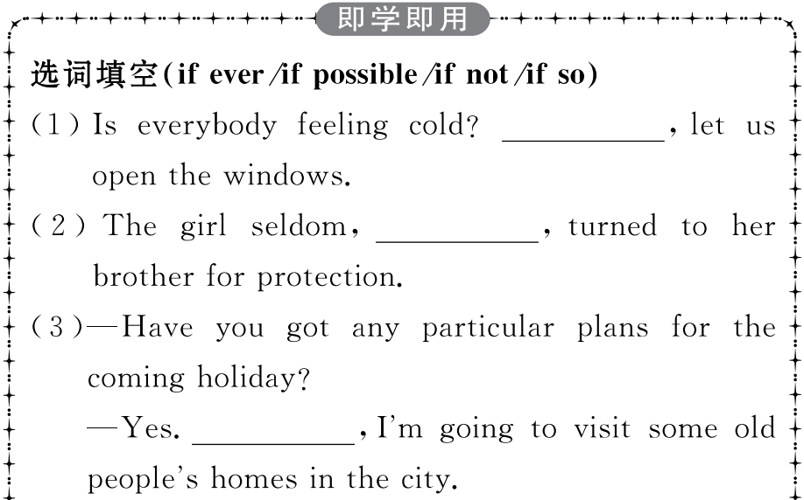
重点词汇
重点句式
随堂练习

Slide 31
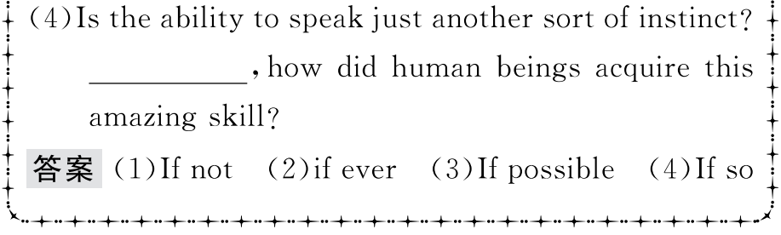
重点词汇
重点句式
随堂练习

Slide 32
重点词汇
重点句式
随堂练习
2.Almost everywhere you go in the UK,you will be surrounded by evidence of four different groups of people who took over at different times throughout history.
几乎你去英国的任何地方,你都会被在不同的历史时期四个不同群体统治这个地方的证据所包围。
【句式剖析】本句是一个复合句,其中everywhere是连词,引导地点状语从句。
Everywhere they looked nearly everything was destroyed.
他们无论朝哪里看,那里的一切几乎都被毁了。
I wanted to save up money and buy my own car,so I applied everywhere I could that summer.
那年夏天,我想攒钱买属于自己的车,所以我四处求职。

Slide 33
重点词汇
重点句式
随堂练习
【温馨提示】
(1)everywhere还可常用作副词,意为“到处”。
I looked for it everywhere,but didn’t find it.
我哪儿都找过了,但没有找到。
注意:有时根据需要可与介词 from 连用。
Congratulations poured in from everywhere.
祝贺像潮水一样从四面八方涌来。
(2)everywhere可用作表语,表示某种情况很普遍。
Girls with long hair were everywhere in the 1960s.
在20世纪60年代,女孩子留长发的现象相当普遍。
(3)everywhere用作名词,在句中作主语。
Everywhere seemed to be silent.万籁俱寂。

Slide 34
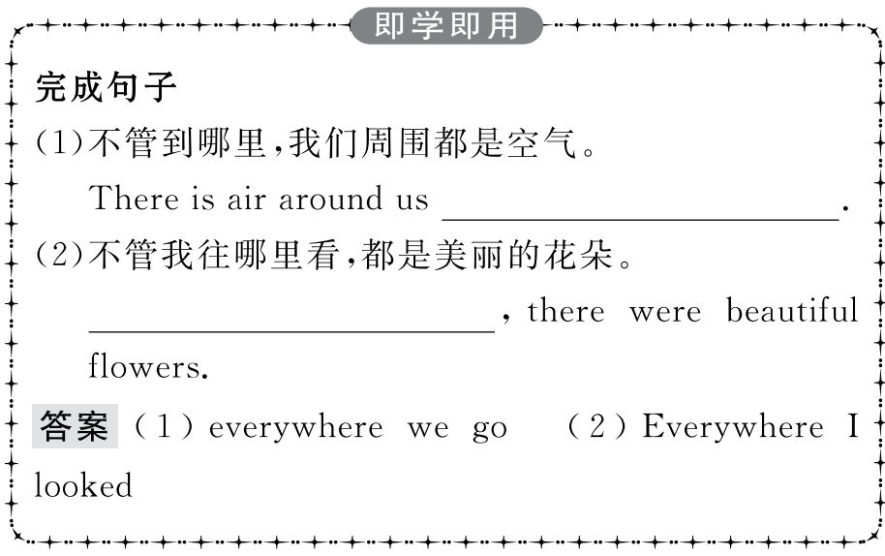
重点词汇
重点句式
随堂练习

Slide 35
重点词汇
重点句式
随堂练习
Ⅰ.单词拼写
1.My friends all live (在附近),so I often get together with them.
答案:nearby
2.The body has natural (防御) mechanisms to protect it from disease.
答案:defence
3.Experts have found a lot of (证据) that stress is partly responsible for disease.
答案:evidence
4. (围绕;包围) yourself with good people who love you and inspire you.
答案:Surround
5.Even a small success gives us a sense of (成就).
答案:achievement

Slide 36
重点词汇
重点句式
随堂练习
Ⅱ.语篇填空
When people hear the names the United Kingdom,Great Britain,Britain,England,they often are confused by what these different names mean and want to know the 1. (different) between them.2. (solve) this puzzle,you had better know a little bit about British history.
difference
To solve

Slide 37
重点词汇
重点句式
随堂练习
In the 16th century,the country was called the Kingdom of England 3. the nearby country was joined to it.Two 4.__________ (century) later,it changed to the Kingdom of Great Britain when Scotland was joined to it.In the 19th century,the Kingdom of Ireland
5. (add) to create the United Kingdom of Great Britain and Ireland.Finally,in the 20th century,the southern part of Ireland broke away from the UK,6. resulted in the full name we have today:the United Kingdom of Great Britain and Northern Ireland.
The four countries that belong to the United Kingdom have many things in common,7. they still have some differences,such as education systems,legal systems,and traditions as well as football teams for 8. (compete) like the World Cup!
when
centuries
was added
which
but
competitions

Slide 38
重点词汇
重点句式
随堂练习
The United Kingdom 9. (go) through hard times in its history as many foreign invaders came to the country.They all had great influence on the country.
There is so much more to learn about the interesting history and culture of the United Kingdom.10. (study) the history of the country will make your visit much more enjoyable.
went
Studying

Slide 39
重点词汇
重点句式
随堂练习
Ⅲ.概要写作
根据P40—41课文内容,写一篇60词左右的内容概要。
参考范文
Many people are confused by the different names referring to the UK and want to know their differences.(要点1) Wales,Scotland and the Kingdom of Ireland were joined to the country at different times,resulting in different names.(要点2) While the four countries work together in some areas,they also have some differences.(要点3) In its history,the United Kingdom was influenced by foreign invaders in many aspects,which makes the history and culture of the United Kingdom interesting to learn.(要点4)

