Slide 1
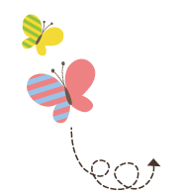
Unit 4 Li Ming Comes Home
六年级下册
Lesson 20 Looking at Photos
WWW.PPT818.COM

Slide 2
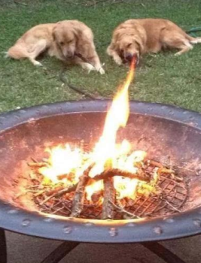
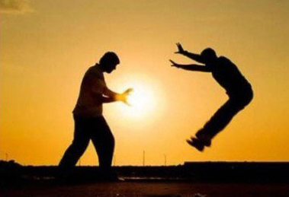
Thoese photos are funny!

Slide 3
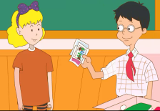
1. Do you remember?
Jenny: What are you doing, Li Ming?
Liming: I'm getting ready to go home next week. Look! I found these photos!
Jenny: May I see them?
Liming: Sure.
Jenny: Look at this photo. Danny wanted to play basketball with a ping­ pong ball!
Liming: Danny said the basketball was heavy. Then I taught him to play ping-­pong, but he hit his h and. Poor Danny!
Jenny: Look, Li Ming! Here's a photo of you, Danny and Santa. Do you remember?
Liming: Oh, yes! I went to the shop with Danny. We bought Christmas gifts. Then we saw Santa. We talked to Santa.

Slide 4
知识点1
get ready to do sth.＝get ready for sth.为……做好准备
We are getting ready to play football.
我们正在为踢足球做好准备。
They are getting ready for the football game.
他们正在为足球比赛做好准备。
例句：

Slide 5
get的一词多义：
拓展
get | 收到， 得到 | I get many presents on my birthday. 我生日那天收到很多礼物。
 | 到达 | I always get to school on time. 我总是按时到校。
 | 变得 | The weather gets cold.天气变冷了。

Slide 6
知识点 2
find /faɪnd/v.发现；找到(过去式为found)
Did you find your pen? 你找到你的钢笔了吗？
例句：
字母i的发音是/aɪ /。
发音：
谱系记忆法：
ind
wind n． kind adj. mind v． find v.
风 和蔼的 介意 找到，发现

Slide 7
词语辨析：find与look for
look for | 寻找 | 强调找的过程 | I'm looking for my ruler. 我正在寻找我的尺子。
find | 找到 | 强调找的结果 | I didn't find my ruler. 我没找到我的尺子。

Slide 8
知识点 3
May I see them? 我可以看看它们吗？
这是以情态动词may引导的一般疑问句，意思是“我可以……吗？” 用来征求对方的意见，询问对方是否同意自己做某事。
用法：
May I ＋动词原形＋其他？
句型结构：
Sure./Yes, you can.
肯定回答：
Sorry./No, you can't.
否定回答：

Slide 9
易错点
提示
该句型的否定回答要用can't。
—May I watch TV now? 现在我可以看电视吗？
—No, you can't. You must finish your homework first.
不，你不能。你必须首先完成你的作业。
例句：

Slide 10
单项选择。
—May I ________ your bike?
—Sorry.
A．ride B．riding C．rides
典例
A

Slide 11
知识点 4
remember/ rɪ'membə/ v. 记得，回想起
remember to do sth.记得去做某事（事情还没做）
remember doing sth.记得做过某事（事情已做）
短语：
Remember to close the window.记得关窗户。
I remember turning off the light.我记得关灯了。
例句：
反义词记忆法：
forget忘记

Slide 12
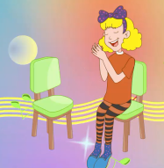
2. Let's sing!
Come and sit down beside me, my friend.
Do you know that we all miss you?
We feel happy to see your bright smile, dear.
We feel happy that you will miss us, too.

Slide 13
3. Let's do it!
Pair work. Talk about the photos. Then write.
He was on the playground.
Where was Bob last Sunday?
What did he do?
He played basketball with his friends.
1．Bob played basketball with his friends last Sunday.
2．_____________________________________________________
3．____________________________________________________
4．___________________________________________________
Jenny flew a kite last Sunday.
Danny saw pandas last Sunday.
Steven bought some fruit last Sunday.

Slide 14
照片秀。
三四名同学一组，每人准备一张自己的照片。首先，由小组内一名同学展示自己的照片并简单介绍照片上的人物身份。然后，其他组员开始针对照片进行询问，用上句型 “Where was/were+主语？”以及“What did +主语+do？”。 问答结束后，由另一名同学继续展示，以此类推。

Slide 15
一、单项选择。
( )（1）I'm ________ready to go home next week.
A. get B. getting C. geting
( ) （2）We are getting ready ________ swim in the sea.
A．to B．for C．at
B
A
点拨：
根据swim是动词可知要用短语“get ready to do sth.”，所以选A。

Slide 16
( )（3） What can you________ in the picture?
—I ________ at it, but I can't ________anything.
A．look; look; look for B．see; see; look for
C．see; look; find
C
点拨：
本题考查同义词语的辨析。see 看见(强调看的结果)；look at 看……(强调看的过程)；find 发现，找到(强调寻找的结果)。根据句意“——在图画里你能看见什么？——我看了，但是我什么也没有发现。”可知选C。

Slide 17
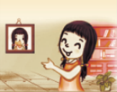
二、判断下列句子与图片是（T）否（F）相符。
（ ）（1）Here is a photo of the girl.
（ ）（2）The basketball is heavy.
（ ）（3）—May I play football？
—Sure!
T
F
T

Slide 18
三、用所给单词的反义词填空，完成句子。
（1）I don’t want to play basketball. The basketball is_______ (light).
( 2 ) Please __________ (forget) to close the door when you leave the room.
heavy
remember

Slide 19
本节课我们学习了以下知识，请同学们一定加强巩固，以便能和同学们进行灵活交流哦！
重点词汇： find , remember
重点短语：get ready to do sth.
重点句式：May I see them?

Slide 20
1 熟记本节课所学的句型、短语，必须会听、说、读、写。
2 将Do you remember的对话朗读流利。
3 完成配套的课后作业。

