Slide 1
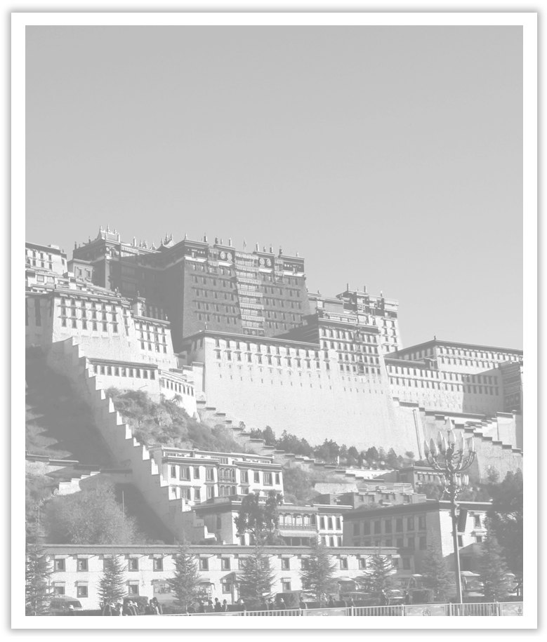
Unit 1 Cultural Heritage
Section Ⅱ Reading and Thinking(1)
WWW.PPT818.COM

Slide 2
1.Discussing—Look at the following pictures and answer the questions.
(1)What do the places in the pictures have in common?
________________________________________________________________________
They are famous cultural heritage sites or cultural relics.

Slide 3
(2)What organization are the following pictures about?
________________________________________________________________________
The organization is UNESCO, that is“联合国教科文组织”。

Slide 4
2.Predicting—Look at the pictures and the title on Page 4 and predict what the text is probably about.
The text is probably about the protection of cultural heritage sites.
________________________________________________________________________

Slide 5
1.First reading—Read the text and fill in the blanks.
solutions
The text is mainly about how the Egyptian government found ____________ to the problem of keeping ____________ between building the Aswan Dam and protecting ________________________________.
balance
the temples and other cultural relics

Slide 6
2.Second reading—Choose the best answer according to the text.
(1)Which is NOT the reason why the government wanted to build a new dam across the Nile?
A.Because the old one must give way to the new.
B.Because there were always floods in the Nile area.
C.Because the farmers were in need of water.
D.Because the electricity was short in Egypt.

Slide 7
(2)Why did the government turn to the UN for help?
A.Because the government met big challenges.
B.Because some citizens protested building the dam.
C.Because the scientists had studied the problem.
D.Because there were many farmers in the area of Nile.
(3)What can be inferred from the last two paragraphs?
A.Easier said than done.
B.More haste, less speed.
C.Action speaks louder than words.
D.Many hands make light work.

Slide 8
(4)Which of the following shows the structure of the whole text?
答案 (1)A (2)A (3)D (4)B

Slide 9
3.Third reading—Read the text again and order the following events.
①A document was signed and the work began.
②The government turned to the United Nations for help.
③The scientists studied the problem of building the new dam.
④The government needed to build a new dam across the Nile.
⑤Some citizens who lived near the dam protested the proposal.
⑥22 temples and countless cultural relics were rescued.
⑦The government established a committee.
⑧Experts investigated the issue, conducted several tests and made a proposal.
答案 ④③⑤②⑦⑧①⑥

Slide 10
1.Why does the author use so many numbers in the text?
To tell the readers the protection of cultural heritage sites was very difficult./
To describe the project of the Aswan Dam in a vivid and clear way./
To show the greatness of the spirit of the Aswan Dam project./
To make the text more persuasive.
________________________________________________________________________
________________________________________________________________________
________________________________________________________________________
________________________________________________________________________

Slide 11
2.What’s the spirit of the Aswan Dam project? Do you need it in your study? Why?
The spirit of the Aswan Dam project is cooperative, creative, determined as well as persistent.
Yes.I need it.Because we will meet with unexpected problems in study.If one cannot work it out by himself, he can turn to teachers or other students for help.
________________________________________________________________________
________________________________________________________________________
________________________________________________________________________
________________________________________________________________________

Slide 12
阅读技巧点拨
如何预测课文内容？
1.By looking at the pictures.
2.By reading the title.
3.By what you’ve known.

Slide 13
语言现象感知
Ⅰ.单词理解
体会句中加黑单词的词性和词义
1.But the proposal led to protests.____________
2.Water from the dam would likely damage a number of temples.____________
3.Experts investigated the issue, conducted several tests...____________
4.The spirit of Aswan Dam Project is still alive today.____________
5.Perhaps the best example is shown by UNESCO, which runs a programme...
____________
n.抗议
adv.可能地
n.问题
adj.活着的
v.管理

Slide 14
Ⅱ.词块积累
写出下列词块的含义
1.the protection of cultural sites________________
2.a number of temples________________
3.turn to the United Nations for help________________
4.within the international community________________
5.make a proposal for...________________
6.environmentalists from around the world ________________
文化遗址保护
许多庙宇
向联合国求助
在国际社会范围内
对……提出建议
全世界的环境学家

Slide 15
7.be taken down piece by piece____________________
8.over the next 20 years__________________
9.a path to the future________________
10.work together to build a better tomorrow_________________________
被一块一块地拆下来
在接下来的20年里
通向未来之路
一起建设更加美好的明天

Slide 16
Ⅲ.句式欣赏
1.动名词结构作主语
Finding and keeping the right balance between progress and the protection of cultural sites can be a big challenge.
2.倒装句式
①There comes a time when the old must give way to the new，...
②Not only had the countries found a path to the future that did not run over the relics of the past, but they had also learnt that it was possible for countries to work together to build a better tomorrow.

Slide 17
3.where引导的定语从句
Temples and other cultural sites were taken down piece by piece, and then moved and put back together again in a place where they were safe from the water.

