Slide 1
Unit 2 Good Health to You!
六年级下册
Lesson 9 Eat More Vegetables and Fruit!
WWW.PPT818.COM

Slide 2
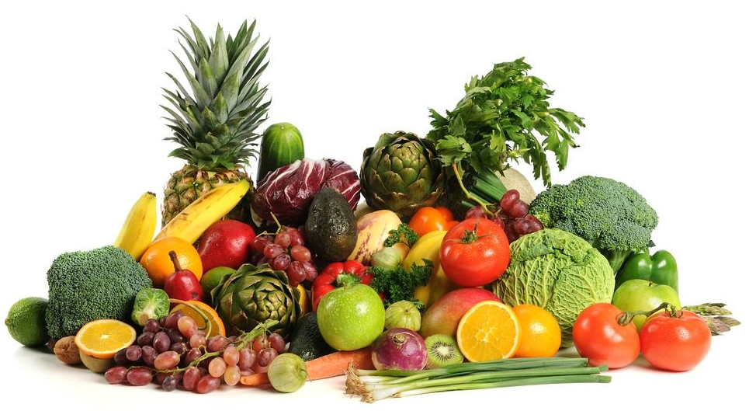

Slide 3
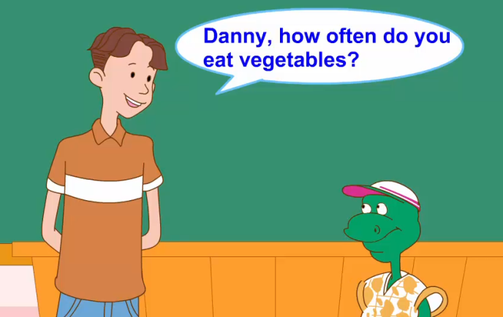
1. Let's get to work!

Slide 4
How often does Danny eat vegetables and fruit?
丹尼多久吃一次蔬菜和水果？
知识点 1
询问频率的特殊疑问句
句型结构：
How often+助动词+主语+动词原形+其他？
—How often do you play basketball?
你多久打一次篮球？
—Three times a week.一周三次。
例句：

Slide 5
I go to the park twice a week.(对画线部分提问)
_______________________________________
典例
How often do you go to the park?
often /'ɒfn/ adv. 常常；经常
My sister often walks to work.
我姐姐经常步行去上班。
例句：
how often 多久一次
短语：

Slide 6
拓展
表示频率的副词，其频率从小到大依次为：
never(0%)→sometimes (20%)→often (60% )→ usually— (85%)→always (100%)
歌谣记忆法记频度副词：
Li Ming, Li Ming真积极， always总是早早起，
usually通常来学习，often经常做家务，
sometimes有时锻炼身体，never从来不缺席。
大家快来比一比，我们共同争第一。
魔法记忆：

Slide 7
单项选择。
I have breakfast four times a week. I ________ have breakfast.
A. always B. never C. often
典例
A

Slide 8
知识点 2
twice a week 一周两次
I play basketball with my friends twice a week.
我和我的朋友一周打两次篮球。
例句：
once 一次；twice 两次。三次及三次以上用“基数词＋times” 表示次数。例如：three times 三次； four times 四次。
次数的表达方法：

Slide 9
易错点
提示
“次数＋一段时间”译为“一段时间内几次”，经常用于回答How often提问的特殊疑问句。
例句：—How often do you eat fruit?
你多久吃一次水果？
—Three times a week.一周三次。

Slide 10
—How often does Danny come here?
—________．
A. One a week B. Once a week
C. A time a week D. First a week
典例
B

Slide 11
我是最佳调查员
请同学们做一张调查表，来询问朋友们吃某些食物和做运动的频率，用上句型How often do you…? 根据朋友们的答案把你的调查表补充完整。快来看看谁是最佳调查员吧!

Slide 12
2. Let’s do it!

Slide 13
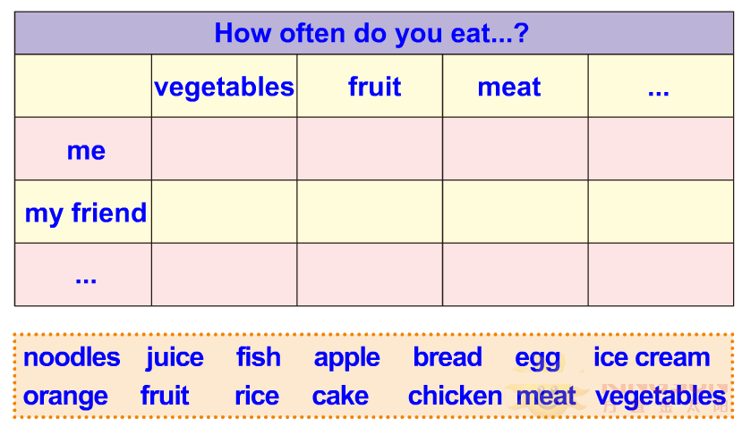
2. Let’s do it!

Slide 14
一、单项选择。
( ) 1. —________ do you eat donuts?
—Twice a week.
A. How many B. How much C. How often
( ) 2. Fruit is good ________us!
A. for B. in C. at
( ) 3. I think you need ________more vegetables.
A. eats B. to eat C. ate
C
A
B

Slide 15
二、选出不同类的单词。
( ) 1. A. year B. day C. time
( ) 2. A. often B. more C. always
( ) 3. A. three B. twice C. once
( ) 4. A. potatoes B. vegetables C. tomatoes
( ) 5. A. before B. after C. food
C
B
A
B
C

Slide 16
本节课我们学习了以下知识，请同学们一定加强巩固，以便能和同学们进行灵活交流哦！
重点词汇：often
重点短语：twice a week
重点句式：How often does Danny eat vegetables and fruit?

Slide 17
1 熟记本节课所学的句型、短语和单词，必须会听、说、读、写。
2 将Let’s get to work!朗读流利。
3 完成配套的课后作业。

