Slide 1
Unit 4 Food and Restaurants
单元主题写作
WWW.PPT818.COM

Slide 2
单元主题写作
话题分析
本单元的主要话题是“Food and Restaurants”。通过在餐馆就餐、超市购物等活动学习了如何点餐，如何询问价格和各种食物、饮料的数量表达等。
围绕本单元的话题，常见的作文有介绍三餐饮食习惯、介绍饮食喜好和超市购物等。

Slide 3
单元主题写作
典 型 例 题
一日三餐对人们的身体健康有着非常重要的作用。李华是一名学生，他有一个很好的饮食习惯。请根据表格中的内容写一篇不少于50词的短文，介绍一下他喜欢及不喜欢的食物及饮料。
 | Food | Drinks
Likes | 面条、饺子、鸡蛋、鱼 (最喜欢)、苹果(最喜欢) | 牛奶、茶、咖啡
Dislikes | 米饭、肉、热狗 | 汽水、可乐

Slide 4
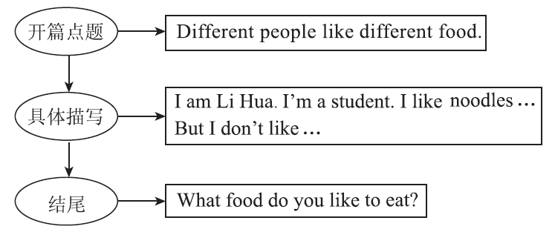
单元主题写作
思 路 点 拨

Slide 5
单元主题写作
素材积累
常用单词：
1．食物 ________ 2. 蔬菜 ________
3．饮料 ________ 4. 水果 ________
5．健康的 ________ 6. 最喜欢的 ___________
food
vegetable
drink
fruit
healthy
favourite

Slide 6
单元主题写作
常用短语：
1．对……有好处________________
2．对……有坏处________________
3．想要________________
4．一杯茶________________
be good for
be bad for
would like
a cup of tea

Slide 7
单元主题写作
常用句型：
1．It is good for our health. 它对我们的健康有好处。
2．Don't eat too much junk food. 不要吃太多垃圾食品。
3．Grapes are my favourite fruit. 葡萄是我最喜欢的水果。
4．He likes fish best. 他最喜欢鱼肉。

Slide 8
单元主题写作
高分模板
It is important for us to eat three meals a day. And different people like different food. I am Li Hua. I'm a student. I like many kinds of healthy food, such as noodles, dumplings, eggs and so on. Fish is my favourite food. And apples are my favourite fruit. Milk, tea and coffee are my favourite drinks. I think they are good for my body. But I don't like rice, meat or hot dogs. I don't like to drink pop or coke, either. What food do you like to eat?

Slide 9
单元主题写作
名师点评
1．短文包含了所有要点，内容充实。
2．画线句子里使用了“It is＋adj.＋for sb. to do sth.”和“…be good for…”句型，句式既简单又经典。

Slide 10
单元主题写作
小试身手
一日三餐对我们非常重要。你的一日三餐都喜欢吃什么呢？在哪里吃？和谁一起吃呢？请根据自己的情况写一篇英语短文。
要求：1．包含所给要点， 可适当发挥。
2．词数：40－60。

Slide 11
单元主题写作
One possible version：
Hello, today let's talk about what we eat for our meals. For breakfast, I usually have some bread and meat with my parents at home. I often have some noodles or dumplings for lunch at school. I eat them with my friends. For supper, I eat some noodles at home again. I really like noodles. Between two meals, I often eat some fruits. I think they're good for my health.

