Slide 1
Module
3
Making plans
Unit 1
What are you going to do at the weekend?
WWW.PPT818.COM

Slide 2
Teaching aims：
1.检测本课单词与短语：
go over, picnic, housework, have a picnic,else, nothing, nobody,silly, fantastic.
2. 观察并了解be going to 形式的构成, 能简
单使用一般将来时(am/is/are going to + do)
3. 通过用英语与同伴谈论自己和周围人们打
算做的事情, 进一步熟悉一般将来时的用法。

Slide 3
Words and expressions
go over
复习；练习
/'pIknIk /
/'haʊs'wɜ:k/
/ɒn/
/els/
picnic
野餐 n.
housework
家务劳动 n.
on
在……的时候 prep.
其他；另外 adv.
else

Slide 4
Words and expressions
nobody
/'nəʊbɒdI/
/æt/
/'nʌθIŋ/
/'sIlI/
/fæn'tæstIk/
没有人 pron.
at
在……点钟 prep.
nothing
没有什么，没有东西 pron.
silly
愚蠢的，傻气的 adj.
fantastic
极好的 adj.

Slide 5
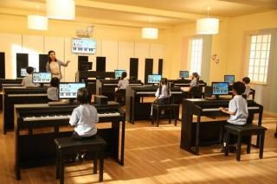
Look and say
have a lesson
piano

Slide 6
email
check his

Slide 7
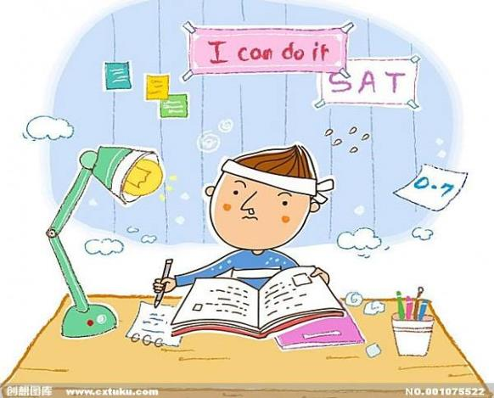
go over
lessons

Slide 8
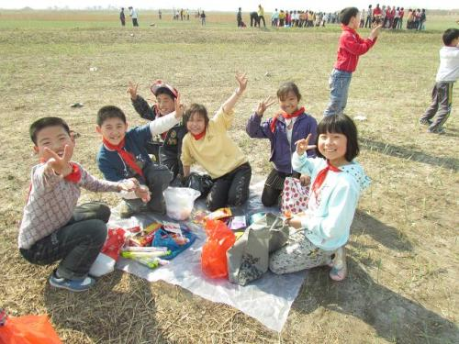
have a
picnic

Slide 9
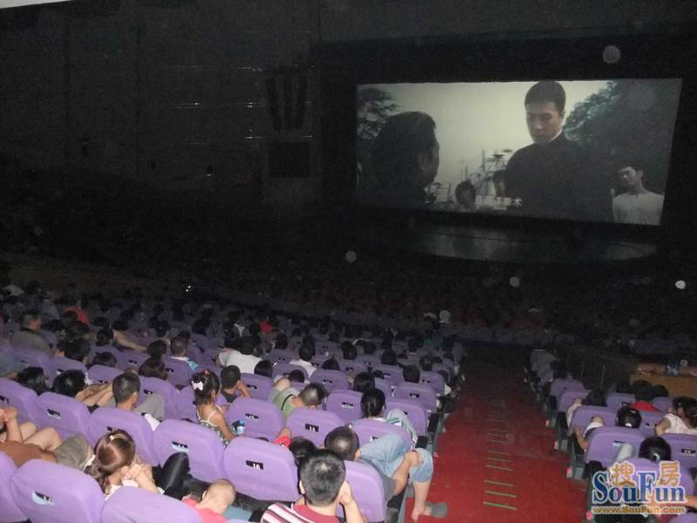
movie
see a

Slide 10
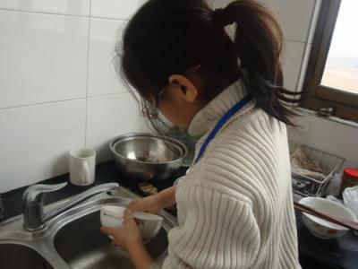
help with the
housework

Slide 11
1 Listen and match the words and
Expressions.
check
go over
have
see
help
have
a movie
a piano lesson
a picnic
lessons
my email
with the housework

Slide 12
Then read them carefully.
check my email 查收电子邮件
go over lessons 复习功课
have a piano lesson 上钢琴课
see a movie 看电影
help with the housework 帮忙做家务
have a picnic 去野餐；举行野餐

Slide 13
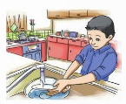
2 Match the expression in Activity 1 with
the pictures.
go over lessons
1
2
help with the housework

Slide 14
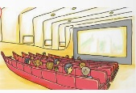
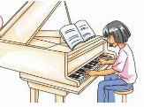
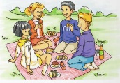
3
see a movie
4
check my email
5
have a piano lesson
have a picnic
6

Slide 15
Free talk
1.What are we doing now?
2.What are we going to do at 11:50?
We are having an English lesson.
We are going to have lunch.

Slide 16
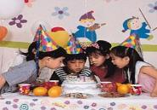
A:What are you going to do this weekend?
B:I am going to ….

Slide 17
What is she going to do at the weekend?
watch TV
She is going to _________.

Slide 18
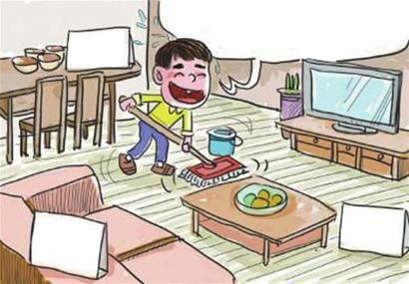
What is he going to do at the weekend?
He is going to____________.
do the housework

Slide 19
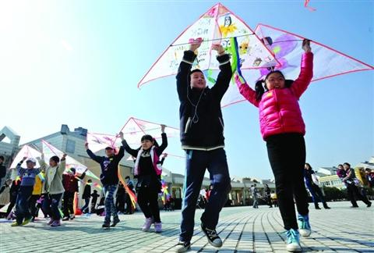
What are they going to do at the weekend?
fly a kite
They are going to________.

Slide 20
1、How many people are talking?
2、Who are they?
3、What are they talking about?
Three people are talking.
They are Daming, BettyandTony.
They are talking about what they are going to do at the weekend.

Slide 21
Read and find
在周末
在周六早上
查看邮件
帮忙做家务
看电影
上钢琴课
野餐
在公园
独自呆在家里
别傻了
一个极好的周末
复习课程
制定计划
at the weekend
on Saturday morning
check the email
help with the housework
see a movie
have a piano lesson
have a picnic
in the park
stay at home alone
Don’t be silly
a fantastic weekend
go over lessons
make plans/ make a plan

Slide 22
Now listen and answer the questions.
What’s Daming going to do on Saturday
morning?
2. What’s Betty going to do on Saturday afternoon?
3. Who is going to have a piano lesson on Saturday?
________is going to have a piano lesson on Saturday.
4. Where are they going to meet?
They are going to meet__________.
check his email
He’s going to _______________,do his homework and ________________________.
help with the housework
She’s going to___________.
see a movie
Lingling
in the park

Slide 23
Read and find
Betty: What are you going to do at the weekend,
Daming?
Daming: On Saturday morning, I’m going to check my email and do my homework. Then I’m going to help with the housework. What are you going to do Betty?
Betty: I’m going to see a movie in the afternoon . You can come too.
Daming: Sure! Who else is going to be there?
else 副词 置于 what,who;where,when 疑问代词或疑问副词之后。

Slide 24
Betty: Nobody. Lingling is going to have a piano lesson, so she can’t come with us, but on Sunday afternoon , Lingling and I are going to have a picnic. Would you like to join us?
Daming: Yes. I’d love to. Are we going to meet here?
Betty: No. we aren’t. We’re going to meet in the park at one o’clock.
Tony: Hi, everyone!
Betty: Hi ,Tony. What are your plans for the weekend?
Tony: Nothing. I’m going to stay at home alone.
Betty: Don’t be silly! You’re going to come with us. It's going to be a fantastic weekend!

Slide 25
Grammar
一般将来时
1. 定义: 表达自己打算做某事、计划做某事或者有意做某事。
2. 结构: be（are，am，is）+ going to + 动词
3. 时间短语:
this afternoon / evening, tonight
tomorrow (morning / afternoon / evening )
the day after tomorrow,
next Sunday / week / month / year

Slide 26
1.肯定句: 主语+ be going to +动词原形
1) 我打算在早上查看一下电子邮件。
I _______________ my email in the morning.
2) 他打算在周末去野餐。
He ______________________ at the weekend.
am going to check
is going to have a picnic
Notes:
26

Slide 27
2. 否定句：主语+ be not going to +动词原形
表示某人不打算做某事
我们不打算在星期六开晚会。
We _________________________ on Saturday.
3. 一般疑问句: Be +主语 + going to +动词原形？
回答： Yes, 主语 + be. No, 主语+ be not.
你打算在下午做作业吗？ - 是的。
____ you ______________ homework in the afternoon ?
- Yes , I ___.
aren’t going to have a party
Are going to do your
am
Notes:
27

Slide 28
4. 特殊疑问句：
特殊疑问词+ be +主语+going to +动词原形？
1) 他打算在周末做什么？
What ____he ____________ at the weekend?
2) 他们打算什么时候打扫房间？
When ____ they _____________ the room?
3) 你为什么打算呆在家里?
Why ____ you ______________ at home?
is going to do
are going to clean
are going to stay
Notes:
28

Slide 29
4. Complete the conversation
alone else fantastic nothing silly
Betty: What are your plans for next weekend ,Lingling?
Lingling: _________.I don’t have any plans.
Betty: Are you going to spend it_______ at home?
Lingling: Well,…what are you going to do?
Betty: Tony and I are going to have a picnic in the park. We’re going to have a _________ time. Are you going to come?
Lingling: I’m not sure.
Betty: Don’t be_____! What _____ are you going to do?
Nothing
alone
fantastic
silly
else

Slide 30
Practice
--- What are you going to do on Saturday morning?
--- I’m going to check my email and do my homework.
 |  | You | Your friend
 | morning | check email ,do homework | clean the room
Saturday | afternoon | have a piano lesson | go shopping
 | evening | listen to some music | see a movie
 | morning | play tennis | help with the housework
Sunday | afternoon | have a picnic | draw a picture
 | evening | see a movie | check email
--- What is your friend going to do on Saturday morning?
--- She/ He going to clean the room.

Slide 31
Homework
1、Copy the words and expressions.（必做）
2、Write a short passage about what you are
going to do at the weekend?(选做）

