Slide 1
Unit 7 Lesson 1
This is Jenny speaking.
WWW.PPT818.COM

Slide 2
重点句型：
A: Hello! This is …speaking. May I speak to…?
B: Hold on, please.
…is calling.
B: This is …Speaking.

Slide 3
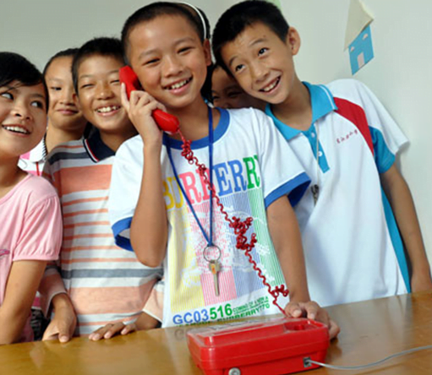
Let’s learn!
Hello! This is Jenny speaking.

Slide 4
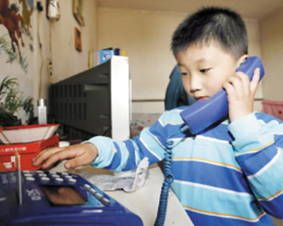
Let’s learn!
Hello! This is Li Ming speaking.

Slide 5
Let’s learn!
This is Wang Hong speaking.

Slide 6
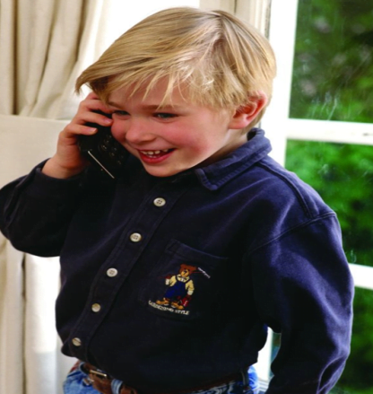
Let’s learn!
Hello! This is Guo Yang speaking.

Slide 7
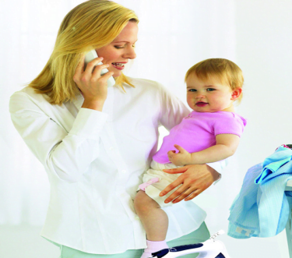
Look and say
Hello! May I speak to Jenny?
Hold on, please.

Slide 8
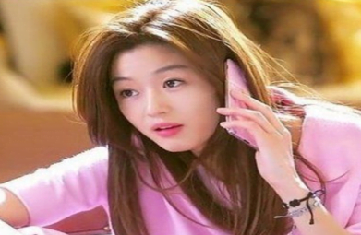
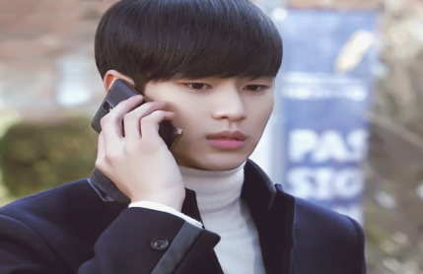
Look and say
Hello! May I speak to Wang Hong?
Hold on, please.

Slide 9
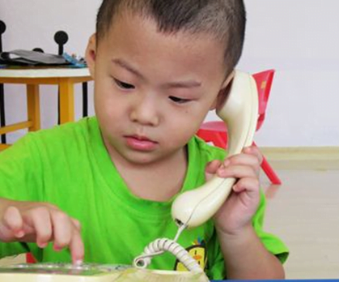
Look and say
Hello! May I speak to Guo Yang?
Hold on, please.

Slide 10
Look and say
Hello! This is Jenny speaking.
May I speak to Li Ming?

Slide 11
Look and say
Hold on, please.

Slide 12
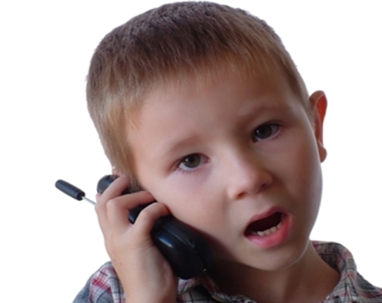
Look and say
This is Li Ming speaking.
Hi, Jenny!

Slide 13
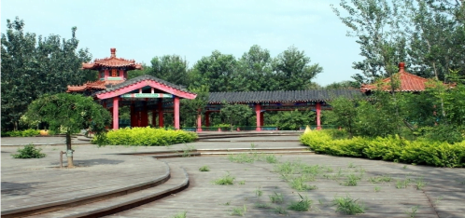
Look and say
Let’s go to the park!

Slide 14
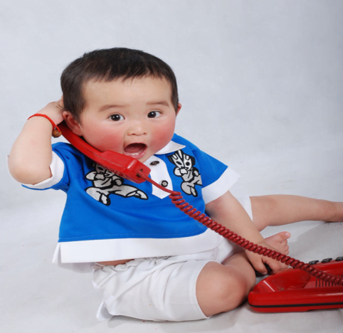
Look and say
Ok!

Slide 15
group work 小组合作
四人小组为单位进行情景剧表演，可以选择
表演课本，也可以自己进行创编。
要求： 声音洪亮
自信大方
富有创意
语音语调优美

Slide 16
Let’s learn!
This is _________ speaking.
May I speak to ___________?
Hold on, please.
_____we go to the library?
Let’s go to the park.
Let’s do some training tomorrow.
Wang Hong
Guo Yang
Li Ming
Jenny
Li Ming
Jenny
Wang Hong
Guo Yang
Shall

Slide 17
Homework
Make a calling with your friends.

