Slide 1
Can I help you?
WWW.PPT818.COM

Slide 2
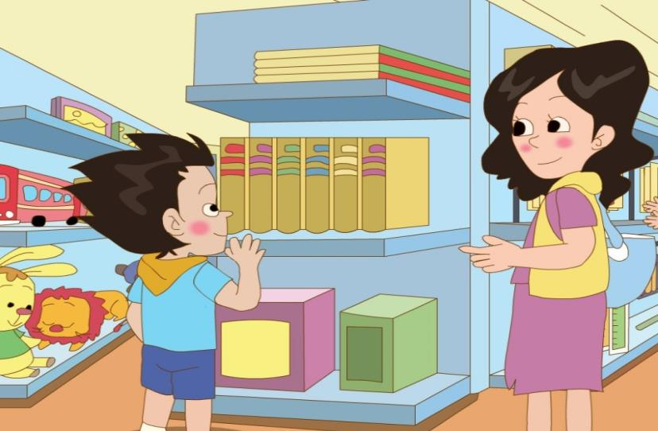

Slide 3
Watch and answer:
What does Dick want to buy?
A. A toy car.
B. A toy train.

Slide 4
Watch and answer:
What colour does Dick want?
A. Red one.
B. Blue one.

Slide 5
Read the first paragraph and answer
(阅读第一段文本，回答):
What does the shop assistant say?
(售货员说了什么？)

Slide 6
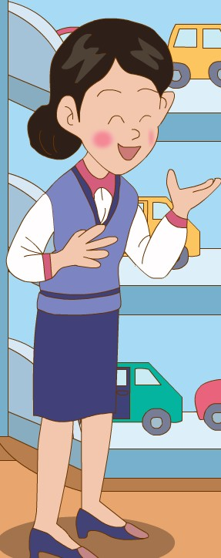
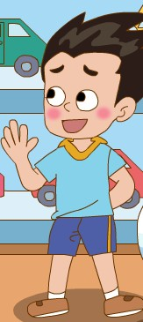
Can I help you?
I want a toy train .

Slide 7
Which one do you like best?
I like the blue one.

Slide 8
How much is it?
It’s fifty-six yuan.
We’ll take it.
Here you are.

Slide 9
Read and imitate
(跟读、模仿)

Slide 10
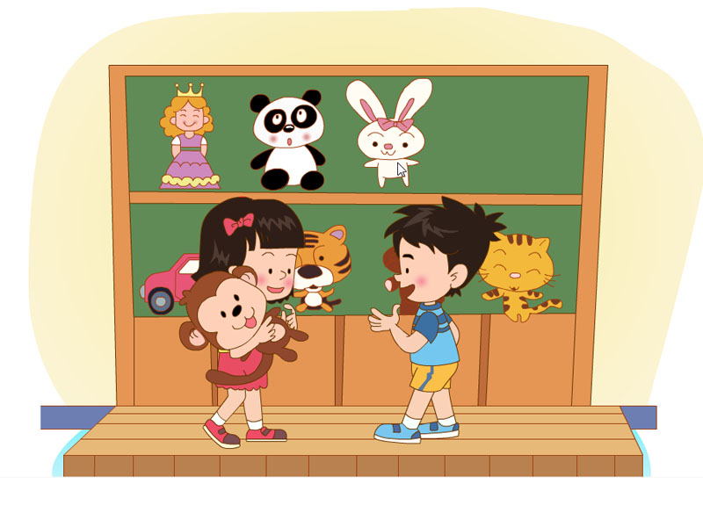
I want a toy, please.
Can I help you?
I like…
Which one do you like?
It’s…
How much is it?

Slide 11
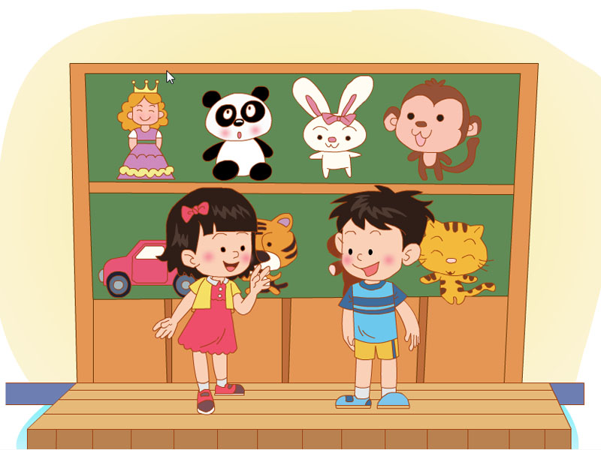
imitate (模仿)：

Slide 12
Fill in the blanks(填空) :
A: __________________?
Can I help you
take
B: I want a _____, please.
toy
A: How about this toy ______?
car
B: It’s too big.
bus
A: How about this toy ______?
It’s small and it’s ______.
All right
cheap
B: ____ ______. We’ll ______ it.

Slide 13
Homework
1、Read after it.
2、Do the shopping practice in pairs.

