Slide 1
Unit 7
I Have A Headache
第一课时
WWW.PPT818.COM

Slide 2
First:
Words Learning!

Slide 3
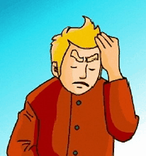
Words Learning:
headache

Slide 4
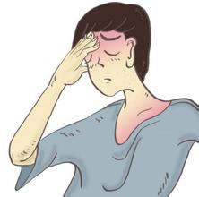
Words Learning:
headache n.
头痛
eg: I have a headache.
我头痛。

Slide 5
Words Learning:
cold

Slide 6
Words Learning:
cold adj./n.
寒冷的/感冒
eg: The weather is cold today.
今天天气很冷。
eg: I have a cold.
我感冒了。

Slide 7
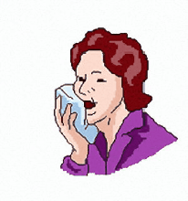
Words Learning:
cough

Slide 8
Words Learning:
cough
咳嗽
eg:---What's wrong with you?
--- I have a cough.
---你有什么问题？
---我有些咳嗽。

Slide 9
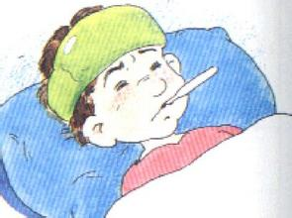
Words Learning:
fever

Slide 10
Words Learning:
fever
发烧，发热
eg: I have a fever, so I don't go to school today.
我发烧了，所以今天不去上学。

Slide 11
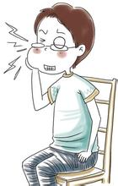
Words Learning:
toothache

Slide 12
Words Learning:
toothache
牙疼
eg: --- I have a toothache.
---Oh, I am sorry to hear that.
---我牙疼。
---我深表遗憾。

Slide 13
Words Learning:
stomachache

Slide 14
Words Learning:
stomachache
胃疼
eg:I eat something unfit, so I have a stomachache now.
我吃了不卫生的东西，所以现在胃疼了。

Slide 15
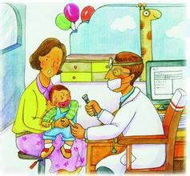
Words Learning:
see a doctor

Slide 16
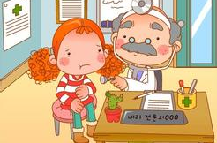
Words Learning:
see a doctor
看医生
eg: You need to see a doctor.
你需要去看看医生。

Slide 17
Can you make sentences with the words above by yourselves ? 请用以上新学单词造句！
Let's try！
Second:

Slide 18
Check Now!
head_che
stoma_hache
tootha_he
cou_h
fev_r
co_d
headache
stomachache
toothache
cough
fever
cold

Slide 19
Third:
请课后认真朗读单词课文，在记忆的基础上运用词句进行对话！

