Slide 1
Unit 6 Lesson 3
I got a football.
WWW.PPT818.COM

Slide 2
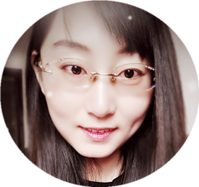
About me:
I’m Miss Liu . I’m from Zhaoyuan. I’m twenty-eight years old. I like travel , reading and singing.

Slide 3
Free talk :
1. Christmas is coming . What will you do at Christmas?
2. If you decorate the Christmas tree. What will you do ?

Slide 4
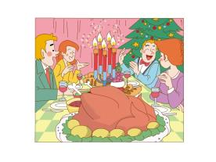
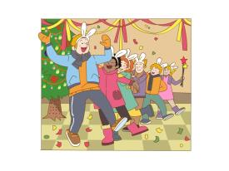
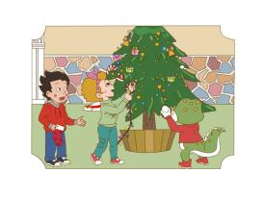
Christmas is coming . What will you do at Christmas?

Slide 5
What will you do at Christmas?
have a big dinner
I will .

Slide 6
What will you do at Christmas?
sing Christmas songs
I will .

Slide 7
What will you do at Christmas?
decorate the Christmas tree
I will .

Slide 8
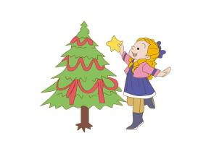
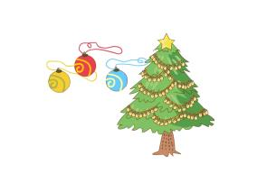
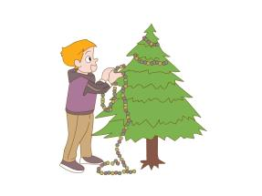
If you decorate the Christmas tree. What will you do ?
I will put the on the tree .

Slide 9
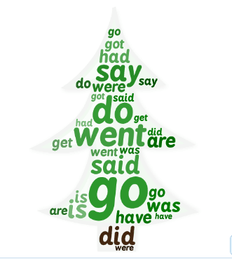
Try to find :

Slide 10
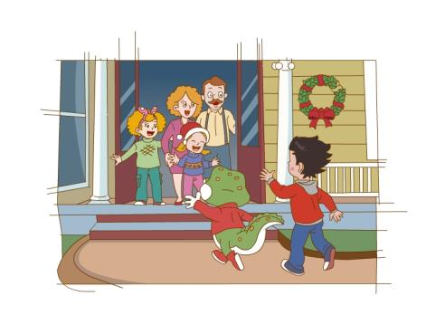
Can you guess ?
Jenny’s home.
Where did Li Ming and Danny go on Christmas Day ?

Slide 11
Can you guess ?
What did they say?
Merry Christmas.

Slide 12
Watch and answer :
1. What were there in the living room ?
2. What were there under the Christmas tree ?

Slide 13
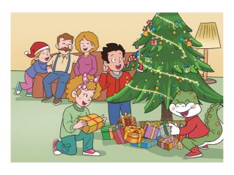
Read and answer:
1. What were there in the living room ?
2. What were there under the Christmas tree ?
There was a beautiful Christmas tree in the living room . There were many presents under the tree .

Slide 14
Watch again:
What presents did the children get ?

Slide 15
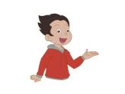
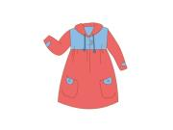
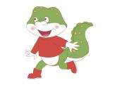
What presents did the children get ?
a football
a nice dress
a book about animals

Slide 16
Let’s retell ：
Jenny got a .
nice dress
Li Ming got a .
book about animals
football
Danny got a . He played it with his . They all .
tail
laughed

Slide 17
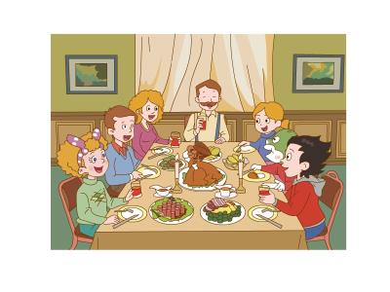
Listen and answer :
1. What did they do after that ?
2. Did they have a good time ?
In the evening , they had a big dinner.
They had a wonderful day .

Slide 18
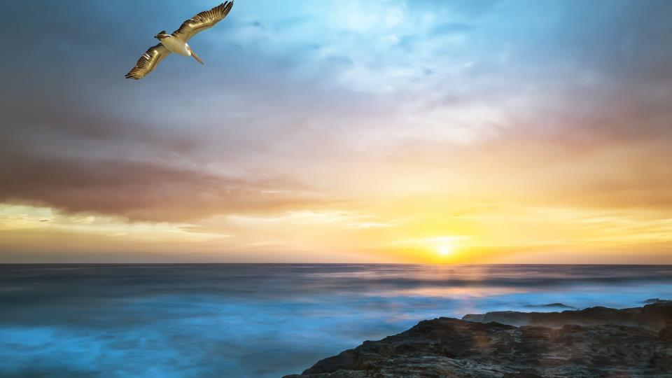
mor
eve
ning

Slide 19
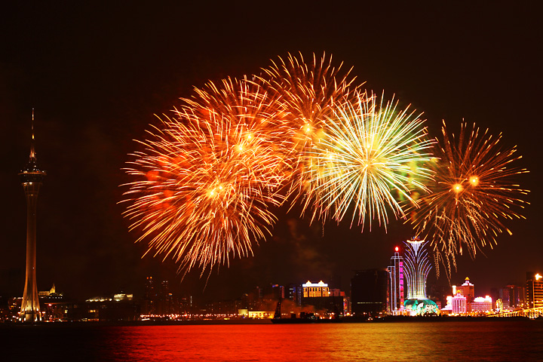
beauti
won
der
ful

Slide 20
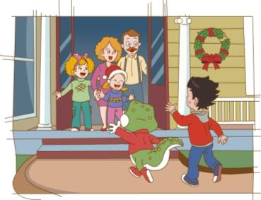
Let’s repeat :
It was Christmas morning .
Li Ming and Danny went to Jenny’s home .
They said “ Merry Christmas ” to Jenny’s family .

Slide 21
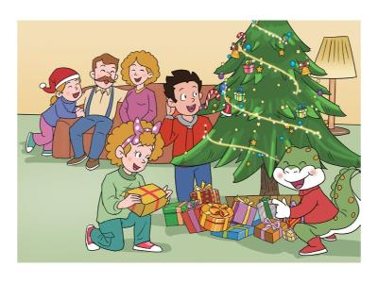
Let’s repeat :
There was a beautiful Christmas tree in the living room .
There were many presents under the tree .

Slide 22
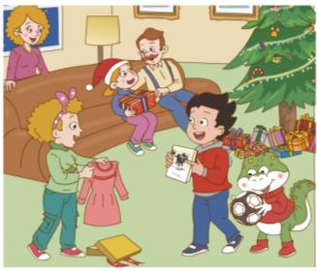
Let’s repeat :
Jenny got a nice dress .
Li Ming got a book about animals .
Danny got a football .
He played it with his tail .
They all laughed .

Slide 23
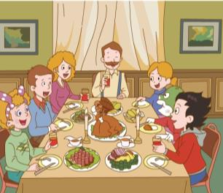
Let’s repeat :
In the evening , they had a big dinner .
“ It’s so good to have you here today, ” said Jenny’s father .
Everyone had a wonderful day .

Slide 24
Groupwork :
had
went
got
sang
It was Christmas Day . Li Ming and Danny
to Jenny’s home . They Christmas songs . They nice presents . They a big dinner together . They had a wonderful day .

Slide 25
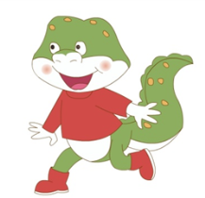
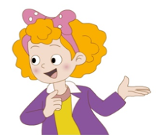
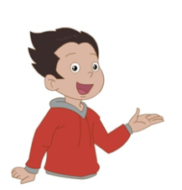
Let’s play :

Slide 26
Summary ：
What have you learned in this class ?

Slide 27
Sharing ：
圣诞节是西方国家一年中最盛大的节日，类似我国过春节。西方人以红、绿、白三色作为圣诞色来装饰，红色的有圣诞花和圣诞蜡烛。绿色的是圣诞树，用杉、柏一类的常青树装饰而成，上面悬挂着五颜六色的彩灯、礼物和纸花。圣诞节是一个分享与团聚的日子，全家人聚在一起，以珍惜和感恩之心感受生活的着喜悦和快乐。

Slide 28
Homework ：
wonderful went animals football said evening got
Sunday December 25 Sunny
Today is Christmas Day . I to Jenny’s home with Li Ming . We “ Merry Christmas ” to Jenny’s family . There were many presents under the Christmas tree . Li Ming a book about . I got
a . I played it with my tail . In the , we had a big dinner . We all had a day.
A diary from Danny

