Slide 1







Shopping
What can I do for you?
WWW.PPT818.COM

Slide 2
Learning Aims
To review and learn words on vegetables, fruits;
To use the shopping sentences to buy things in market;
To learn to remember words in groups;
Love your parents and take care of them;
Be polite while shopping.

Slide 3
Brain Storm
Try to remember the words in 15 seconds, you can write them down on the paper.

Slide 4
brain storm 1

Slide 5
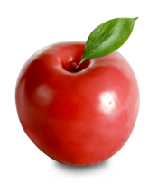
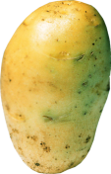

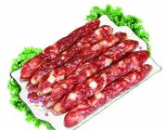
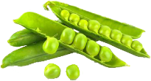
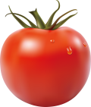
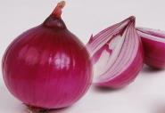
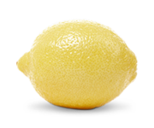
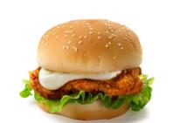
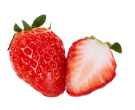

potato
beans
sausage
apple
carrot
lemon
tomato
strawberry
onion
hamburger

Slide 6
fruits
apple
lemon
strawberry
vegetables
potato
carrot
beans
onion
tomato
other food
hamburger
sausage
remember words in groups

Slide 7
Healthy food
apple
lemon
strawberry
peach
potato
unhealthy food
hamburger
sausage
carrot
beans
onion

Slide 8
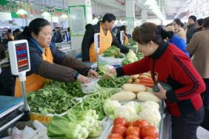
How many do you want?
market
brain storm 2

Slide 9


I want …
2 carrots
2 carrots
5 apples
3 potatoes
3 potatoes
1 lemon
4 tomatoes
2 kilos of beans

Slide 10






I want …
How many … do you want ?
4 tomatoes
2 carrots
5 apples
I would like …
3 potatoes
1 lemon
I 'd like to buy…
1 kilo of beans

Slide 11
brain storm 3
How much are they / is it ?

Slide 12

2 yuan a kilo
10 yuan a kilo
3 yuan a kilo
20 yuan a kilo
12 yuan a kilo

Slide 13


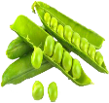
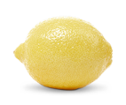
How much are they / is it ?
1 kilo of potatoes
2 yuan
20 yuan a kilo
3 kilos of tomatoes
9 yuan
2 kilos of beans
24 yuan
sausage
1 kilo of lemons
10 yuan
38 yuan a kilo

Slide 14
Listening
Listen and answer the following questions.

Slide 15
1. How much are the sausages?
Thirty-eight yuan a kilo.
2.How many beans does the girl buy?
A kilo of beans.
3.What does the girl buy?
Sausages, beans, lemons and strawberries.
Listen again and complete the blanks.

Slide 16

Listening
(In the market)
Customer: I’ve got some food to buy too.
Salesperson: Can I help you?
Customer: Yes. I’d like some sausages.
________are they?
Salesperson: Thirty-eight yuan a kilo.
________ would you like?
Customer: Half a kilo.
How much
How much

Slide 17
Salesperson: OK. ________would you like?
Customer: A kilo of beans and two lemons.
Salesperson: That’ll be thirty yuan.
Customer: Oh, the strawberries look fresh.
________are they?
Salesperson: Ten yuan a kilo.
Customer: One kilo, please. Here’s fifty-nine
yuan.
What else
How much

Slide 18

salesperson sell
How many do
you want?
1 kilo, please.
customer
buy
shopping words

Slide 19
Conversation
Choose the correct sentences to complete the conversation.

Slide 20
D
Woman: Good afternoon! _____________
Tom: Yes, please. I want some tomatoes.
Woman:_____________
Tom: Seven, please.
Woman: Ok. Here you are.
Tom: Thanks. _____________
Woman: Three yuan a kilo.
They are cheap.
Tom: That’s fine. Give me six, please.
Woman: Here you are.
Tom: How much are these things?
Woman: ____________Four yuan fifty fen.
Tom:____________
Woman: Thank you.
C
A. Here’s the money.
B. How much are the potatoes?
C. How many do you want?
D. Can I help you?
E. Let me see.
B
E
A

Slide 21
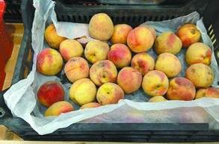
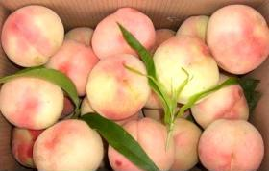
shopping words
These peaches are cheap.
These peaches are expensive.
1 yuan a kilo
5 yuan a kilo
How much are these peaches?

Slide 22
shpping tasks

Slide 23
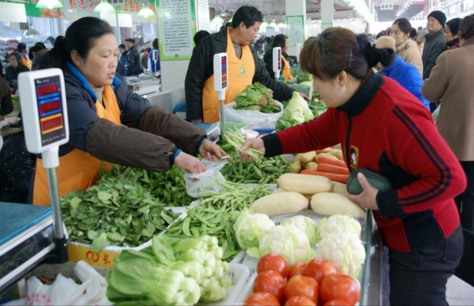
shopping in a market

Slide 24

shopping task 1
Buy things on the shopping list.
Make a short
conversation in pairs.
One salesperson,
one costumer.
shopping list
4 tomatoes
5 potatoes
2 lemons

Slide 25


shopping task 2
What fruits does your mother like? Now buy them in the market.
Makes a conversation between you and a salesperson.
My mother's
favourite fruits

Slide 26

Take care of our parents
Be polite while shopping
Summary
Learn words in groups
What can I do for you?
I'd like to buy.../ I want...
How much...?
How many...?
Here's the money.
Thank you. You're welcome
please
fruits vegetables...
costomer salesperson
cheap expensive

Slide 27
Homework
What's your father's favourite food?
Make a shopping list first and write down a conversation between you and the salesperson.

Slide 28
Nitrates are used as preservatives in food manufacture.
硝酸盐在食品加工业中被用作防腐剂。
Preserved food
腌制食品

