Slide 1
Unit 9
Seeing the doctor
WWW.PPT818.COM

Slide 2
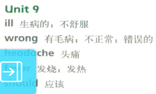
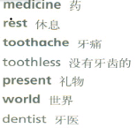
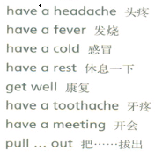
UNIT 9
Seeing the doctor

Slide 3
UNIT 9
Seeing the doctor
You should take some medicine.
你应该吃药。
You shouldn't go to bed late.
你不应该睡觉晚。

Slide 4
UNIT 9
Seeing the doctor
情态动词should--应该，should后跟动词原型，否定式shouldn't--不应该。
PPT模板：www.1ppt.com/moban/ PPT素材：www.1ppt.com/sucai/
PPT背景：www.1ppt.com/beijing/ PPT图表：www.1ppt.com/tubiao/
PPT下载：www.1ppt.com/xiazai/ PPT教程： www.1ppt.com/powerpoint/
资料下载：www.1ppt.com/ziliao/ 范文下载：www.1ppt.com/fanwen/
试卷下载：www.1ppt.com/shiti/ 教案下载：www.1ppt.com/jiaoan/
PPT论坛：www.1ppt.cn PPT课件：www.1ppt.com/kejian/
语文课件：www.1ppt.com/kejian/yuwen/ 数学课件：www.1ppt.com/kejian/shuxue/
英语课件：www.1ppt.com/kejian/yingyu/ 美术课件：www.1ppt.com/kejian/meishu/
科学课件：www.1ppt.com/kejian/kexue/ 物理课件：www.1ppt.com/kejian/wuli/
化学课件：www.1ppt.com/kejian/huaxue/ 生物课件：www.1ppt.com/kejian/shengwu/
地理课件：www.1ppt.com/kejian/dili/ 历史课件：www.1ppt.com/kejian/lishi/

Slide 5
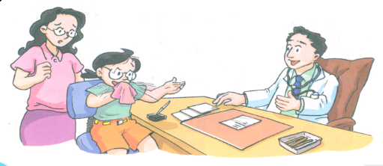
UNIT 6
Listen and say

Slide 6
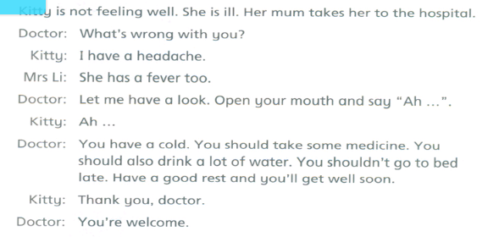
UNIT 6
Listen and say

Slide 7
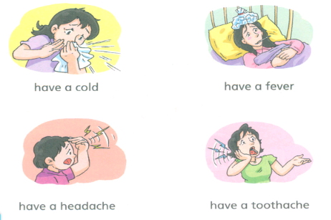
UNIT 9
Look and learn

Slide 8
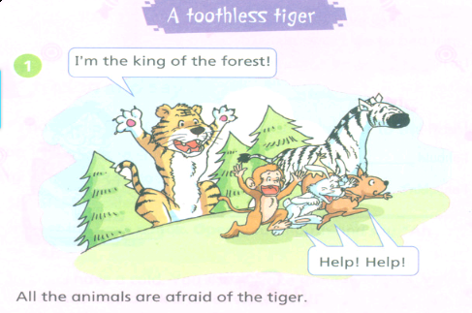
UNIT 9
Read a story

Slide 9
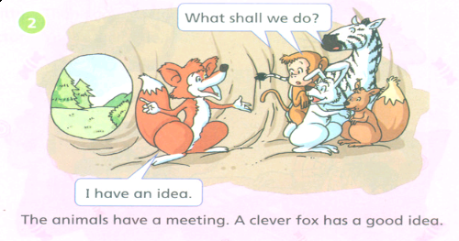
UNIT 9
Read a story

Slide 10
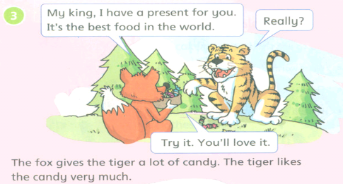
UNIT 9
Read a story

Slide 11
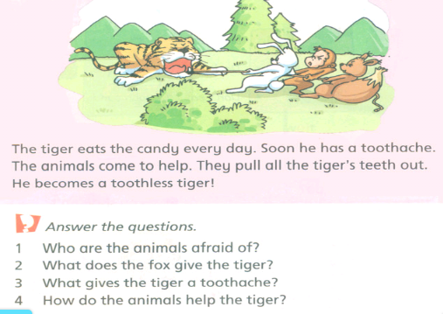
UNIT 9
Read a story

Slide 12
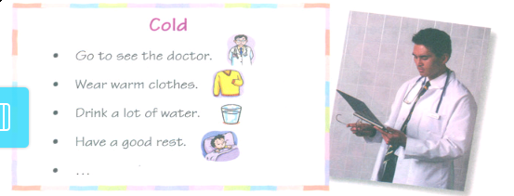
UNIT 9
Ask and answer

Slide 13
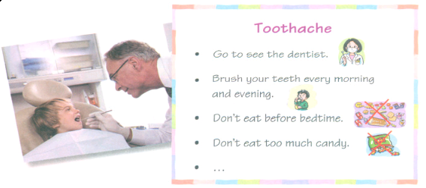
UNIT 9
Ask and answer

Slide 14
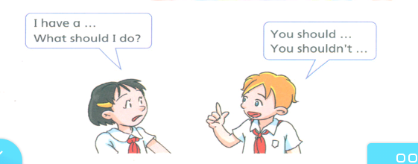
UNIT 9
Ask and answer

Slide 15
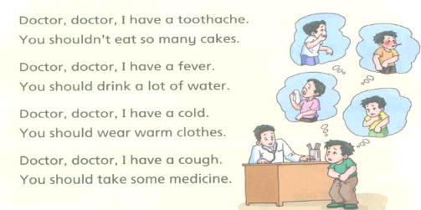
UNIT 9
Listen and enjoy

Slide 16
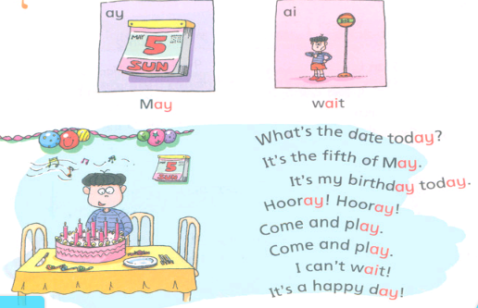
UNIT 9
Learn the sounds

Slide 17
UNIT 9
Learn the sounds
音标学习
ay-[ei] ai-[ei]

Slide 18
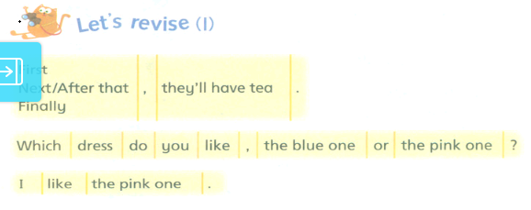
Revision 3

Slide 19
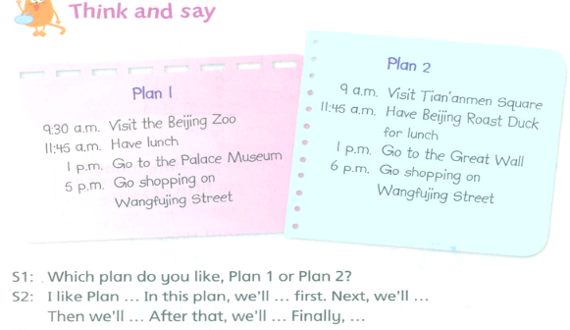
Revision 3

Slide 20
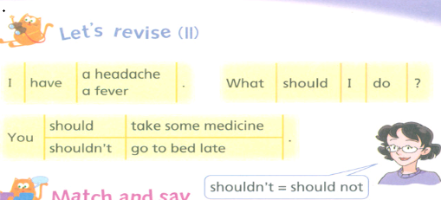
Revision 3

Slide 21
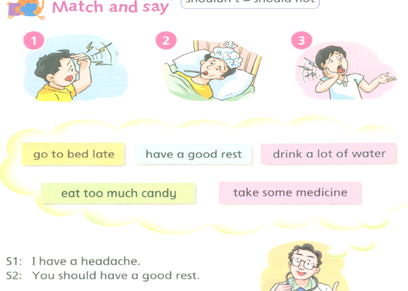
Revision 3

Slide 22
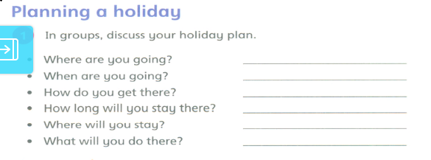
Project 2

Slide 23
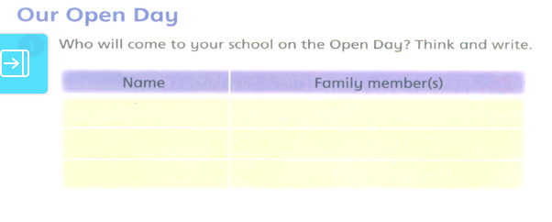
Project 3

Slide 24
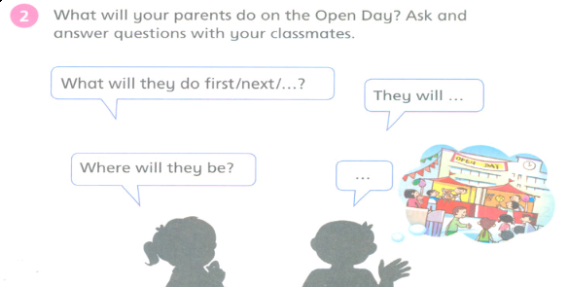
Project 3

Slide 25
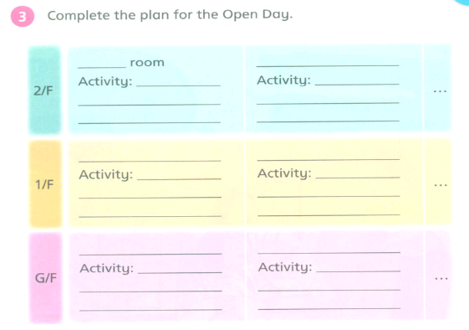
Project 3

Slide 26
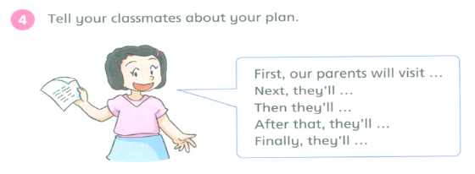
Project 3

Slide 27
THANK
YOU

