Slide 1
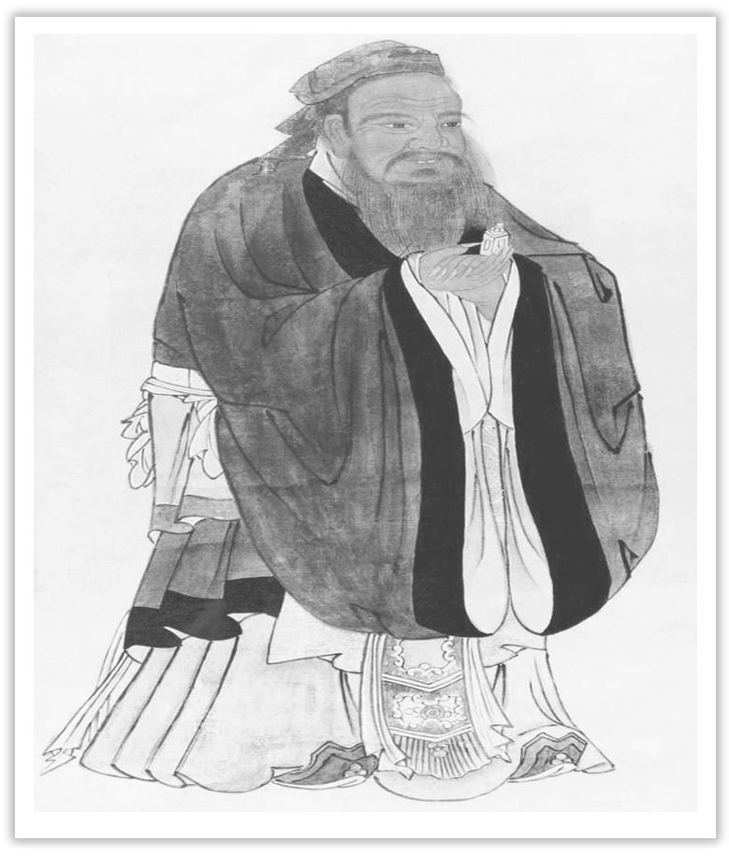
Unit 4 History and Traditions
Section Ⅵ The Rest Parts of the Unit(P_{42～48})
WWW.PPT818.COM

Slide 2
Ⅰ.单词语境记忆——根据英汉提示写出单词的适当形式
1.He finally found a hotel at the corner of the street ____________(收费)60 dollars for a single room with bath.
2.He formally ____________(宣布)on Thursday his intention to retire in January 2020.
3.The experiment shows that proper ____________(数量)of exercise, if carried out regularly, can improve our health.
charging
announced
amounts

Slide 3
4.In order to ____________(确保)the project’s completion on schedule, two experts were hired to watch out the building when it was being built.
5.Tourists shall observe public order and respect local ____________(风俗), cultural traditions and religious beliefs.
6.As soon as he saw his girlfriend Helen, Jack made his way through the crowd to ____________(迎接)her.
7.Sales director is a ____________(职位)where communication ability is just as important as sales skills.
ensure
customs
greet
position

Slide 4
8.Maybe you have travelled to many parts of the world, but nowhere else can you see such ____________(strike)attractions.
9.And when they do what you want them to do, praise them ____________(generous).
10.Absorbed in painting, John didn’t notice evening ____________(approach).
striking
generously
approaching

Slide 5
Ⅱ.句式语境仿写
1.The peaceful landscape of the “Emerald Isle” and its many green counties is a true feast for the eyes, with its rolling green hills dotted with sheep and cattle.
“绿宝石(爱尔兰)岛”风光宁静秀美，郡县草木葱茏，青山连绵起伏，牛羊点缀其中，堪称一场名副其实的视觉盛宴。
[仿写] 有这么优秀的老师教我们英语，我们没费劲就学得很好。
________________________________________, we had no trouble learning it well.
With such an excellent English teacher teaching us

Slide 6
2.And if you introduced yourself to a friendly face, you are more than likely to experience local culture and customs first-hand.
如果你把自己介绍给一个友好的人，你就非常有可能亲身体验当地的文化和风俗。
[仿写] 对生活持积极态度的人更容易成功。
People who have a positive attitude towards life _______________________________.
are more likely to succeed

Slide 7
记单词
语境串记多义词
1.He was in charge of the project.However, he was charged with abusing his power.
他主管这项工程，然而被指控滥用职权。
2.Finally, he adopted a different approach to approach the problem.
最终，他采用了不同的方法来处理这个问题。
3.The wall is dotted with many dots of different sizes.墙上遍布着很多大小不一的圆点。
4.A crowd of passengers crowded in, making the carriage more crowded.
一群乘客涌进来，让车厢更加拥挤。

Slide 8
句型公式
1.“with＋宾语＋宾语补足语”构成的复合结构。
2.主语＋be likely to do...

Slide 9
1.charge n.收费；指控；主管vt.收费；控告；充电
Judy and I had our car parked in an underground car park near Trafalgar Square, where we could get our car battery charged.(教材P₄₂)
朱迪和我把车停在特拉法加广场附近的一个地下停车场，在那里我们可以给车充电。
[合作探究] 体会charge的用法和意义
I wonder how much you will charge me for the six-week course.
我想知道这为期六周的课程您向我收费多少。

Slide 10
The man who had taken charge of the company was charged with taking drugs.
曾经掌管这家公司的那个人被指控吸毒。
Being left in charge of the shopping center has upset him for quite some time.
被留下来负责购物中心已经让他心烦意乱了一段时间。
[自主发现]
①charge (sb) ____________ sth 为……(向某人)收费/要价
②charge sb ____________ sth 指控某人某事
③____________ 主管/看管/负责……
④______________ 主管/看管/负责……
for
with
in charge of...
take charge of...

Slide 11
[巩固内化]
(1)单句语法填空
①He charged me nothing ____________ using his phone.
②The police charged the prisoner ____________ stealing the jewels.
③Mr Li is ____________ charge of that class; that is, that class is in the charge of Mr Li.
(2)同义句转换
④The company is in the charge of Tom while the boss is away.
→Tom is ________________ the company while the boss is away.
→Tom ________________ the company while the boss is away.
for
with
in
in charge of
takes charge of

Slide 12
2.announce vt.宣布；通知；声称 announcer n.播音员，广播员 announcement n.通告，宣告
When we finally reached at the service desk to ask for audio guides, we heard it announced that there were no audio guides left.(教材P₄₂)
当我们最后到达服务台询问音频指南时，我们听到它被宣布没有了。
[合作探究] 体会announce及其派生词的用法和意义
They officially announced the news to the reporters.
他们正式向记者发布了这条新闻。

Slide 13
One day with a basket of vegetables, he announced to us that he was going to cook a dish.一天他带着一篮子的蔬菜，向我们宣布他将烹调一道菜。
The announcer made an announcement that all the details should be announced through the broadcast.广播员宣布所有的细节都应通过广播宣布出来。
[自主发现]
①announce sth ____________ sb(＝announce to sb sth) 向某人宣布某事
②announce(to sb)that... (向某人)宣布……
③____________ an announcement that... 宣布……
to
make

Slide 14
[思考] 动词announce后不跟双宾语，表示“向某人宣布某事”时，应该说announce sth to sb或announce to sb sth。类似用法的单词还有哪些？
________________________________________________________________________
[巩固内化] 单句语法填空
①We have launched another man-made satellite, which ____________(announce)in today’s newspaper.
②Jobs’ ____________ (announce) wasn’t surprising, considering his long struggle with cancer.
suggest, explain, report, say等。
is announced
announcement

Slide 15
3.amount n.数量
We found ourselves very surprised by the large number of visitors and the amount of noise at the entrance of the National Gallery.(教材P₄₂)
我们发现自己被这么多游客和国家美术馆入口处大量的噪音惊呆了。
[合作探究] 体会amount的用法和意义
A large amount of damage was done to the city in a very short time, which shocked everyone on the spot.
短时间内，这个城市受到了大量的损坏，这震惊了在场的每个人。
Large amounts of money were spent on the bridge.建造这座桥花费了大笔的钱款。
It’s estimated that the cost amounts to 10，000 dollars.据估计成本总计为1万美元。

Slide 16
[自主发现]
①a large amount of/ large amounts of...意为：________，其后常常接________名词。
②“a large amount of＋不可数名词”作主语时，谓语动词用________数；
“large amounts of ＋不可数名词”作主语时，谓语动词用________数。
③amount to ____________
很多
不可数
单
复
总计为……

Slide 17
[思考] 归类“大量的”短语
①________________只能修饰不可数名词；
②________________只能修饰可数名词复数；
③__________________________________既可以修饰可数名词，也可以修饰不可数名词。
[巩固内化] 单句语法填空
①A large amount of money ____________ (spend) on books every month.
②Large amounts of time ____________ (need) in dealing with the problem.
a great deal of
a large number of
a lot of, plenty of, a large quantity of
is spent
are needed

Slide 18
4.approach n.方法；途径；接近vt.接近；接洽；着手处理vi.靠近
Judy had her eyes fixed on Van Gogh’s Sunflowers.It was hard to approach the painting as there were so many people around.(教材P₄₂)
朱迪注视着梵高的《向日葵》，但很难接近这幅画，因为周围有那么多人。
[合作探究] 体会approach的用法和意义
All the approaches to the airport were blocked by the police.
所有通往机场的道路都被警察封锁了。
At the approach of the cinema, he stopped and waited for his friends.
在快到电影院时，他停下来等他的朋友。

Slide 19
Yesterday we held a meeting and made an approach to the low-carbon lifestyle.
昨天我们召开了一个会议，对低碳生活进行了探讨。
As Teachers’ Day was approaching, our class decided to hold a party to celebrate the important day for a change this year.随着教师节的临近，今年我们班决定换一种方式举行一场晚会来庆祝这个重要的节日。
[自主发现]
①the approach ____________... 通往……的道路；……的方法
②at the approach ____________ 在快到……的时候
③____________ an approach to 对……进行探讨
to
of
make

Slide 20
[思考] 请想一下approach，way，means，method等在表示“做……的方法时”各自的搭配分别是什么？试完成下列短语。
①the approach ____________ sth
②the way ____________ sth
③the means ____________ sth
④the method ____________ sth
to doing
to do/of doing
of doing
of doing

Slide 21
[巩固内化]
(1)单句语法填空
①With spring ____________(approach), many cold-blooded animals are coming out to hunt food.
②Everyone has their own approach to ____________ (deal)with them.
(2)补全句子
③We will be exploring _____________________________________________.
我们将探索收集信息的不同方法。
approaching
dealing
different approaches to gathering information

Slide 22
5.crowd n.人群；一群人；民众vt.挤满；使……拥挤 crowded adj.拥挤的；挤满的；充满的
Dave could not find a seat in the room.It was very crowded.(教材P₄₆)
戴夫不能在屋子里找到座位，太挤了。
[合作探究] 体会crowd的用法和意义
A crowd of children were passing my house, singing and laughing.
一群孩子唱着笑着经过了我的房子。
Crowds of people poured into the street.人们成群结队地涌向街头。
Too many uncomfortable thoughts were crowding in on her.
太多的烦心事涌上她的心头。

Slide 23
After seeing the report, problems about the company crowded into my mind.
看了这份报告后，很多有关公司的问题涌入我的脑海。
The room was crowded with his friends.房间里挤满了他的朋友。
[自主发现]
①a crowd of ____________
②crowds of ____________
③crowd in ____________ sb (想法、问题等)涌上心头；涌入脑海
④crowd ____________ one’s mind 涌入某人的脑海
⑤be crowded ____________ 挤满……；充满着……
一群……
成群……
on
into
with

Slide 24
[思考] crowd是集合名词，作主语时，该如何使用其谓语动词的形式？
________________________________________________________________________
[巩固内化] 补全句子
①Memories ________________________________ when I saw the photo.
当我看到这张照片时，往事一齐涌入我的脑海。
②The hall __________________________________ his devoted fans.
大厅中挤满了他的忠实粉丝。
③_____________________________________ lined the streets to welcome their hero.
成群的人们排列街头，欢迎他们的英雄。
若视为整体则谓语动词用单数，若强调个体成员，则谓语动词用复数形式。
crowded into my mind
was crowded with
Crowds of people

