Slide 1
Module 4 Seeing the doctor Unit 1 I haven’t done much exercise since I got my computer.
WWW.PPT818.COM

Slide 2
Step 1: Warm-up
Guessing game
What are they?
They are doctors.

Slide 3
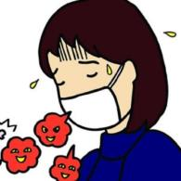
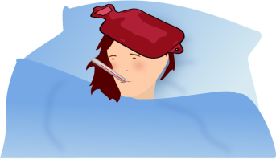
Step 1: Warm-up
What’s the matter with him/her?
He/ She has a …
cough n. /v. 咳嗽
cold n. 感冒
fever n. /v. 发烧

Slide 4
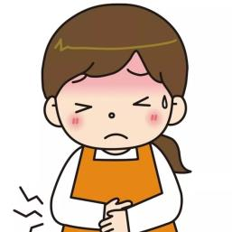
Step 1: Warm-up
toothache n. 牙疼
stomach ache n. 胃疼
headache n. 头疼

Slide 5
Step 2: Pre-listening
观察以下单词的构成：
tooth+ ache = toothache （牙痛）
stomach+ache = stomach ache （胃痛）
名词后缀-ache表示部位疼痛
head+ache = headache （头疼痛）
Can you write the words according to the pictures?
backache (背疼)
legache (腿疼)
armache (胳膊疼)

Slide 6
Step 2: Pre-listening
2
Listen and check (√) what’s wrong with Betty and Daming.
 | cough | fever | headache | stomach ache | toothache
Betty
Daming
√
√
√
√
√

Slide 7
Step 3: While-listening
3
Listen to 3 and mark T(True) or F(False).
1. Daming has been ill for about three days. ( )
2. Daming caught a cold. ( )
3. Daming never has fast food. ( )
4. Daming usually has breakfast on time. ( )
5. Daming’s head hurts because he spent too much
time in front of the computer. ( )
T
F
F
F
T

Slide 8
Step 4: Post-listening
3
Read 3 silently and complete the table about Daming.
Illness
How long
Why
What to do
stomach ache and headache
Since Friday.
Fast food and no breakfast. Spend too much time in front of the computer.
Stop eating fast food and have breakfast every day. Get some exercise.

Slide 9
Step 3: Post-listening
Language points
1. —How long have you been like this? 像这样的情况多久了？
—Since Friday. 自周五以来。
（1）since 作介词时，与完成时连用，意思是“自……以来；自从”。如：
He has lived here since 1992. 他从1992年以来一直住在这里。
（2）since作连词时，有以下用法：
①与完成时连用，意思是“自……以后”，其后面引导含一般过去时态的从
句。如：
I have written home but once since I came here. 我到这里以后只写过一次家信。

Slide 10
Step 3: Post-listening
②用于“It’s + 时间段+since+ 一般过去时态的句子”句型。如：
How long is it since you were in London? 你在伦敦多久了？
◆现在完成时中常用的时间状语for和since。区别如下：
I have been waiting for two hours.
for+一段时间

Slide 11
Step 3: Post-listening
I have been waiting since 8’o clock.
【注意】当since与完成时态连用时，主句中的谓语动词不能用非延续性动词。如：come, go, begin, start, die, buy, borrow, sell等。
since+时间点
2. Let me take your temperature. 让我来给你量下体温。
take sb’s temperature 表示“量某人的体温”。如：
I took my temperature last night. 我昨晚量了下我的体温。

Slide 12
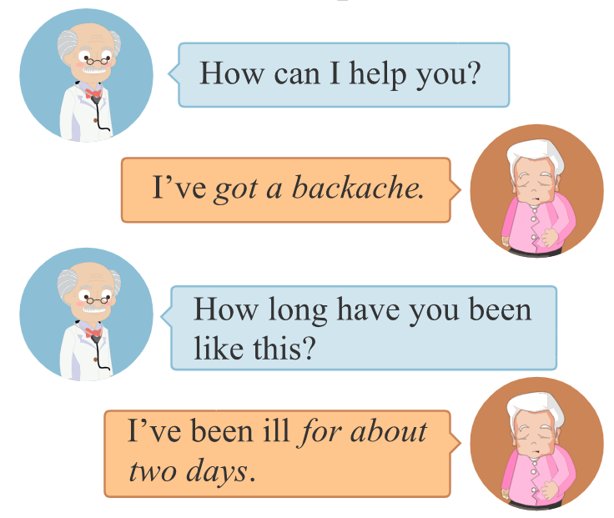
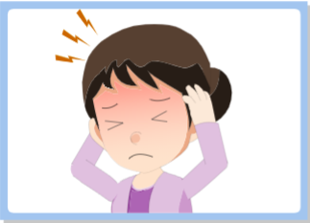
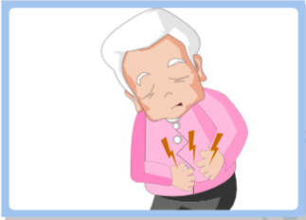
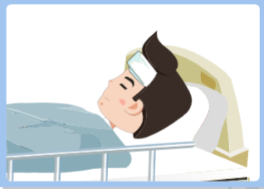
Step 4: Post-listening
Pair work
Act out a conversation between a doctor and a patient.

Slide 13
Step 5: Homework
Homework
1. Practice role-playing 3.
2. Make a conversation between a doctor and a patient.

Slide 14
Thank you!

