Slide 1


Unit 2
Let’s colour it.
WWW.PPT818.COM

Slide 2
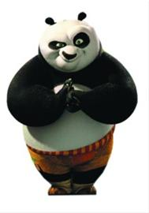
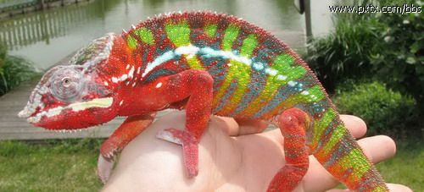
My name is Panpan. Look at me,I’m black and white.
Good morning, I’m a chameleon.
What’s your name?

Slide 3

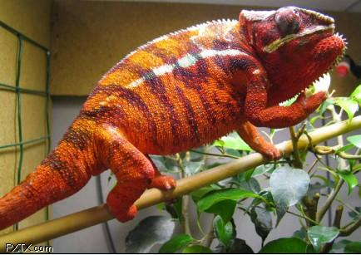
Look at me,I’m red!
red

Slide 4

Look at me,I’m blue.
blue

Slide 5
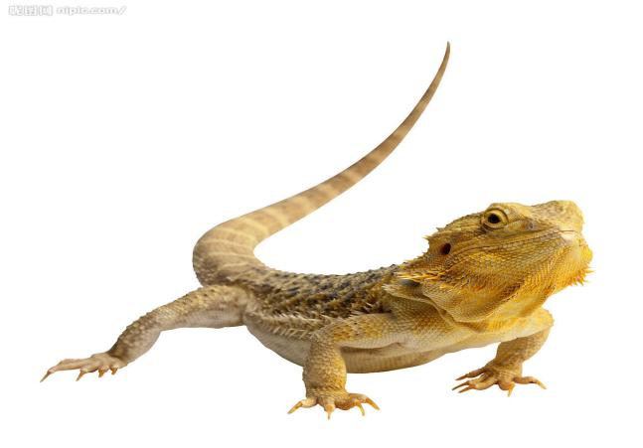
Look at me,
I’m yellow.
yellow

Slide 6
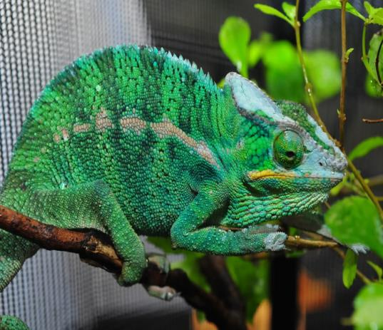
Look at me,
I’m green !
green

Slide 7
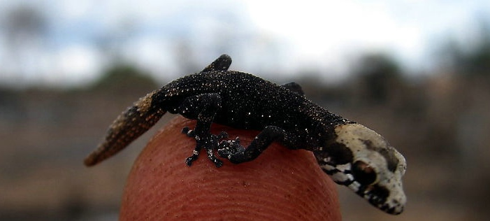
Look at me,
I’m black !
black

Slide 8
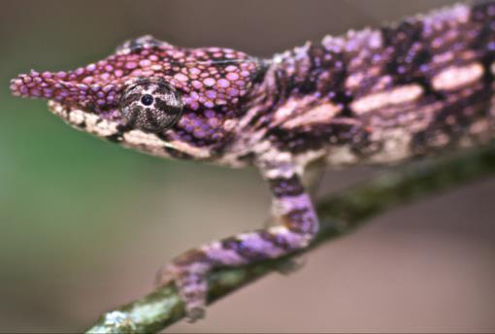
Now， it’s purple.
purple

Slide 9
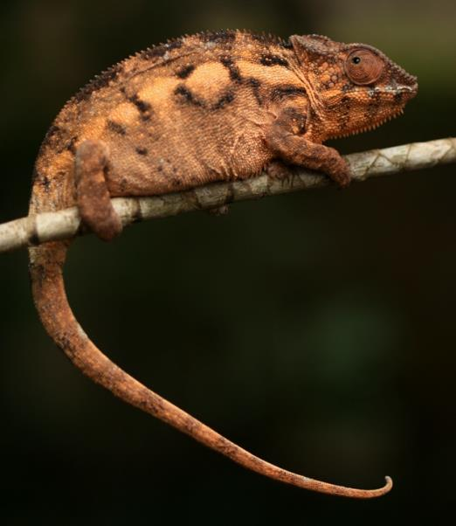
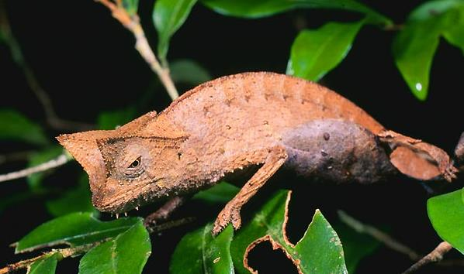
Look at me,
I’m brown.
brown

Slide 10
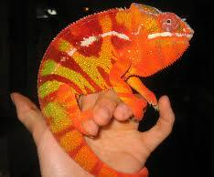
Look at me,
I’m orange.
orange

Slide 11
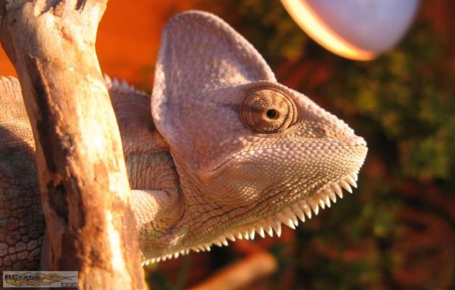
Oooh!
It’s white.
white

Slide 12

Now， I’m red, blue, yellow and green.
Oooh!
That’s good!
……..

Slide 13
blue
red
yellow
green
black

Slide 14
purple
white
orange
brown
black

Slide 15
black , black , It ’s black.
brown , brown , It ’s brown .
green , green , It ’s green.
purple , purple , It ’s purple .
orange , orange , It ’s orange .
。。。？

Slide 16


Let’s colour…
Let’s +colour +物品 +颜色。
the +

Slide 17
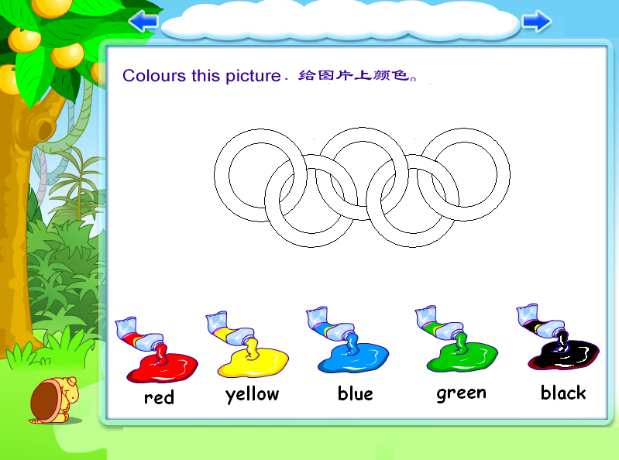

black
red
blue
yellow
green

Slide 18
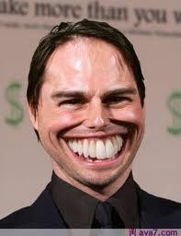
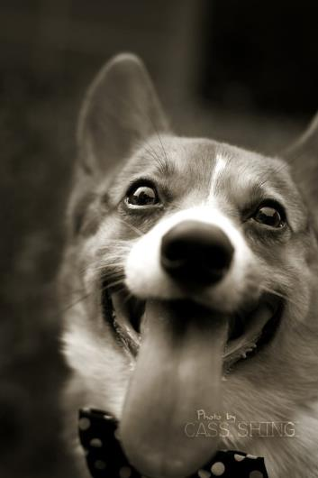
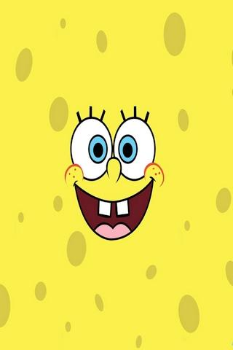
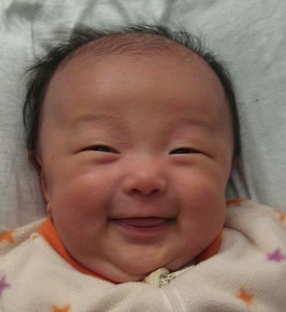
funny 有趣的
a funny face

Slide 19
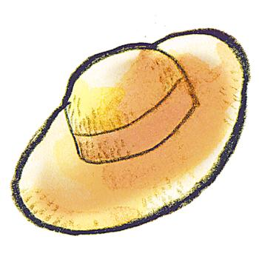
a yellow hat
hat 帽子

Slide 20
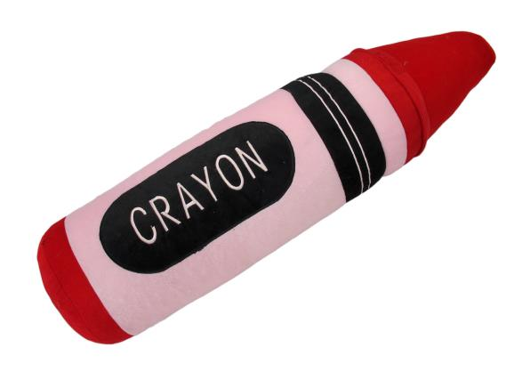
Crayon 蜡笔
a red crayon

Slide 21
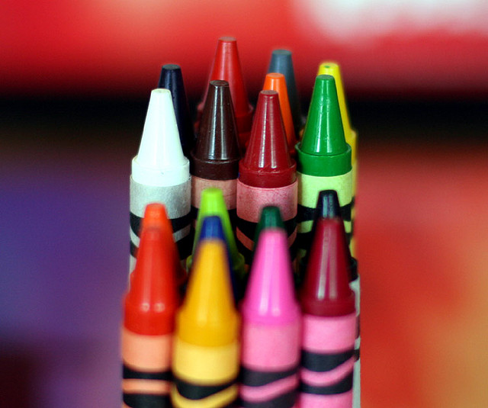
Crayons
black , black , I have a black crayon.
brown , brown , I have a brown crayon .
green , green , I have a green crayon .
purple , purple , I have a purple crayon .

Slide 22
Let’s talk
Q1: Who are they?
The girl is… ,and the boy is… .
Q2:他们先完成了什么的涂色？找出相应的句子划线。
Q3：看图片，你能建议他们接下来要做什么吗？
Let’s colour the 。。。+red/ blue/ brown…

