Slide 1
Unit 5 The Value of Money
Section Ⅰ Listening and Speaking
WWW.PPT818.COM

Slide 2
主题语境——人与社会之文学、艺术与体育
【语境概说】 本单元的主题语境为人与社会的文学、艺术与体育。本单元主要涉及小说、戏剧、诗歌、传记、文学简史、经典演讲、文学名著等。该主题与学生学习和生活密切相关，在此主题意义引领下，引导学生理解戏剧语言(人物语言和舞台说明)，进而分析人物的性格特点和戏剧冲突等，有助于刺激学生发散思维，提高思维缜密程度、思维广度和思维深度，培养创新思维和批判思维等思维品质；同时，扩大学生的视野，极大丰富学生的文化常识，提高文学欣赏水平；并通过语篇学习和戏剧表演等方式，帮助学生建立正确的人生观和价值观。

Slide 3
Not possession，but use，is the only riches.致富之道不在于所有，而在于使用。
He is richest who is content with least，for content is the wealth of nature.
少量即可满足的人是最富有者，因为满足是自然的财富。
When wealth is centralized the people are dispersed；when wealth is distributed the people are brought together.财聚则民散，财散则民聚。

Slide 4
1.Translate the following words and phrases.
①basis n. __________________
②on the basis of ________________
③loan n. ____________
④take out a loan ____________
基础；根据；基点
在……的基础上
贷款；借款
取得贷款

Slide 5
⑤apologise vi. ____________
⑥ignore vt. ____________
⑦in return ____________________
⑧plastic n. ____________
adj. ____________
⑨judge vt.& vi. __________________
n. ______________________
道歉；谢罪
忽视
作为回报；作为回应
塑料
塑料制的
评价；评判；判断
法官；审判员；裁判员

Slide 6
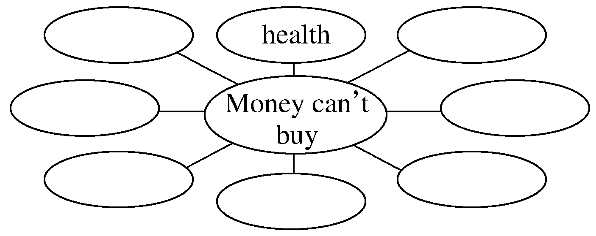
2.Brainstorming：What do you think money can’t buy?
happiness，love，friendship，respect，dream，courage，belief etc.
________________________________________________________________________

Slide 7
3.Look at the picture on Page 49 and tell your classmates what they are doing?
__________________________________________________________________
4.Finish Ex.1 on Page 50.
They are looking at the million pound bank note.

Slide 8
5.Try to translate the sentence in various ways.
我相信他什么都知道。
①_____________________________________________________________
②_____________________________________________________________
③_____________________________________________________________
④_____________________________________________________________
⑤_____________________________________________________________
I think that he knows everything.
I bet that he knows everything.
I dare say that he knows everything.
I believe he knows everything.
I suppose he knows everything.

Slide 9
1.Finish Ex.2 & Ex.3 on Page 50.
2.Finish Ex.4 on Page 50.

Slide 10
1.Speaking—Finish Ex.5 on Page 50 by following the example.
A：What kind of person do you think Chen Liyan is?
B：I think she must be an honest person because...
A：I bet she’s really determined too.You can tell this by how...

Slide 11
2.Pronunciation
①I understand.↘
②Beijing is the capital of China.↘
③There is a book on the desk.↘
④What do you want to eat？↘
⑤How much is a hamburger？↘
⑥A：I bought this dress for 500 dollars.↘
B：500 dollars！↘
⑦A：Am I going to have a birthday party？↗
B：Yes，↘you are.↘ / No，↘ you can’t.↘

Slide 12
语言知识积累
表示推测的常用表达
1.I think that...
2.I bet that...
3.I dare say that...
4.I believe that...
5.I suppose that...

Slide 13
文化知识习得
《百万英镑》的内容简介
《百万英镑》是美国作家马克·吐温创作的中短篇小说，发表于1893年。讲述了一个穷困潦倒的办事员美国小伙子亨利·亚当斯在伦敦的一次奇遇。 伦敦的两位富翁兄弟打赌，把一张无法兑现的百万大钞借给亨利，看他在一个月内如何收场。一个月的期限到了，亨利不仅没有饿死或被捕，反倒成了富翁，并且赢得了一位漂亮小姐的芳心。文章以其略带夸张的艺术手法再现大师小说中讽刺与幽默，揭露了20世纪初英国社会的拜金主义思想。

Slide 14
学习策略形成
1.学会用不同的句式表达推测。
2.学会用语调突出表达的内容。
语调(intonation)
即说话的腔调，就是一句话里声调高低抑扬轻重的配置和变化。英语的基本语调包括升调(↗)和降调(↘)。
1.降调：其基本含义是“结束”、“肯定”。常见的一般陈述句、命令祈使句和特殊问句都用降调。
2.升调：其基本含义是“没有结束”或“不肯定”。常见的一般疑问句用降调。

Slide 15
1.base n.基础；基地 vt.以……为基础；基础设在…… basis n.根据；基础
[合作探究] 体会basis的用法和意义
Many pictures have been based on simple geometric designs.
许多画都是基于简单的几何图案。
I hope the trade between us will further develop on the basis of equality and mutual benefit.我希望我们之间的贸易将在平等互利的基础上进一步发展。
[自主发现]
①________________ 以……为基础；以……为根据
②________________ 在……的基础上；根据……
be based on
on the basis of

Slide 16
[巩固内化] 同义句转换
The film True Story，which is on the basis of a true story，attracts fans’ attention all over the country.
→The film True Story，which ________________________ a true story，attracts fans’ attention all over the country.
is based on

Slide 17
2.apologise (＝apologize) vi.道歉；谢罪 apology n.道歉，致歉
[合作探究] 体会apologise的用法和意义
You must apologize to her for having kept her waiting.
让她等了这么久，你应该为此向她表示歉意。
He made/offered an apology to the public for the team’s performance.
他就队伍的表现公开道歉。
You owe him an apology for what you said.
你要为你所说的话向他道歉。

Slide 18
[自主发现]
①____________________________ 为(做了)某事向某人道歉
②make/offer an apology to sb for (doing) sth ________________________
③________________ 应向某人道歉
apologize to sb for (doing) sth
为(做了)某事向某人道歉
owe sb an apology

Slide 19
[巩固内化] 一句多译/补全句子
①他因迟到向客人道歉。
→He ________________ the guests ____________ being late.
→He ____________________________ the guests ____________ being late.
②I really __________________________ having lost your letter.
丢了你的信我该向你道歉。
apologised to
for
made/offered an apology to
for
owe you an apology for

Slide 20
4.in return作为报答；作为回应；反过来，作为交换
When we help someone，should we expect to get something in return？(教材P₅₁)
当我们帮助别人时，我们是否应该期望得到回报？
[合作探究] 体会in return的用法和意义
①This poem describes the painful feelings of a man in love with someone who does not love him in return.
这首诗描述了一个男人爱上了一个____________并不爱他的人的痛苦。
反过来

Slide 21
②He helped me，and I hoped that I would do something for him in return.
他帮助了我，我希望为他做点什么来____________他。
③The girls called out their names in turn.
那些女孩儿____________报出自己的名字。
[自主发现]
④________________ 逐一；依次
报答
逐一
in turn

Slide 22
[巩固内化] 补全句子
①He gave her some roses ________________ for her kindness.
②He is always helping others without expecting anything ________________.
③The teacher told us to come in ________________.
in return
in return
in turn

Slide 23
4.judge v.判断；评价；评判 n.法官；审判员；裁判员
Should we judge people based on how much money they have？(教材P₅₁)
我们应该根据人们有多少钱来评判他们吗？
[合作探究] 体会judge的用法和意义
A man should be judged by his deeds，not his words.
判断一个人应根据他的行动，而不是他的言词。
Judging by his accent，he must be from the South.
从他的口音判断，他一定是南方人。

Slide 24
[自主发现]
①judge...by... ________________
②________________ 根据……判断
[巩固内化] 补全句子
①It is only shallow people who _____________ (根据……做出判断) appearances.
②___________________________ (从他说的情况来看)，they ought to succeed.
根据……判断
judging by/from
judge by
Judging from what he said

