Slide 1
陕旅版四年级上册
Unit5 Our School 第1课时
WWW.PPT818.COM

Slide 2
教学目标：
1. 理解会说会用会写以下单词和短语：library，garden，playground，toilet，teachers’ office，school gate
2. 能准确理解本课对话内容，并能在实际生活中和别人进行交流。

Slide 3
Let’s sing—Farmer Joe Has a Farm

Slide 4
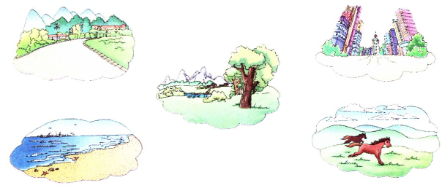
Think and circle
Where is your school?

Slide 5
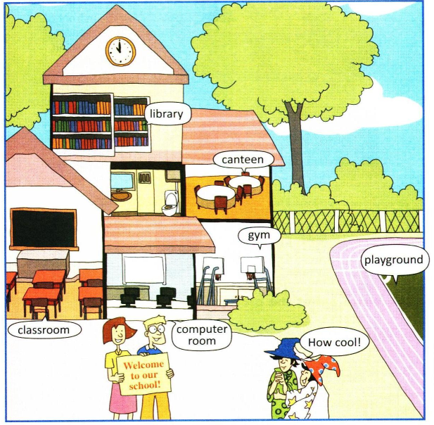
看一看，这所学校里都有什么？

Slide 6
Let’s learn
library

Slide 7
garden

Slide 8
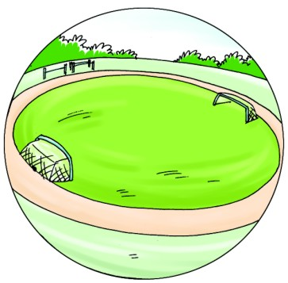
playground

Slide 9
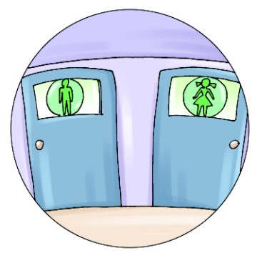
toilet

Slide 10
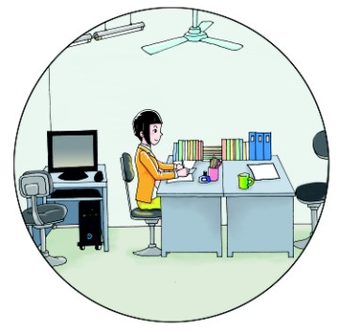
teachers’ office

Slide 11
知识小贴士
学习单词teachers’ office时要注意teachers’是名词所有格，意思是“教师的”。

Slide 12
school gate

Slide 13
Practise
听单词，选择正确的选项
A. office
B. toilet
C. library
A. teacher
B. farmer
C. computer

Slide 14
Gold finger
library garden playground toilet teachers’ office school gate

