Slide 1
I have a ball.
第4课时
WWW.PPT818.COM

Slide 2
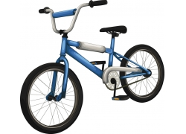
Peter has a new bike, and Yang Ming wants to have a look at it.
Peter
Yang Ming

Slide 3
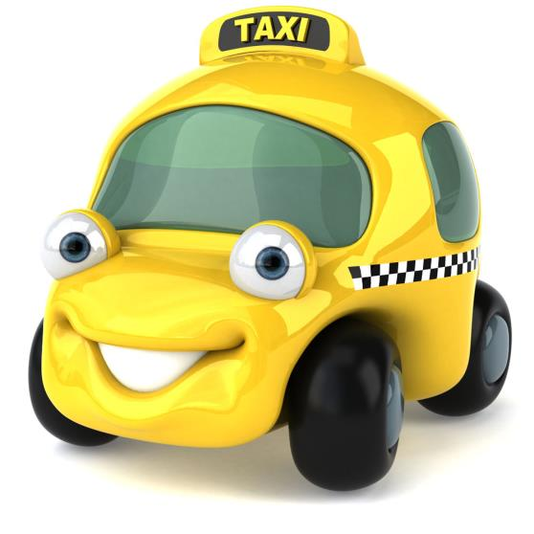
taxi
I have a new taxi.

Slide 4
bike
I have a new bike.

Slide 5
train
I have a new train.

Slide 6
Taxi, taxi. I have a new .
Bike, bike. I have a new .
I have a new .

Slide 7
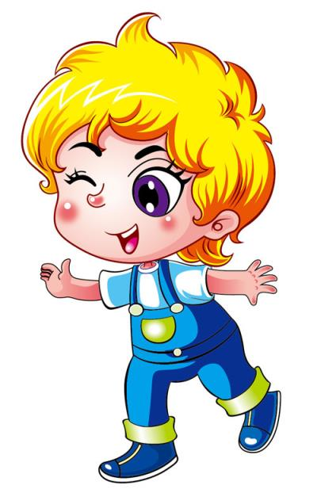
Hi, Yang Ming!
I have a new bike.

Slide 8
Really? Can I see it?

Slide 9
Sure!

Slide 10
Peter: Hi, Yang Ming! I have a new bike.
Yang Ming: Really? Can I see it?
Peter: Sure!

Slide 11
Let’s chant
I have a new .
Nice, nice, nice!
I have a new .
Cool, cool, cool!
I have a new .
Super, super, super!

Slide 12
Homework
1.Practise the chant again.
2.Use I have a... to make sentences.

Slide 13
Thank You.

