Slide 1
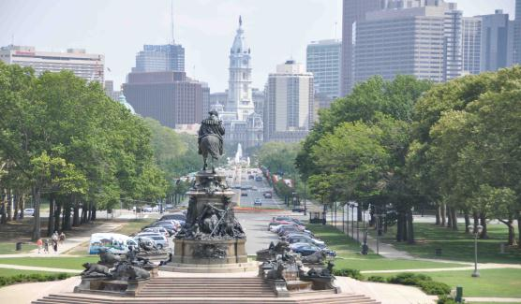
Module 7 Summer in Los Angeles
Unit 1 Please write to me and send me some photos!
WWW.PPT818.COM

Slide 2
1 给某人写信
2 为……做准备
把东西准备好
3 列清单
4 狂热于
发疯
5 “疑问词+不定式”结构
6 在……的结尾/末端
7 短裤
长裤 +动词复数
太阳镜
穿薄裤子
8 支付……的费用；为…..付款
支付机票钱
花多少钱买某物
1 write to sb =write a letter to sb
2 prepare for
get things ready
3 make a list ( of )
4 be crazy about
go crazy
5 what to take = what I should take
6 at the end of
7 shorts trousers sunglasses
a pair of shorts / trousers /sunglasses
wear light trousers
8 pay for
pay for the air ticket
pay some money for sth

Slide 3
9 动词 重量有……，重……
名词 重量
长胖
减肥
表示时间，金钱，重量，
路程的名词作主语时，+V单
10 最好干某事
11 旅行公司
12 总重量
13 顺便说一下，顺便问一下
14 忘记干过某事
忘记去干某事
别忘了带护照。
15 玩得高兴，过得愉快
9 weigh
How much do you weigh?
Please weigh the bananas.
weight
put on weight
lose weight
10 had better do sth
11 travel company
12 total company
13 by the way
on one’s way to +地点
on my way to school
14 forget doing sth
forget to do sth
Don’t forget to take your passport.
Have a good / great time
= enjoy oneself

Slide 4
1 请给我写信并寄给我一些照片。
2玲玲正在为她的洛杉矶之旅做准备。
3 我正在列旅行用品清单。
4 我喜欢稍早点把东西准备好。
5 听起来荒唐，但我不知道带什么。
6我要在七月底离开，打算在哪儿待四周。
Please write to me and send me some photos.
Lingling is preparing for her trip to LA.
I’m making a list of things for my trip.
I like to get things ready earlier.
It sounds crazy, but I don’t know what to take.
I’m leaving at the end of July and I’m going to stay there for four weeks.

Slide 5
7 短裤很好，或者你可以穿轻薄的裤子。
8如果你已经付过机票钱和家庭寄宿费了，那就应该够了。
9 你的包一定不要太重。
10 你最好询问一下旅行社你所有包总重量的事。
11 顺便说一下， 别忘了带你的护照。
Shorts are good, or you can wear light trousers.
If you’ve already paid for the air tickets and for homestay, it should be OK.
Your bag mustn’t weigh too much.
You’d better ask the travel company about the total weight for all your bags.
By the way ,don’t forget to take your passport.

Slide 6
English Standard link 课标链接
能够运用所学词汇描述关于出国短期学习的对话；在生活中接触英语时，乐于探究并尝试模仿；能在老师的指导下参与角色表演等活动，注意使用正确的语音、语调及重读。

Slide 7
Learning aims
Memorize 10 words and 2 key phrases in M7U1; can understand conversations about holiday trips.
Can get specific information from a conversation on a person’s trip by listening practice, self-study and group work.
3. Get to know the famous universities all over the world. Define the importance of learning English.

Slide 8
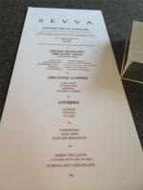
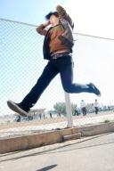
New words
shorts n. 短裤
list n. 名单; 清单
crazy adj. 发疯的，荒唐的

Slide 9
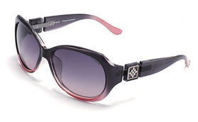
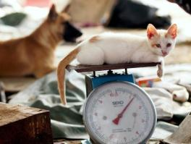
sunglasses n.
太阳镜，墨镜
trousers n. 裤子
weigh v. 重量有……, 重……

Slide 10
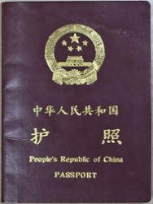
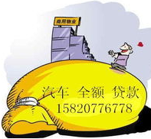
total adj.
总的，全部的
weight n.
重量
passport
n. 护照

Slide 11
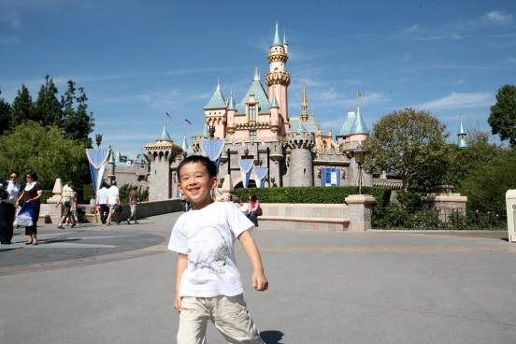
Lead in
Do you like travelling?

Slide 12
What will you take for a trip?

Slide 13
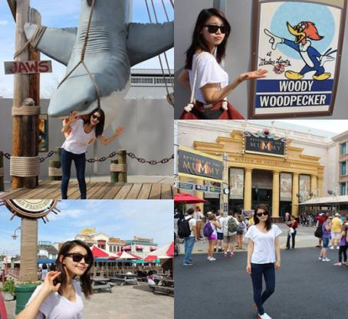
Do you want to have a trip in America?

Slide 14
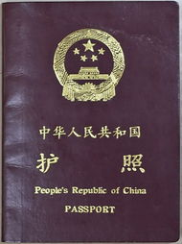
What must you take if you go to another country?
大明和玲玲也要去旅行，他们要去哪里？将要做些什么？
他们将在那里呆多长时间？多少同学一组？让我们一起来听听吧！

Slide 15
Listen and complete the notes.
Where Daming and Linging are going: _______________________
What they are going to do: _________________________________
How long they will stay: ____________________________
How many students there are in the group: _________________________
They are going to LA.
They are going to do an English course.
They’ll stay for about four weeks.
They are going in a group of 20.

Slide 16
Listening Practice
Task I. Listen to the dialogue, then answer the following questions.
1.Where is Lingling going?
2.When is Lingling leaving?
3.How long is Lingling going to stay there?
4.How much money does Lingling prepare?
Los Angeles/LA
She is leaving at the end of July.
She is going to stay there for four weeks.
200 dollars

Slide 17
Task II.Listen and fill the blanks .
Lingling: Hi, Betty. I’m ______ __ ____ __things for my trip. I like to get things ready earlier. Can you help me? Betty: Sure. ___ _____ ___ _____?
L: Well, it sounds crazy but I don’t know what to take.
B: You should take notebooks, pens and a _________
L: OK. What clothes should I take to LA？
B: When are you leaving and ____ ______ are you going to stay there？
L: I’m leaving ___ ____ ___ ____ July and I’m going to stay there for four weeks.
B: Shorts are good, or you can wear _____ trousers. It’ll be sunny and hot there.
making a list of
How can I help
dictionary
how long
at the end of
light

Slide 18
Pronunciation and intonation
语音和语调
Watch the video of this passage. Pay attention to your pronunciation and intonation. Try your best to imitate it.
（模仿）
ReadingPK

Slide 19
Now check (√) the things Betty suggests Linging take.
dollars 4 T-shirts 7 passport
shorts 5 pens 8 sunglasses
Jeans 6 a dictionary 9 notebooks
√
√
√
√
√
√
读完后找出Betty建议Lingling在旅行时所带的物品。然后小组内核对
答案，最后找小组的代表说出答案。

Slide 20
Cooperation and discussion
Contents:
I. Find sentences in the conversation which contains but, and, or compound sentences.
1.It sounds crazy,but I don’t know what to take.
2.When are you leaving and how long are you going
to stay there?
3.I’m leaving at the end of July and I’m going to stay
there for four weeks.
4.Shorts are good or you can wear light trousers.
II. Find sentences in the conversation which suggest that...
Can you help me?
Ling ling wants help.
2. Betty is glad to offer help.
3. Lingling asks for more help.
4. Betty tells Lingling to remember something important.
How can I help?
What else?
Oh, by the way, don’t forget to take your passport.

Slide 21
Language points
1. I’m making a list of things for my trip.
make a list “列清单“。
make a list of … “列…的清单”。
e.g. I usually make a list of things before going shopping.

Slide 22
2. I’m leaving at the end of July.at the end of … “在…的结尾，在…的末端”。
e.g. The hospital is at the end of the street.
3. Shorts are good, or you can wear light trousers.
shorts“短裤”，用复数。trousers “裤子”，用复数。另外，sunglasses表示“太阳镜”，用复数。在表示“一副、一条”时，用a pair of。
4. If you’ve already paid for the air tickets and for homestay, it should be OK.
pay for “支付…的费用, 为……付款”。
e.g. My father paid for my driving lessons.
我爸爸支付了我学车的费用。
homestay 指吃住在当地人家里，实际体验当地人的生活。

Slide 23
5. Oh, by the way, don’t forget to take your passport.
by the way “顺便说一下”，用于转入与刚才说的主题无关的事。
e.g. By the way, why not drop in for a drink?
顺便问一句，今晚来我家喝一杯怎么样？
don’t forget to do sth. “不要忘记做某事”等于remember to do sth.
e.g. Don’t forget to take your homework when you go to school tomorrow.
6. Is 200 dollars enough?
200美元够吗？
表示金钱、时间、重量或路程的名词做主语时，我们通常把它看成一个整体概念，即使它形式上是复数的，谓语动词也应该用单数形式。
Three months has passed since you left.
自从你离开已经过去三个月了。
Ten kilometres is not so far. 10公里不算远。

Slide 24
Complete the passage with the words in the box.
crazy list passport shorts total trousers weigh weight
When you are planning a trip, make a (1) ____ of things to take. Do not go (2) ______ and take too many clothes. For warm countries you can keep cool with (3) ______ and some light(4) _______.
list
crazy
shorts
trousers

Slide 25
If you travel by plane, your bag cannot (5) _____ too much. For some flights, twenty kilos may be the (6) _____ you can take. To make sure, ask the travel company for help. Remember to check the (7) ______ of your bag. And finally, the most important thing: do not forget to take your (8) ________!
weigh
total
weight
passport

Slide 26
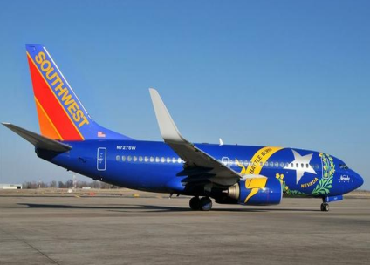
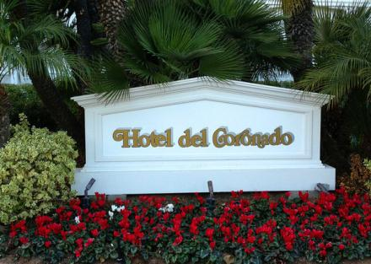
Now work in pairs. Ask and answer questions about your trip to LA.
A: How are you going to travel to LA?
B: …
A: Where are you going to stay?
B: …
让学生假设自己要去洛杉矶旅行，编写对话，最后分角色表演
对话。评出最佳表演小组。

Slide 27
Summary
Key phrases in M7U1
为…做准备
列一份…的清单
把东西准备好
你能帮我吗？
我怎么帮你？
这听起来很荒唐。
在7月末
穿薄裤子
支付机票钱
你最好做…
你所有包的总重量
顺便说一下
别忘了带你的护照
prepare for…
make a list of…
get things ready
Can you help me?
How can I help?
It sounds crazy.
at the end of July
wear light trousers
pay for the air tickets
You had better do…
the total weight for all your bags
by the way
Don’t forget to take your passport.

Slide 28
Grammar
在第一单元结束的时候我只对本模块的语法进行简单的一提。具体的用法在第三单元再详细讲解。
1. 并列复合句的定义：由并列连词and, but, or等把两个或两个以上的简单句连在一起而构成的句子。
例如：
The boy fell off the bike, but he didn’t hurt.
2. 并列复合句的构成：
并列复合句的基本结构是：简单句+并列连词+简单句
例如：
I help him and he helps me.
You must put on your coat, or you’ll have a bad cold in such a cold day.

Slide 29
练一练
A
1. The term will end ____ the end of December.
A. at B. in C. to D. of
2. My parents gave me _______ as a gift.
A. sunglass B. sunglasses
C. a pair of sunglasses D. two pair of sunglass
C
3. I went home after I _______ the service in the hotel.
A. pay for B. pay off
C. paid for D. paid off
4. - ______, where can I find the hospital?
-Oh, go straight ahead.
A. By the way B. In the way C. On the way
C
A

Slide 30
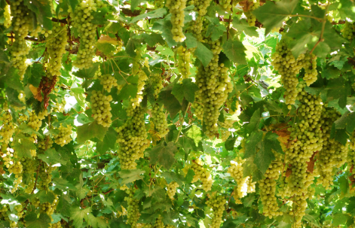
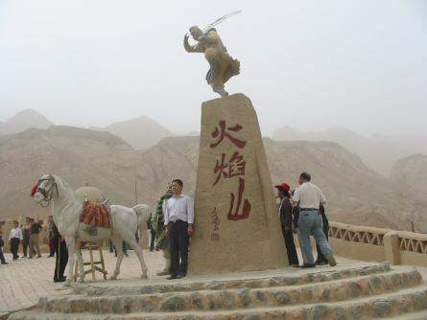
Homework
仿照课文对话部分，编写一个去新疆
旅行的对话。

