Slide 1
Unit 12
What is your father’s job?
WWW.PPT818.COM

Slide 2
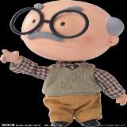
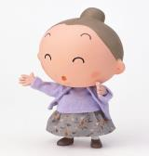
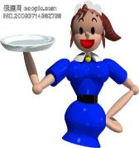
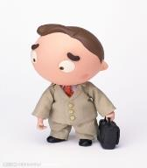
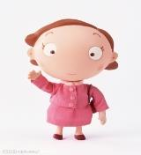
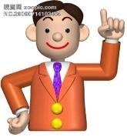
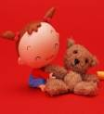
Family Tree
Free talk
grandpa
grandma
aunt
mother
uncle
father
sister

Slide 3
Let’s Guess
巧猜职业
job

Slide 4
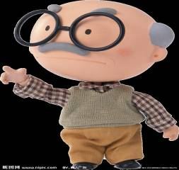
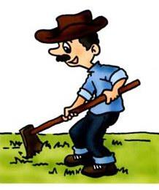
PPT模板：www.1ppt.com/moban/ PPT素材：www.1ppt.com/sucai/
PPT背景：www.1ppt.com/beijing/ PPT图表：www.1ppt.com/tubiao/
PPT下载：www.1ppt.com/xiazai/ PPT教程： www.1ppt.com/powerpoint/
资料下载：www.1ppt.com/ziliao/ 范文下载：www.1ppt.com/fanwen/
试卷下载：www.1ppt.com/shiti/ 教案下载：www.1ppt.com/jiaoan/
PPT论坛：www.1ppt.cn PPT课件：www.1ppt.com/kejian/
语文课件：www.1ppt.com/kejian/yuwen/ 数学课件：www.1ppt.com/kejian/shuxue/
英语课件：www.1ppt.com/kejian/yingyu/ 美术课件：www.1ppt.com/kejian/meishu/
科学课件：www.1ppt.com/kejian/kexue/ 物理课件：www.1ppt.com/kejian/wuli/
化学课件：www.1ppt.com/kejian/huaxue/ 生物课件：www.1ppt.com/kejian/shengwu/
地理课件：www.1ppt.com/kejian/dili/ 历史课件：www.1ppt.com/kejian/lishi/
grandpa
farmer
农民

Slide 5
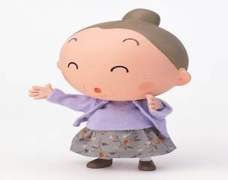
grandma
cleaner
清洁工

Slide 6
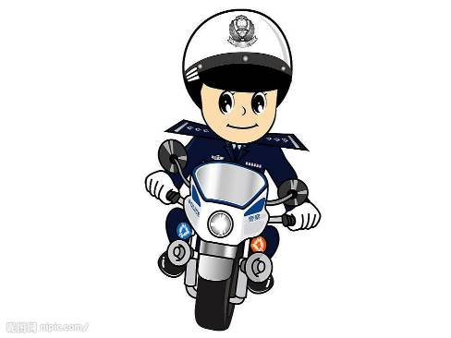
father
policeman
警察

Slide 7
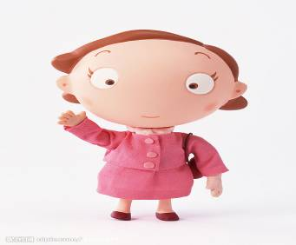
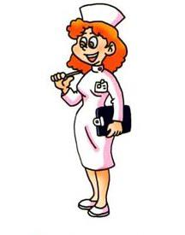
mother
nurse
护士

Slide 8
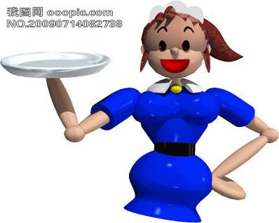
aunt
teacher
老师

Slide 9
uncle
worker
工人

Slide 10
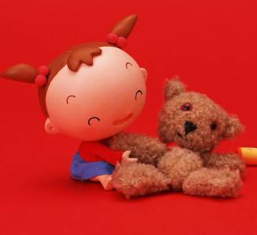
Sister
妹妹
pupil
学生

Slide 11
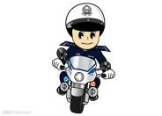
farmer
cleaner
grandpa
grandma
nurse
worker
teacher
mother
uncle
aunt
father
pupil

Slide 12
Let’s learn
工人
worker
警察
police
农民
farmer
job
护士
nurse
清洁工
cleaner
老师
teacher
学生
pupil

Slide 13
学习课文

Slide 14
1.What is your father‘s job？
你爸爸是做什么工作的？
2.He is a factory worker.
他是一名工厂的工人。

Slide 15
3.What about your mother？
What’s her job？
你的妈妈呢？她的工作是什么?
4.She is a teacher.
她是一名老师。

Slide 16
5.Do you want to be a teacher like your mother？
你想成为像你妈妈一样的老师吗？
6.Yes，I do. I want to help children learn.
是的。我想帮助孩子们学习

Slide 17
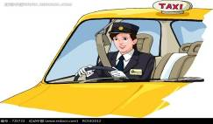
his job， writer，tell people stories
her job， driver，drive school bus for pupils
the woman’s job，farmer， grow food for people
the man’s job， factory worker，make machines for people

Slide 18
Grammar 语法
句型结构：
问句：What ’s sb’s job?
答语： He /She is a/an ……
询问某人的工作：
sb’s 是名词所有格形式
比如：What is your father’s job？
你爸爸的工作是什么？
What is Mike’s job？
迈克的工作是什么？

Slide 19
询问对方职业
What’s your job ?你的工作是什么？
What do you do ?你是做什么工作的？
询问第三人称的职业
What’s her job ? 她的工作是什么？
She is a farmer.她是一个农民。

Slide 20
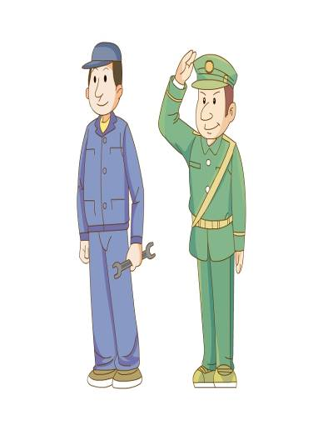
名词单复数
man
Policeman
警察
Policemen
警察（复数）
男人
复数
men
男人，man的复数

Slide 21
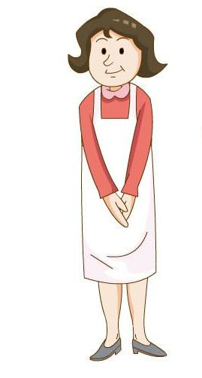
woman妇女
复数
women
妇女，woman的复数

Slide 22
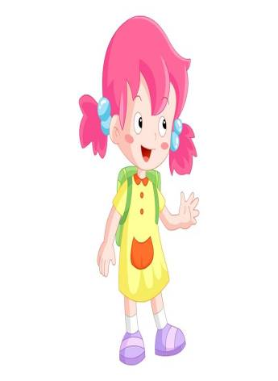
名词所有格
She 她
Her 她的
Her cat 她的猫

Slide 23
He 他
His 他的
His book 他的书

Slide 24
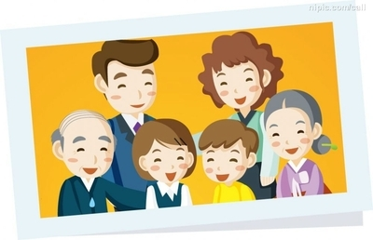
Let’s practice
Example：
Ask and answer.
A：Who’s the tall man in the picture？
B：He’s my father.
A: what’s his job？
B: He is a doctor.
A: Is your mother a doctor，too？
B: No，she is a music teacher.
She is good at music.

Slide 25
Interview

Slide 26
Do the project
What do you want to be when you grow up？
teacher
farmer
Name
Job
Step1：make a table
Step2：ask your classmates what they want to do and fill in the table.
Step3：make a report. Tell the class what you found.

Slide 27
重点句型
What's your/his/her job?
I'm /He is /She is a____.
你记住了吗？

Slide 28
What’s your job?
I’m a …

Slide 29
Homework:
1：read and act dialogue in pairs
2：copy the structures for times
3：看哪些工作是男士经常做的，那些是女士做的。:例如，nurse经常是女护士

