Slide 1
Unit3 This is my father.
人教精通版三年级下册
WWW.PPT818.COM

Slide 2

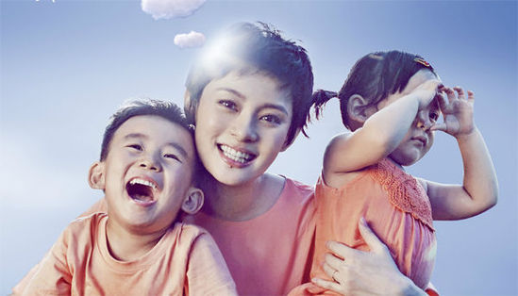
Lead-in
Do you know them?
This is Sun Li.
This is her ...
daughter.
This is her …
son.

Slide 3

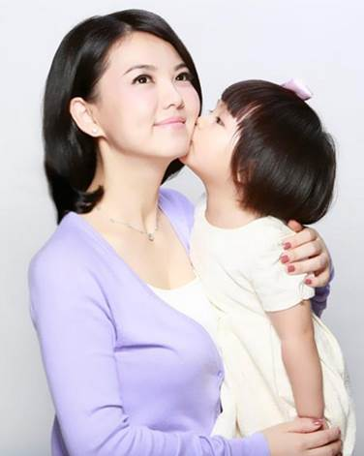

Presentation
Mother and _______.
daughter

Slide 4
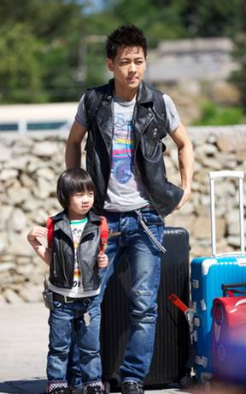
Presentation
Father and _______.
son

Slide 5
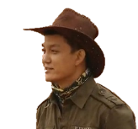
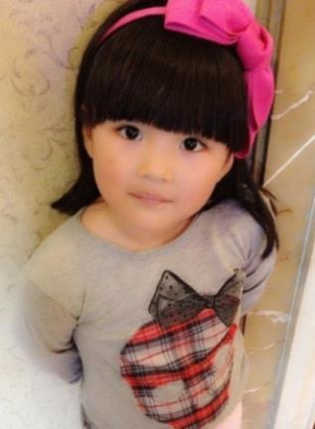
Presentation
What’s your name?
My name’s Angela.
How old are you?
I’m nine.

Slide 6
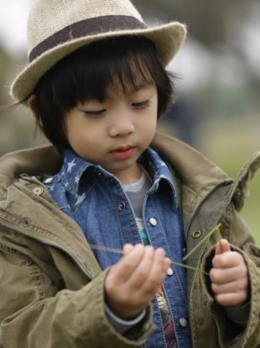
Presentation
What’s your name?
I’m Kimi.
How old are you?
I’m nine.

Slide 7
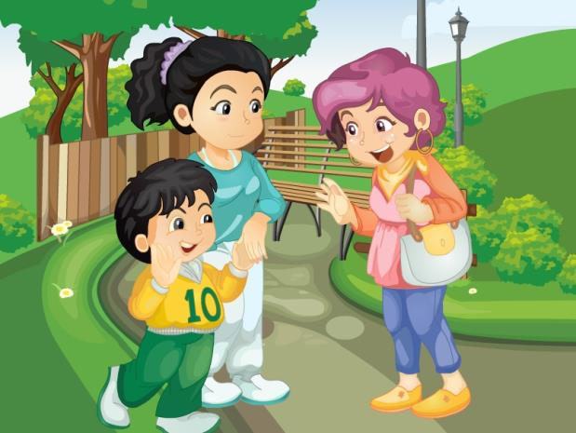

Presentation
Who are they?
What are they talking about?

Slide 8

Presentation
Hi, Miss Wu. This is my son.
Hello, what’s your name?
My name’s Gao Wei.
How old are you?
I’m eight.

Slide 9
Presentation
Just talk
 | Hi, Miss Wu. This is my son.
 | Hello, what’s your name?
 | My name’s Gao Wei.
 | How old are you?
 | I’m eight.

Slide 10






Practice
Show time
Work in three, choose a way you like to read or act the story.（3人一组,选择你喜欢的方式去读或者表演故事。）
Act out the dialogue.（表演对话）
Read in roles.（分角色朗读）
Read together.（齐读）

Slide 11
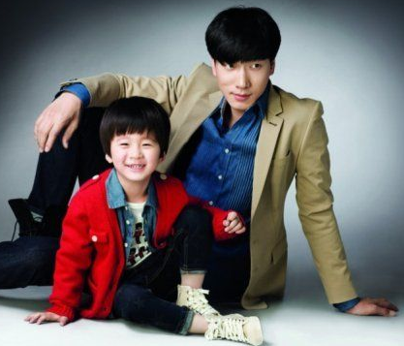
Practice
句子大练兵
A: This is my ____.
B: Hi, _____________?
C: My name is Tian Tian.
B: _____________?
C: I’m eleven.
son
what’s your name
How old are you

Slide 12
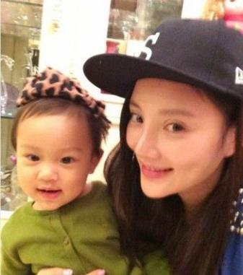
Practice
句子大练兵
A: This is my _______.
B: Hi, what’s your name?
C: ________ Tian Xin.
B: How old are you?
C: _____ eleven.
daughter
My name’s
I’m

Slide 13
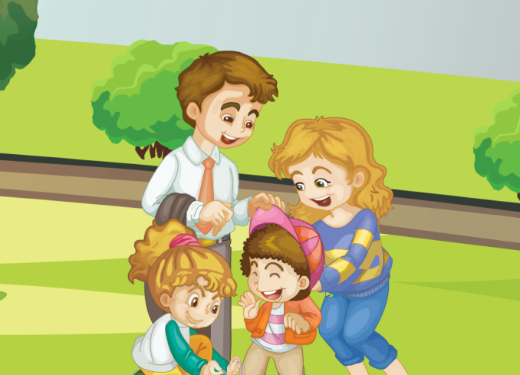
Practice
Let’s chant

Slide 14

Summary
1. 本课的重点单词：
daughter
son
2. 本课的重点句型：
—What’s your name?
—My name’s ...
— How old are you?
— I’m ...

Slide 15
Homework
跟读课文Just talk部分的录音，注意语音、语调。
模仿本课对话，编写一段新的对话，不少于4句。
预习Lesson 16。
Close

