Slide 1
Unit 6
It’s a grapefruit.
WWW.PPT818.COM

Slide 2
Just practise
Just write
Let’s do a survey

Slide 3
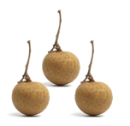
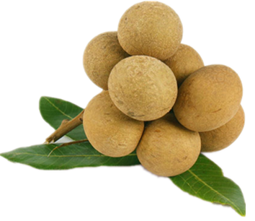
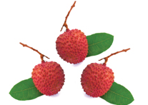
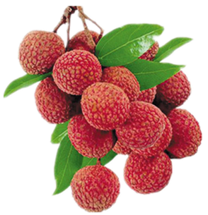
Just practise
What are these? They’re grapes.
What are those? They’re apples.
a longan
three longans
many longans
a lychee
three lychees
many lychees

Slide 4
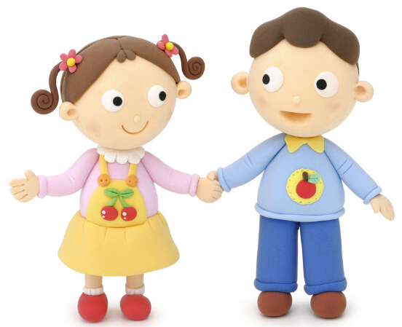
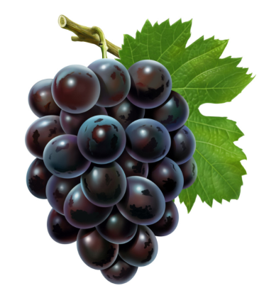
They’re grapes.
What are these?

Slide 5
They’re apples.
What are these?

Slide 6
They’re longans.
What are these?

Slide 7
They’re lychees.
What are these?

Slide 8
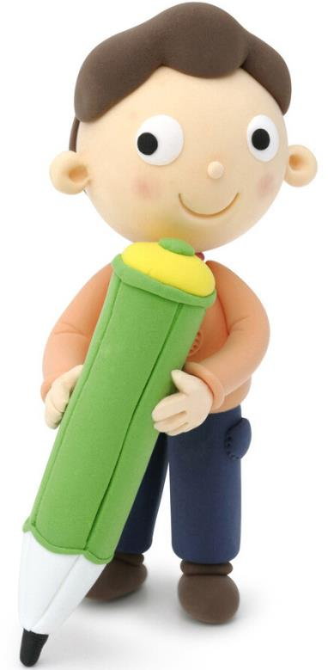
Just write
these those
they thank
they’re=they are
What are these?
They’re grapes.
What are those?
They’re apples.

Slide 9
Let’s do a survey
What are these/those? Do you like them?
NAMES
coconuts
hami melons
cherries
strawberries
apples
peaches
watermelons
grapefruits
oranges
FRUIT

Slide 10
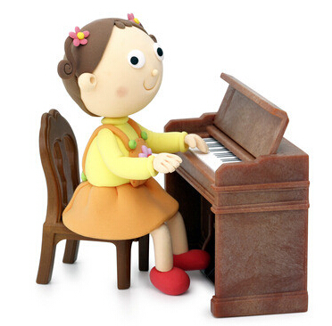
Let’s chant
y
You’re very young.
You’re very strong.
Do your work hard,
In your own yard.

Slide 11
Thank You

