Slide 1
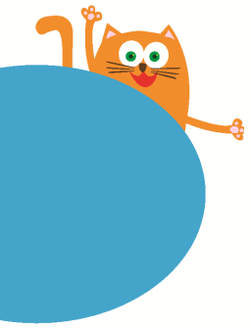
Small Animals
11
Period 1
WWW.PPT818.COM

Slide 2
Hi! I am Po!

Slide 3
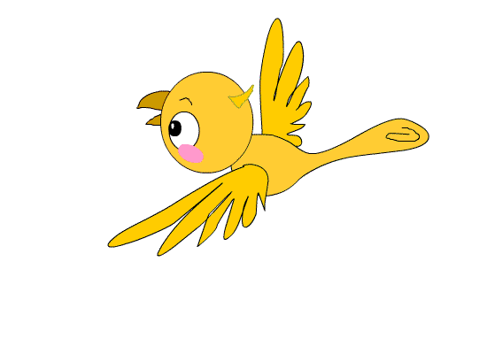
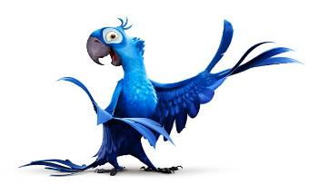
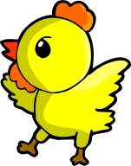
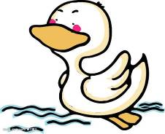
small
big

Slide 4
a-t at
c-at
cat

Slide 5
h
at
f
m
fat
mat
hat

Slide 6
Task 1
Practice in your group.
Please say it out one by one.

Slide 7
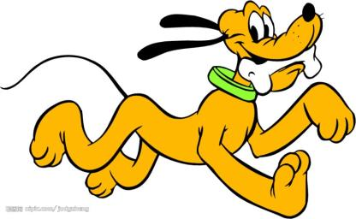
nail
What is it?
snail
tail
It is a dog .

Slide 8
o-g og
d-og
dog

Slide 9
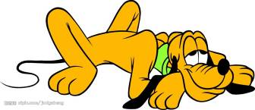
j
- og
h
l
jog
hog
log
A dog on a log.
It can jog, jog, jog.

Slide 10
It is a mouse .
What is it?

Slide 11
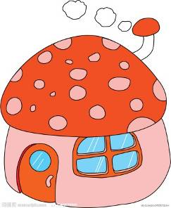
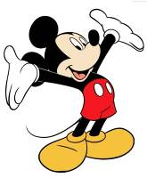
Mickey Mouse, mouse, mouse,mouse.
lives in a house, house, house,house.
It has a long long tail.

Slide 12
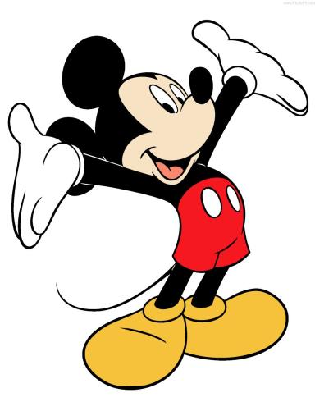
o-u ou
m-ou-se
mouse

Slide 13
Its ears are______.
Its eyes are _____.
Its mouth is _____.
Its tail is ________.
What is it?
It is a mouse.

Slide 14
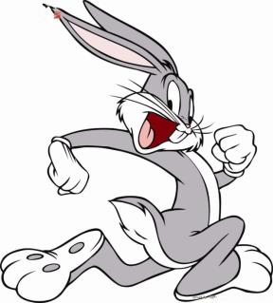
Its ears are long.
Its teeth are long.
Its nose is small.
Its tail is short.
?
What is it?
rabbit
It is a ________.

Slide 15
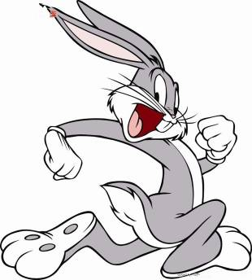
it bit
r-a-bb-it
rabbit

Slide 16
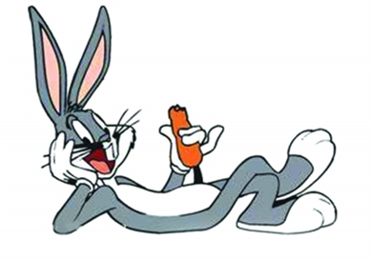
Its ____ are ____.
Its ____ are ____.
Its ____ is _____.
Its ____ is _____.
?
What is it?
It is a ________.

Slide 17
Its ears are long.
Its teeth are long.
Its nose is small.
Its tail is short.
It can hop, hop, hop.

Slide 18
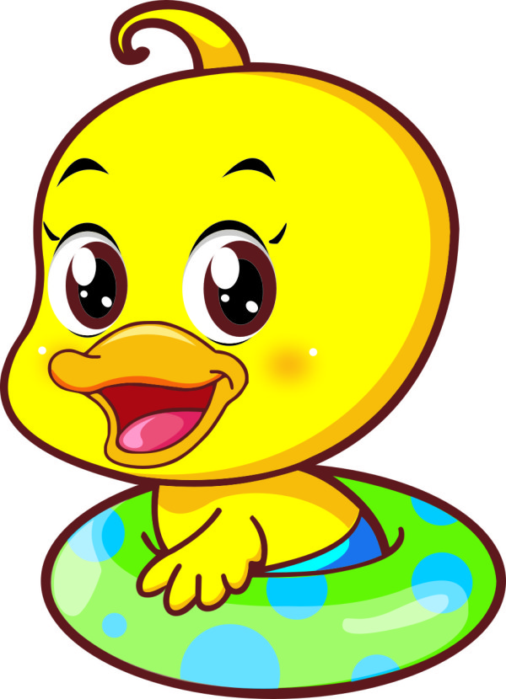
Task 2
For level 1, just read.
For level 2, read and recite.
For level 3, read, recite and act.

Slide 19
Let’s say and act.
Its ears are long.
Its teeth are long.
Its nose is small.
Its tail is short.
It can hop, hop, hop.

Slide 20
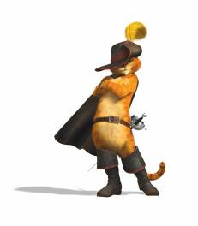
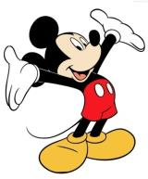
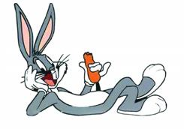
My favourite small animals

Slide 21
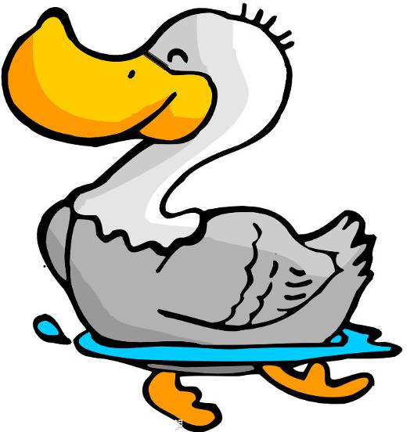
What is it?
It is a duck.
feet

Slide 22
Task 3: Group Work
(1). Choose your favourite small animal.
每个小组讨论并选择一个最喜爱的小动物。
(2). Talk in a low voice.
小声讨论以免别的小组知道你的选择哦!
(3). Say and guess.
每个组员轮流描述一句让其他小组猜谜。
最后由小组长负责公布答案。

Slide 23
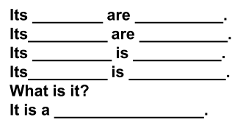

Slide 24
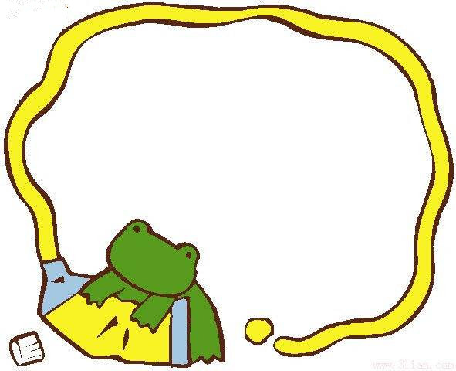
Summary
Today we have learnt:
What is it?
It is a ________.
l

Slide 25
Homework
Finish the worksheet:
Talk and write.
What’s your favorite small animal?
l

Slide 26
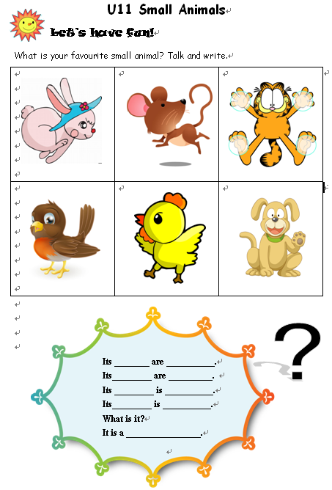
Homework
l

