Slide 1
Unit 7 Summer holiday plans
WWW.PPT818.COM

Slide 2
Let's link
Rules（规则）:
Read the country or city loudly and find out his interesting places as quickly as possible!
大声读出国家或城市，以最快速度找到它的风景名胜，并大声读出来哦！

Slide 3
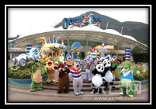

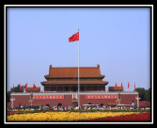
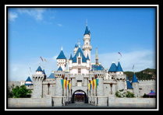
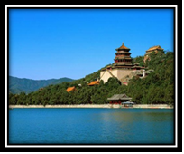

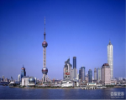
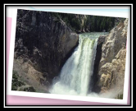
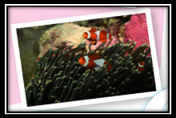
the UK
Ocean Park
the US
Australia
Disneyland
Hong Kong
Shang Hai
Beijing

Slide 4
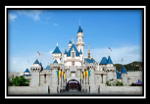
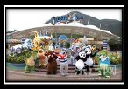







Let's talk
Can you talk about your summer holiday plans?
This summer holiday, I’ll go to Disneyland and Ocean Park.
I will go to…
That sounds great.
那听起来不错。
如果你觉得别人的计划很好，你可以说:That sounds great./That’s wonderful.如果你觉得计划不合理，你可以说: That’s not good./That sounds bad…

Slide 5
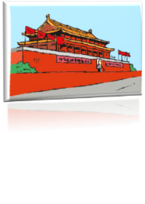

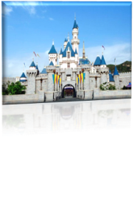






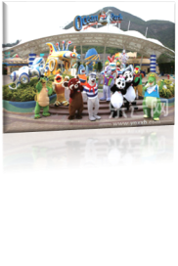



Listen and order
根据听到的先后顺序给下列图片进行排序。见《伴你学》P84，我尝试第三题。

Slide 6
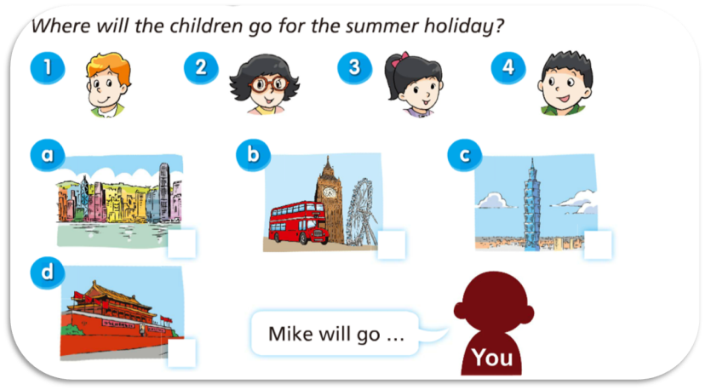




Listen and match
见书本P70，“Match and say”。

Slide 7
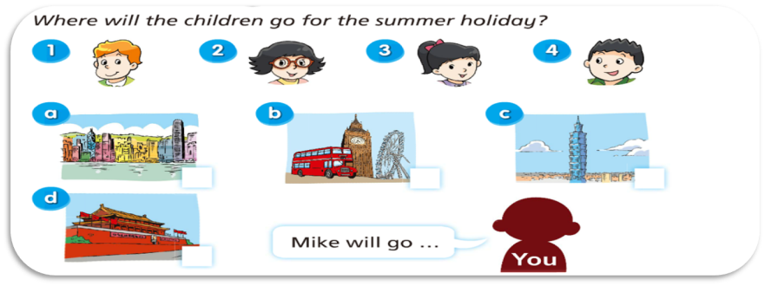




Say a chant
Where,where,where will Mike go ?
London,London,Mike will go to London.

Slide 8
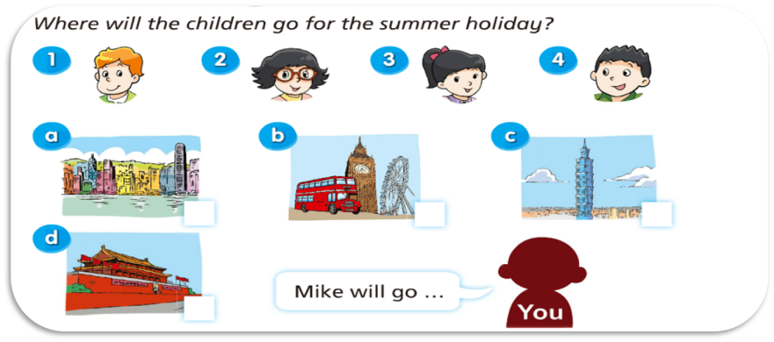




Let’s talk
…will go to…

Slide 9
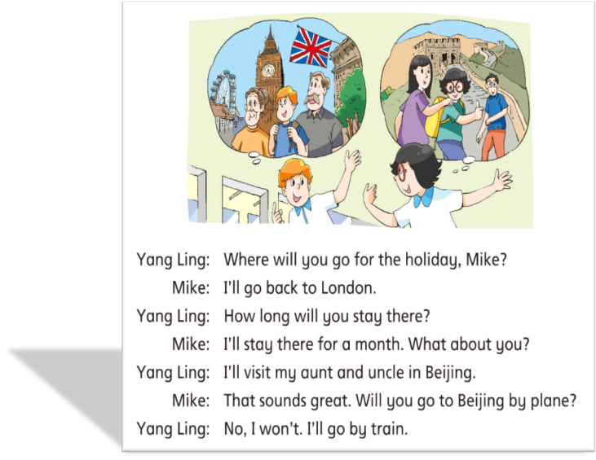


Read and circle
保持
stay
停留
How long多久

Slide 10


Read and find
Who | Where | What
Mike | London
Yang Ling | Beijing
Su Hai | Hong Kong
Liu Tao | Taipei
go back to London to visit his grandparents
visit her aunt and uncle
go to Disneyland and Ocean Park
take some photos

Slide 11



Read and imitate
The children are talking about their plans for the summer holiday.
Where will you go for the holiday, Mike ?
I’ll go back to London.
How long will you stay there ?
I’ll stay there for a month. What about you ?
I’ll visit my aunt and uncle in Beijing.
That sounds great.
Will you go to Beijing by plane ？
No, I won’t .
I’ll go by train.

Slide 12



Read and imitate
Where will you go for the summer holiday, Su Hai ?
I’ll go to Hong Kong with my family.
Will you go to Disneyland ?
Yes, I will. We'll go to Ocean Park too.
What about you, Liu Tao ?
I’ll go to Taipei with my parents.
That's wonderful.
I want to see the city too.
Ok .
I’ll show you some photos after the holiday.
Thanks !

Slide 13

Read freely
Show time

Slide 14



Mike will stay in London for a month.What will he do there ?
After a month, what will he do ?
He will fly to Beijing. Then Yang Ling and he will visit many interesting places there, for example,...

Slide 15

Homework
运用将来时句型写自己的暑假计划。
完成“伴你学”相应内容
读Story time三遍，并试着进行简单复述。
Invite your friends and play with them together.

