Slide 1
Unit10 How to stay safe
WWW.PPT818.COM

Slide 2
safe安全的
safety 安全
Safety first 安全的

Slide 3
cross横过
cross the street
穿过大街
crossing
人行横道、十字路口
safety crossing
安全的十字路口
road 路
cross the road
穿过马路

Slide 4
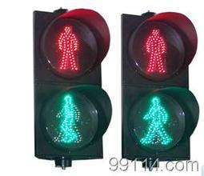
traffic交通
light灯
traffic lights交通灯
Traffic light is red.

Slide 5
Do cross the street at the traffic
lights or safety crossing.
在交通灯区或安全的十字路口穿过路口。
Don't cross the road when
the traffic light is red.
当红灯亮时不能穿过马路

Slide 6
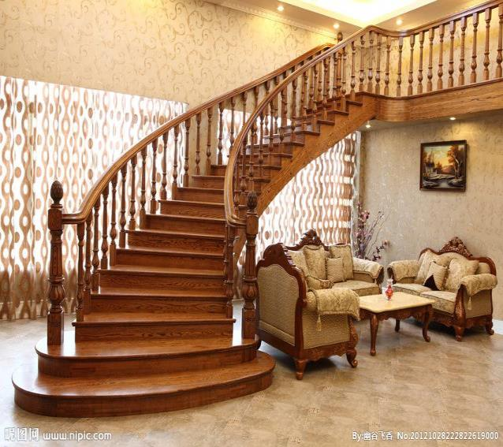
up stair楼上
stair楼梯
down stair楼下
Don't run on the stairs.

Slide 7
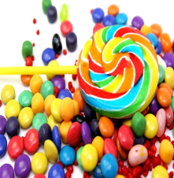
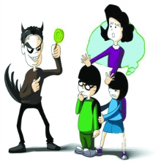
money
钱
candy
糖果
stranger
陌生人
Don't take any money or candy
from strangers in the street.
在大街上，不要从陌生人那里拿钱或糖果。

Slide 8
trouble 麻烦、烦恼
in trouble 遇到烦恼
Do tell your teacher if you
see a classmate in trouble.
如果看见你的同学有麻烦，告诉你的老师。

Slide 9
hour 小时
without 没有
during school hours 上学期间
Don't leave the school during school
hours without asking your teacher.
在上学期间不要离开学校，除非问了老师。

Slide 10
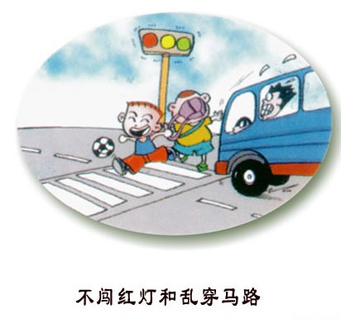
should 应该
shouldn't 不应该
He shouldn't play football
on the road.
他不应该在马路上踢足球。

Slide 11
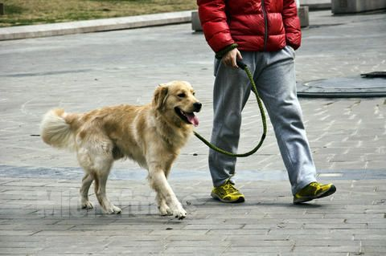
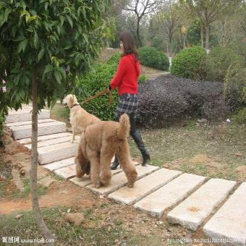
He shouldn't walk a dog
on the road.
他不应该在马路上遛狗。
She shouldn't walk a dog
in the park.
她不应该在公园里遛狗。

Slide 12
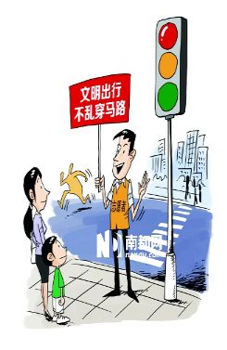
You shouldn't cross the street when
the traffic light is red.
It's too dangerous.
Don't cross the street when
the traffic light is red.
It's too dangerous.

Slide 13
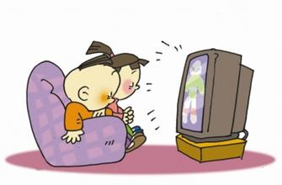
watch TV
You shouldn't ___________
____________.
for too long
It's bad for your eyes.
watch TV
Don't ___________
____________.
for too long
It's bad for your eyes.

Slide 14
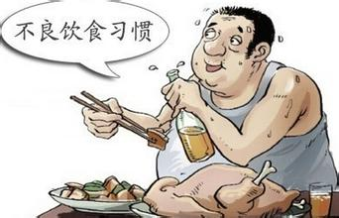
eat too full（吃太饱）
You shouldn't ___________.
It's bad for your health（健康）.
eat too full（吃太饱）
Don't ___________.
It's bad for your health（健康）.

Slide 15
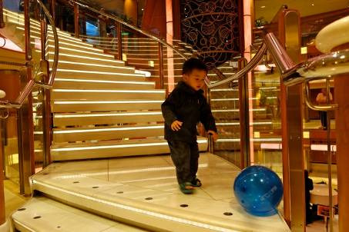
play on the stair.
You shouldn't ___________.
You'll fall down.
play on the stair.
Don't ___________.
You'll fall down.

Slide 16
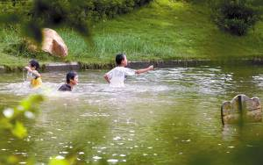
swim in the lake.
You shouldn't ___________.
You'll be dangerous.
swim in the lake.
Don't ___________.
You'll be dangerous.

Slide 17
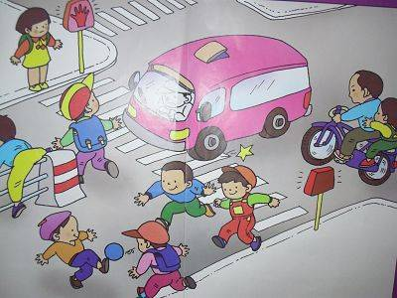
play on the road
You shouldn't ___________.
You'll be dangerous.
play on the road
Don't ___________.
You'll be dangerous.

