Slide 1
Unit 7
Will people have robots?
Section B
Period 2 (3a – Self Check)
WWW.PPT818.COM

Slide 2
Have a try!
Can you make a sentence with each of the words in the box below?
meet work live look keep wear
more less fewer take

Slide 3
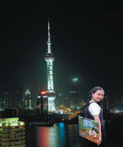
3a
Read Jill’s answer to the question “What will your life be like in the future?” Fill in the blanks with the words in the box.
meet work live look keep wear more less fewer take
In 20 years, I think I’ll be a newspaper reporter. I’ll _______ in Shanghai because there will be ________ jobs in that city.
live
more

Slide 4
As a reporter, I think I will ________ lots of interesting people, so I’ll have more friends. I’ll have ________ pets, though, because I’ll ________ have free time. And my apartment will be no good for pets because it’ll be too small. So I’ll probably just ________ a bird.
meet
fewer
less
keep

Slide 5
During the week, I’ll ________ smart clothes. On the weekend, I’ll ________ less smart but I’ll be more comfortable. In the future, people will ________ more so they’ll probably have fewer vacations, but I think I’ll ________ a holiday in Hong Kong when possible. One day I’ll even go to Australia.
wear
look
work
take

Slide 6
Ask and answer.
1.What will Jill be in twenty years?
2. Where will Jill live in twenty years?
3. Will Jill have pets?
She will be a newspaper reporter.
She will live in Shanghai.
Yes, she will.

Slide 7
Complete the chart about your life 20 years from now. You can add more items.
3b
What will … your be like?
job
home
free time activities
neighborhood

Slide 8
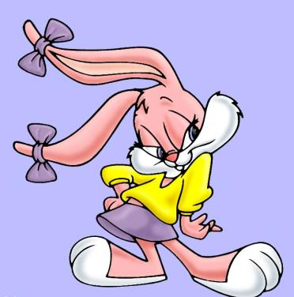
3c
Write about your life 20 years from now. Use 3a and 3b to help you.

Slide 9
1. I think students won’t need dictionaries because
a robot will tell them the meanings of words.
____________________________________________
____________________________________________
____________________________________________
____________________________________________
2.
3.
4.
5.

Slide 10
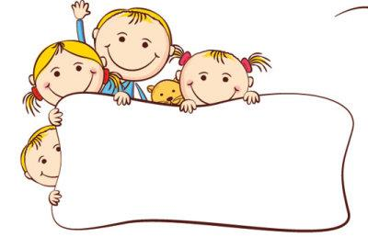
Self Check
1
Put the words in the correct columns in the chart.

Slide 11
job people pollution robot fresh water paper planet
car clean air city free time building money tree
more / fewer | more / less
job, people, robot, planet, car, city, building, tree
pollution, fresh water, paper, clean air, free time, money

Slide 12
2
Fill in the blanks in the conversation.
Girl: Mom, what will the future _______ like?
Mom: Well, nobody knows what the future will be ________.
Girl: But ________ I be beautiful like you? _________ I be a pilot? I want to fly up into the sky.
Mom: You’re already beautiful. And you should study hard. Then you _________ be a pilot.
be
like
will
Will
can

Slide 13
Girl: OK, I must study harder then.
Mom: But you should also remember that _________ will _________ both good and bad things in life.
Girl: Oh, but I’m not scared, Mom, because you ________ help me!
there
be
will

Slide 14
Pairwork
Ask and answer the questions.
Which country will win the next World Cup?
What will the weather be like tomorrow?
Which movies will win awards next year?
What will teenagers do for fun twenty years from now?

Slide 15
A: I think that France will win the next
World Cup.
B: I disagree. I think that Brazil will win.

Slide 16
Life will be more enjoyable in the future!
Thanks for listening !

