Slide 1
Unit 7 Know Our World
Ring Up or Call?
WWW.PPT818.COM

Slide 2
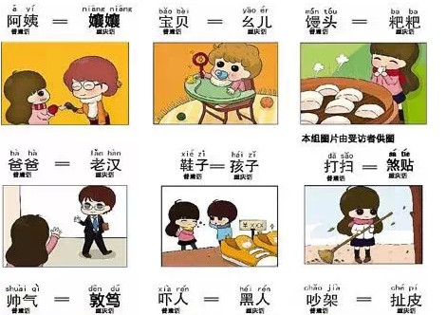
Can you read ?

Slide 3
Think about it
1.What are some of the differences in spoken Chinese in different parts of China?
2. What are some of the differences in spoken English?

Slide 4
Listen and answer.
1.What is Brian asked to do?
He is asked to write a report on Asia.
2.What does “ring up” mean?
It means call someone on the phone.
3.How many different kinds of English are there in the world?
Four.They are American English, British English, Australian English and African English.

Slide 5
Reading
Read the lesson and write true (T) or false (F)
( ) 1. Brian is from the U.S.
( ) 2. Brian wants to ring up his Chinese friend.
( ) 3. The pronunciation and the grammar are the same between British English and American English.

Slide 6
Language points
1. Brian is chatting online with David, a new friend from New York.
2. Maybe I’ll ring him up tonight.
3. Phones don’t go up when they ring.
4. There are quite a few differences between your English and my English.

Slide 7
Language points
1. Brian is chatting online with David, a new friend from New York.
chat with… 同……聊天
eg: 和朋友聊天是愉快的。

Slide 8
2. Maybe I’ll ring him up tonight.
ring sb. up 给某人打电话
eg:你可以礼拜天给我打电话吗？
也可用其他方式表示给某人打电话：
call sb. / phone sb. / give sb. a call

Slide 9
3. Phones don’t go up when they ring.
go up 上升；升起
eg:我们节目的收视率提高了。
Our show has gone up in the ratings.

Slide 10
4. There are quite a few differences between your English and my English.
differences between … and …
……与……之间的不同之处
eg:你和我有什么不同之处？

Slide 11
7. Sometimes we describe the same thing in different ways…
in different ways 用不同的方式或方法
in the same way 用相同的方式或方法
eg:我们用不同的方法学习英语。

Slide 12
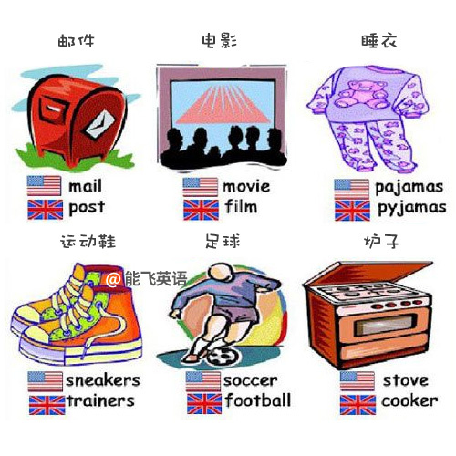

Slide 13
Time for Reflection
ring sb up
go up
in different ways
chat with…
打电话
上升；升起
用不同的方式或方法
同……聊天

Slide 14
Fill in the blanks
Could you s____ this word for me?
Sorry! He is in the w________ (盥洗室)now.
B________ is another name of washroom.
Lily comes from U.K. and she is a B_____.
His p____________ (发音) of French words is simply terrible.

Slide 15
6. Is it an A________ (美国的) car or an English car?
7. How do you like the English ________ (语法) book?
8. These jokes would be far too difficult to _________ (翻译).
9. It’s not always obvious how you _________ (发音) a word when you see it.
10. She’s Italian by birth but is now an __________ (澳大利亚的) citizen.

