Slide 1
Unit 3
Welcome to Sunshine Town
Revision
WWW.PPT818.COM

Slide 2
Part one：预习检测

Slide 3
This is a play about a story of twin b______. Their friend called them for h___. Justin and Paul d_____ to Hill Building. 三个穿警服的男子
p___ them into a van. They were not p_______. They were r_____. Paul opened the b___ door of the van with his knife. They ran to the police station. They met the robbers a___ in the police station. They 很惊讶地看见to see them.The policemen s_____ the van because the back door of the van was open.
rothers
elp
rove
Three men in police uniform
ushed
olicemen
obbers
ack
gain
were surprised
topped

Slide 4
A short passage
leep
During the day we work and play. At night we s___. In the morning we are r____ to work and play again. while we are asleep, our bodies grow most. We can do better at our lessons and we feel b___ too when we have had enough rest. Boys and girls who are eight or nine years old need ten h___ of sleep every night. Our bodies need plenty of air w___ we sleep. If we do not get enough fresh air, we will be t____ when we wake up. While in bed we must not cover our heads. I_ we do, we will not get enough f___ air. If we open our w_____ at night, we can have plenty of fresh air. Boys and girls who want to grow and be s_____must get plenty of sleep.
eady
etter
ours
hen
ired
f
resh
indows
trong

Slide 5
Q1: What gives us fresh air?
Q2:What’s the date tomorrow?

Slide 6
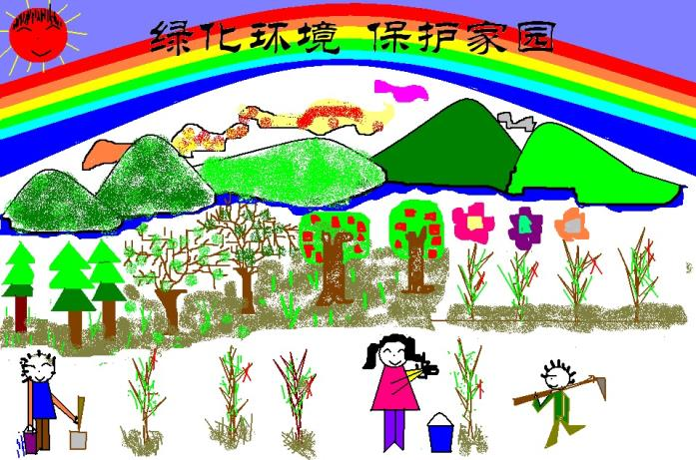
Tree Planting Day
March 12th is _____________.

Slide 7
Part two: Work in pairs:
A: Who…take part in …？
B：…
A：Where…plant trees？
B: …
A：When…begin？
B：…
A：What…take？
B：…
A：How many trees…plant？
B：…

Slide 8
中考链接
1. Mike’s father ____________ (arrive) in Nanjing in two weeks.
2. He doesn’t like his job. He ____________ (change) his job.
3. We ______________(go) to the Summer Palace soon.
4.I can smell the tasty dishes. Who ___________(cook) in the kitchen?
will arrive
will change
will go
is cooking

Slide 9
More exercises
5.I ______(call) you as soon as I get there.
6.My hometown is very beautiful and quiet, but it _____(rain) a lot.
7.They_______(not give) me any answer until I tell them the secret.
8.Where _____ we ______(plant) trees tomorrow?
will call
rains
won’t give
shall plant

Slide 10
移动方向介词
Prepositions of movement

Slide 11
across
The little horse is walking _______ the
river.

Slide 12
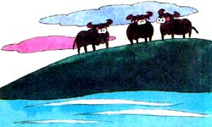
along
The cows are walking ______ the river.

Slide 13
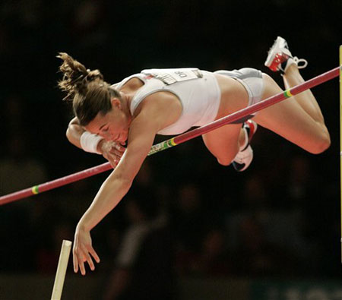
The woman is jumping _____ the stick.
over

Slide 14
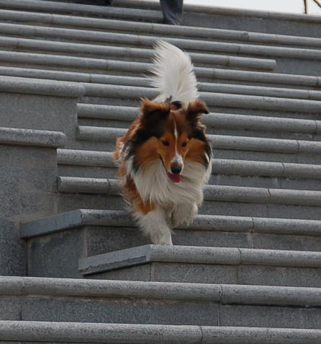
The dog is walking______ the stairs.
down

Slide 15
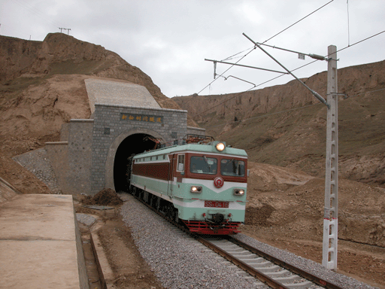
through
The train is going _______ the tunnel.

Slide 16
中考链接
C
1. On sunny winter mornings, the sun shines ______the window and makes the room warm.
across B. into C. through D. out
After coming into the building, he walked _____ the lift and went ______to the tenth floor.
towards; up B. into; up
C. to; down D. into; /
B

Slide 17
Ask the way
请问，叠石桥在哪里？
Could you tell me how to get to Dieshiqiao, please?
Could you tell me the way to Dieshiqiao, please?
Excuse me, how can I get to Dieshiqiao?
Excuse me, where is Dieshiqiao?
Excuse me, is Dieshiqiao near here?
Dieshiqiao is to the west of our school. It’s about 2,000 metres away from here.

Slide 18
A map:
Show the way to Dieshiqiao

Slide 19
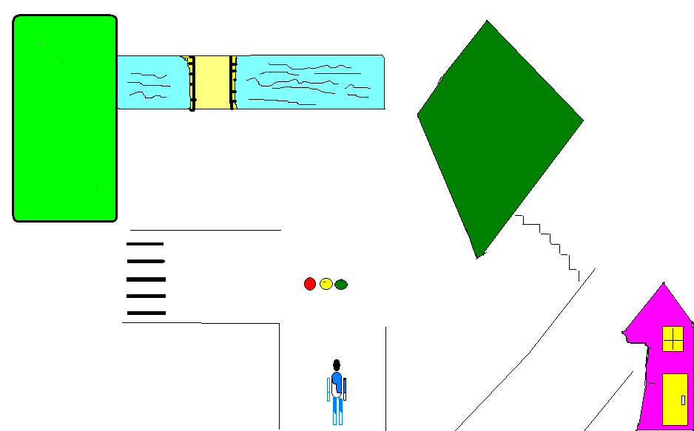
Turn right and walk along the river.
The forest (森林）
Go through the forest.
Sunshine
Park
Walk over the bridge.
Walk towards the bridge.
Go past Sunshine Park.
Go across First street
at the zebra crossing.
First Street
Go down the steps.
Turn left into First street.
Dieshiqiao is on the other side of the road.
Walk straight on
until you see
the traffic lights.
Dieshiqiao
we

Slide 20
Writing
内容：明天你们班将组织同学们参加两项有意义的活动。假如你是班长Emily，请你根据“活动设计卡”中的内容，写一封邀请函，邀请同学们参加，并将函粘贴于班级英语角。
时间 | 3月12日
 | 上午 | 下午
地点 | 花园 | 操场
内容 | 植树 | 接力赛relay race
要求 | 带工具（tool） | 自行进行四人分组
目的 | 美化校园 | ……（内容自拟）
Dear friend,
May Day is coming. I am happy to ____________________________________________________________________________________________________________.
Emily

Slide 21
Sum up
Important words and phrases: afraid, fail, suddenly, robber, ring, monitor, drive, uniform, exit, towards, invite sb to…, three men in police uniform, get into/out of the car, (get on/off the bus), walk past the wooden house, cross the road ( walk across the road), walk straight on along this road, turn left/right, at the traffic lights, be surprised to see, half of the students
一般将来时shall/will, be going to
Prepositions of movement: across, along, over, up, down, through, towards, past…

Slide 22
Task Three: Translations
明天是植树节。我们将在操场周围植树。
我们每班将种4棵树。
老师将和我们一起参加。
我们将采取不同的路线到达指定地点。
这次活动将让我们知道植树的重要性。
Tomorrow is Tree Planting Day .We will plant trees
around the playground.
Each (of the) class will plant 4 trees.
Teachers will take part in this activity with us.
We will take different routes to get to the right place.
We will know the importance of planting trees from this activity.

Slide 23
Homework :
Review Unit 3 again.
Finish the exercises.
Goodbye !

