Slide 1

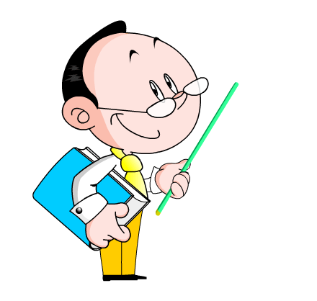
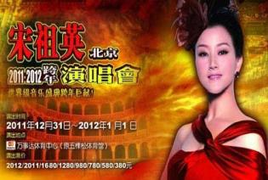
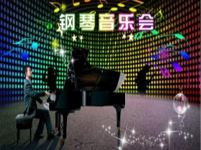
Module 8 Choosing presents
Unit 2 She goes to concerts.
WWW.PPT818.COM

Slide 2
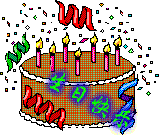
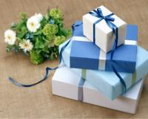
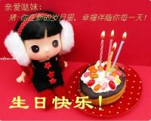
Lead-in
Do you often get presents on your birthday? Talk about your birthday presents.

Slide 3


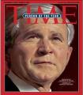
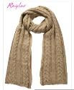


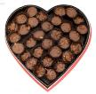
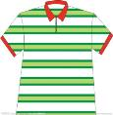

Match the words with the pictures.
a box of chocolate
a CD
a cinema ticket
a concert ticket
a football
a magazine
a scarf
a silk shirt
a T-shirt
A
B
C
F
E
D
H
G
I

Slide 4
Match the people with what they like doing.
1. Daming’s grandparents A. going to concerts
2. Daming’s mother B. going shopping
3 Betty’s cousin C. staying healthy
4. Tony’s sister D. watching films
5. Lingling’s aunt and uncle E. watching football matches
1.______.2_______.3________.4._______5.________
C
B
D
A
E

Slide 5

Language Points
1. Betty’s cousin likes reading and she
reads lots of books and magazines.
Betty的堂妹喜欢看书，她看了许多书和杂志。
1) like “喜欢”,其后接名词、动词不定式或动名词。
2) lots of 相当于 a lot of “许多，大量”, 后面接不可数名词,
相当于much。后面接可数名词复数形式时，相当于many。

Slide 6



eg: There is lots of/a lot of/much food in the fridge. 冰箱里有许多食物。
a lot of 与lots of 多用于肯定句，在否定句和疑问句中多用many或much。

Slide 7
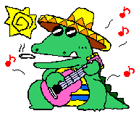
2. She likes going to concerts.
她喜欢去听音乐会。
go 之后加 to 跟宾语, 可构成一些 动词短语
go to school 上学
go to the film 去看电影
go to the doctor 去看病
go to bed 上床睡觉

Slide 8
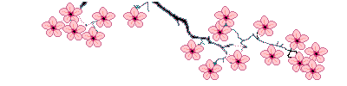
3. They sometimes wear T-shirts.
他们有时穿T恤衫。
辨析： put on / wear / in / with
put on, wear, in和with都可以用来表示“穿”，但用法不同。

Slide 9
(1) put on指穿的动作，其后直接跟穿戴的东西。
例如：It’s very cold. Please put on your coat.
天非常冷。请穿上你的外套。
(2) wear指穿的状态，后面直接跟穿戴的东西。
例如：Girls like to wear skirts in summer.
女孩子们在夏天喜欢穿裙子。

Slide 10
(3)介词in表示穿的状态，后面可跟衣服或颜色。可以作后置定语，也可与be连用作谓语。
例如：The girl in red is my sister.
穿红衣服的那个女孩是我姐姐。
I’m in black today.
我今天穿了一身黑衣服。
(4)介词with表穿戴只能作定语，而且常与眼镜、手套或帽子等名词连用。
例如：The girl with glasses is our monitor.
戴眼镜的那个女孩是我们的班长。

Slide 11
Look at these sentences. Underline “ ’ ” (apostrophe).
1. Daming’s grandparents sometimes wear T-shirts.
2. Betty’s cousin likes to go to the cinema.
3. Tony’s sister often buys CDs of her favourite songs.
4. Lingling’s aunt and uncle don’t go to football matches. They watch TV.
5. Daming’s mother doesn’t buy chocolate.

Slide 12

Work in groups
Write a passage about choosing birthday presents for your family and friends.
My mother likes… She always goes to… I usually buy her…
Make sure you use apostrophes(“ ’ ” ) correctly.

Slide 13
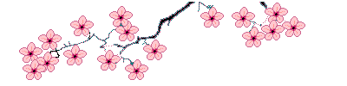

单项选择
1. He usually _____ football at weekends.
A. watch B. watches C. see D. sees
2. Jim _____ Chinese very well, _____ he doesn’t know how to write.
A. speaks; but B. talks; but
C. speaks; and D. talks; and
3. I have _____ homework to do.
A. a lots of B. a lot
C. many D. lots of

Slide 14
4. It’s Daming’s birthday. _____ do you send him?
A. When B. Where C. What D. How
5. She is a good teacher. She is _____ angry (生气) with her students.
A. usually B. never
C. often D. sometimes

Slide 15
Homework
Retell the text as fluently as possible.

