Slide 1
Unit 5 The Value of Money
Section Ⅳ Discovering Useful Structures——
情态动词；过去将来时
WWW.PPT818.COM

Slide 2
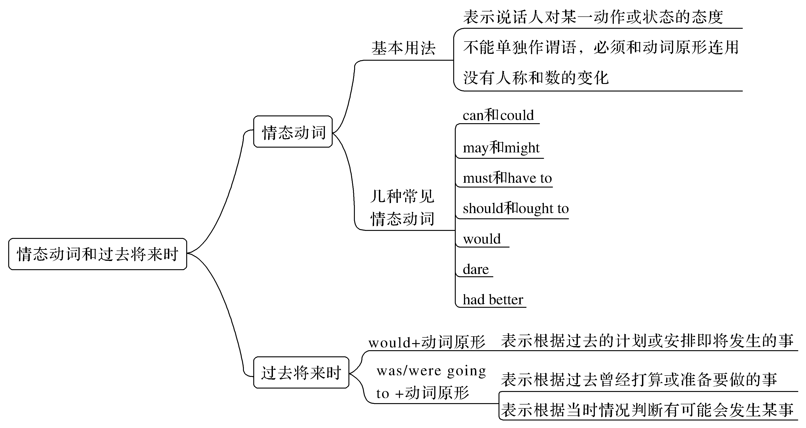

Slide 3
情态动词表示说话人对某一动作或状态的态度，本身不能单独作谓语，必须和不带to的不定式(即动词原形)连用。情态动词没有人称和数的变化。
一、情态动词
1.can和could (could是can的过去式，语气更委婉)
[合作探究1]
①He can use the computer skillfully now，but he couldn’t last year.
他现在能熟练使用电脑了，但去年他不会。

Slide 4
②Training by oneself in a gym can be highly dangerous.
一个人在体育馆训练有时会很危险的。
③—Can/Could I have a look at your new pen?
——我可以看一看你的新钢笔吗？
—Yes，you can./No，you can’t.
——可以。/不可以。
④That can’t be Mary—she’s in hospital.那不可能是玛丽——她在住院。
⑤Someone is knocking at the door.Who can it be?有人在敲门，可能是谁呢？
⑥You can’t be careful enough.你再细心也不为过。

Slide 5
[自主发现1] (1)①句中can表示 ____________。
(2)____________句中can表示可能性，可译为“有可能；有时会”。
(3)③句中can表示 ____________。
(4)____________句中can/could在否定句、疑问句中表示推测或怀疑，译为“____________”。
(5)⑥句中can’t与____________或too连用，表示“再……也不为过”。
[名师提醒] can 表示允许时，在疑问句中用could更委婉，在回答中一律用can。
能力
②
许可
④⑤
可能
enough

Slide 6
2.may和might
[合作探究2]
①—May I watch TV after supper?
——晚饭后我可以看电视吗？
—Yes，you may./No，you mustn’t.
——是的，可以。/不可以。
②They may/might be having a meeting，but I’m not sure.
他们可能在开会，但是我不确定。
③If that is the case，you may/might as well try.
如果事情是这样的，你不妨一试。

Slide 7
[自主发现2]
(1)①句中may表示______________________。否定回答时，用____________。
(2)②句中may和might表示____________，____________可能性更小。
(3)③句中______________________________，意为“不妨”。
允许或征询对方许可
mustn’t
可能性
might
may/might as well＋动词原形

Slide 8
3.must与have to
[合作探究3]
①I have to wait here because I have no umbrella with me.
我不得不在这儿等，因为我没带伞。(强调客观需要)
②I must recite the text this morning.
今天早上我必须背会这篇课文。(强调主观意志)
③—Must we hand in our exercise books today?
——我们今天必须交上练习册吗？
—Yes，you must./No，you don’t have to/you needn’t.
——是的，必须交上。/不，没必要。

Slide 9
④You mustn’t smoke here.
你绝不能在这吸烟。
⑤Your mother must be waiting for you now.
你的母亲现在一定在等着你。
⑥Why must you always interrupt me？
你为什么非要一直打断我呢？

Slide 10
[自主发现3]
(1)①句中have to和②句中must均表示“____________”，但____________是指说话人的主观看法，而____________则强调客观需要。
(2)③句中must 所构成的疑问句，回答的否定形式通常为____________或____________，意为“不必要”，而一般不说____________ (④句中mustn’t表示“禁止”)。
(3)____________句中must 常表示有根据的、比较确定的推测(只用于肯定的陈述句)，译为“一定，必定”。
(4)⑥句中must表示“____________”。,
必须
must
have to
needn’t
don’t have to
mustn’t
⑤
偏要，偏偏

Slide 11
4.should和ought to
[合作探究4]
①All visitors should/ought to register with the British Embassy.
所有游客都必须到英国大使馆登记。
②I find it astonishing that he should be so rude to you.
他竟然对你这样无礼，真让我吃惊。
③Mr Lee asked if he should get his visa on time.
李先生问能否按时拿到签证。

Slide 12
[自主发现4]
(1)①句中should表示“___________________”，其同义词是____________；在疑问句中，通常用____________代替ought to。
(2)②句中should 有时可用于某些从句中，表示说话人惊奇、失望等感情色彩，常译为“竟然，怎么会”。
(3)③句中should作为shall的过去式，用于第一、三人称作主语的疑问句，且多用于间接引语中，以征求对方的意见。
义务、责任、建议
ought to
should

Slide 13
5.will和would
[合作探究5]
①Would you pass me the ball，please？你可以把球传给我吗？
②She said that she would try her best to help us.
她说过她愿意尽自己最大努力来帮我们。
③Each time his mother’s birthday came，he would buy her a present.
每次到他母亲生日的时候，他都要给她买一件礼物。(表示过去的习惯)
④We will do our best to save the child.我们会尽力抢救这个孩子。
⑤Oil will float on the water.油总是浮在水面上。

Slide 14
[自主发现5]
(1)①句中would表示____________，比will更委婉客气。
(2)②句中would和④句中的will表示__________________。
(3)③句中would和⑤句中的will表示习惯性动作或客观真理。
[名师提醒] would表示过去的习惯性动作时，暗示现在仍然如此；而used to表示过去常常做某事，强调现在不是这样了。
My father used to go to the office by bike when he was young.
我父亲年轻的时候总是骑自行车去上班。(现在不是这样了)
请求、建议
意志、愿望和决心

Slide 15
6.dare
[合作探究6]
①If he dare go，I’ll go with him.如果他敢去，我就跟去。
②Tom didn’t dare to do it.汤姆不敢做那件事。
[自主发现6]
(1)dare作情态动词时，表示“敢，敢于”。常用于否定句和疑问句中，后接动词原形，否定形式为dare not。
(2)dare常用作实义动词，有时态、人称和数的变化，后面可接带to的不定式。

Slide 16
7.had better
[合作探究7]
You had better get some sleep.你最好睡一会儿。
You had better not talk with strangers.你最好不要和陌生人讲话。
[自主发现7]
had better表示“____________”，使用时常缩写为____________，无人称和数的变化，其否定式一般把not放在had better之____________。
最好……
’d better
后

Slide 17
二、过去将来时
过去将来时常表示从过去的某一时间来看将来要发生的动作或呈现的状态。
1.would (not)＋动词原形
[合作探究1]
He said he would come to see me.他说他要来看我。
He told me he would go to Beijing.他告诉我他将去北京。
[自主发现1]
“would＋动词原形”构成过去将来时，常_________________________________。
表示根据计划或安排即将发生的事

Slide 18
2.was/were(not)going to＋动词原形
[合作探究2]
She said she was going to start at once.她说她将立即出发。
I was told that he was going to return home.有人告诉我他准备回家。
It seemed as if it was going to snow.看来好像要下雪。
[自主发现2]
“was /were＋going to＋动词原形”也可表示根据表示过去曾经打算或准备要做的事；而且还可表示根据当时情况判断有可能会发生某事。

Slide 19
[巩固内化1] (1)选词填空：can，could，couldn’t，be able to
①Samuel，the tallest boy in our class，____________ easily reach the books on the top shelf.
②It was really annoying; I ____________ get access to the data bank you had recommended.
③It was so noisy that we ____________ hear ourselves speak.
④ ____________ I have a word with you? It won’t take long.
can
couldn’t
couldn’t
Can

Slide 20
(2)补全句子
⑤I ________________________ for your kindness.
我再怎么感谢你的好意也不为过。
⑥Keep working on it! You ______________________________ for the exam.
继续努力！准备考试再充分也不为过。
cannot thank enough
can’t prepare too much

Slide 21
[巩固内化2]
(1)用适当的情态动词填空
①You ____________ feel all the training a waste of time，but I’m a hundred percent sure later you’ll be grateful you did it.
②Life is unpredictable; even the poorest ____________ become the richest.
③—____________ I smoke in this room?
—No，you ____________.
(2)补全句子
④I needn’t wait，I _____________________________ you now.
我不必等了，不妨现在就告诉你。
may
might
May
mustn’t
may/might as well tell

Slide 22
[巩固内化3] 选词填空：must，needn’t，have to，mustn’t
①—Can’t you stay a little longer?
—It’s getting late.I really ____________ go now.My daughter is home alone.
②You ____________ be careful with the camera.It costs!
③—____________ I turn down the radio now?
—No，you ____________.
④My brother was ill，so I ____________ call a doctor in.
must
must
Must
needn’t
had to

Slide 23
[巩固内化4] 补全句子
①It was sad to me that they，so poor themselves，________________________.
他们这么穷竟然还带食物给我，这使我很难过。
②You ____________________ the baby to the doctor’s.
你应该把这婴儿带去看看医生。
③I asked the teacher if I ________________________.
我问老师我能否请一天假。
should bring me food
should take
should have one day off

Slide 24
[巩固内化5]
选词填空：would，used to
①I still remember my happy childhood when my mother ____________ take me to Disneyland at weekends.
②Whenever I was in trouble，he ____________ help me.
③If I write a letter，____________ you post it for me?
④I ____________ drink coffee，but now I drink green tea.
would
would
would
used to

Slide 25
[巩固内化6] 补全句子
①He ___________________________ say what he thought.
他不敢说出他的想法。
②__________________________ staying where she was?
她还敢冒险呆在原来的地方吗？
didn’t dare (to)/dared not
Dare she risk

Slide 26
[巩固内化7] 补全句子
①It’s half past two.I think we __________________.
现在两点半了。我想我们最好还是回家吧。
②You _____________________________ class any more.
你最好不要再上课迟到了。
had better go home
had better not be late for

Slide 27
[巩固内化8] 补全句子
①I told him I ________________________ at the station.
我跟他说，我会到车站去给他送行。
②The sky went very dark and we thought it _______________________ but it was a false alarm.
天空变得黑沉沉的，我们以为要下雨了，不过只是虚惊一场。
③They said that they ________________________ a meeting.
他们说他们曾经打算开个会。
would see him off
was going to rain
were going to have

