Slide 1
Module 2 Education
Unit1 They don’t sit in rows
WWW.PPT818.COM

Slide 2
Learning aims :
知识目标：
Grasp new words, phrases and key structures.(重点)
能力目标：
To get information from the listening material. (难点)
To introduce our school
3. 情感目标: We should love our school.

Slide 3
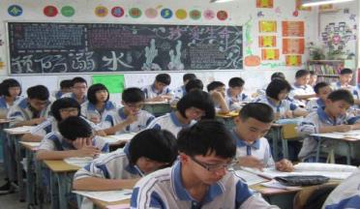
quiz on our school
How many students are there in our school?
Over 1500.
How many students are there in a class?
It's got about 45. (=It has got)
How do students sit in class?
We sit in rows.
Where do students do sports?
On the sports ground or in the gym.
What do students wear in school?
Sports suits.

Slide 4
School in Britain

Slide 5
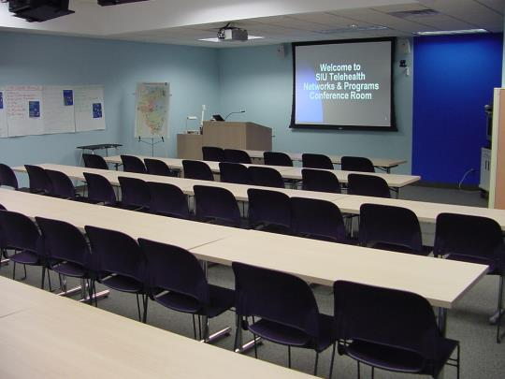
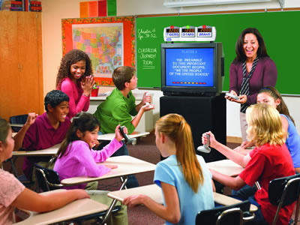
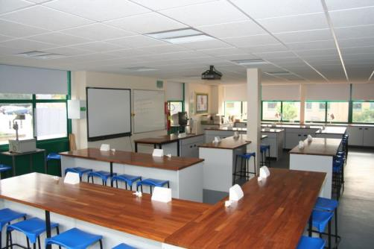
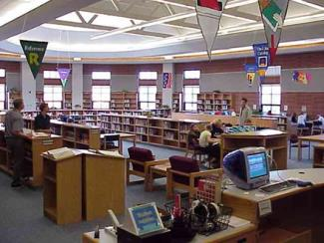
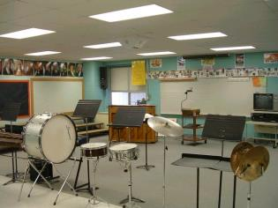
well-equipment

Slide 6
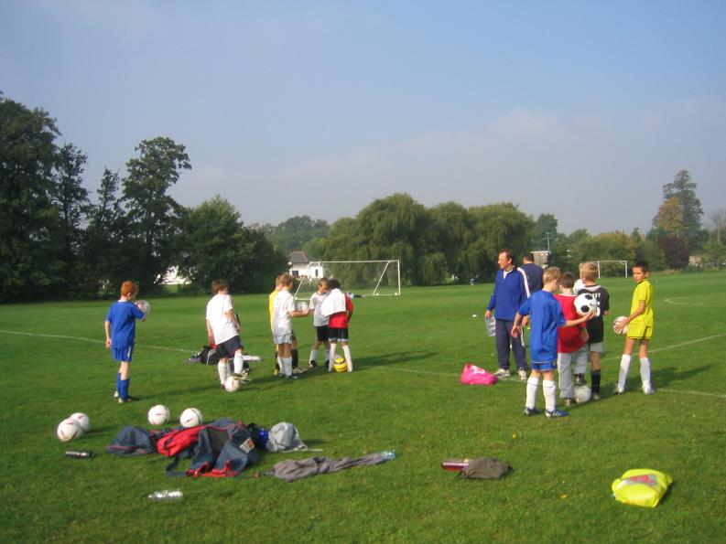
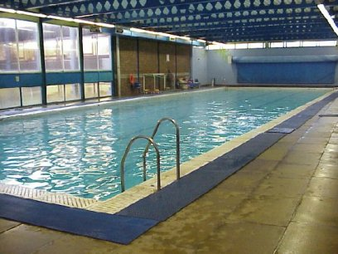
activities

Slide 7
While-listening (TB P10 ACT2)
nice
1. The weather was ______ when Tony was in London.
2. Tony played football with ____________
______________________________.
3. Daming is surprised to hear that Tony
________________________.
4. Tony didn’t go to lessons. He was ___________.
some of Susie’s classmates at lunch time
went to school on holiday
just visiting

Slide 8
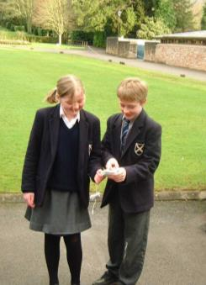
while-listening （ACT 3 P11）
 |  | Susie's School | Tony's Schools
Number of pupils in the school |  | 1. . | Over 1500
Number of pupils in a class |  | about thirty | about 2. .
Uniform |  | a jacket and 3. . | sports suits
Arrangement of seats |  | sit around tables | sit 4. .
Sports areas & after-class activities |  | 5. and a huge sports ground Kids enjoy 6. . | Students like playing football and have an excellent swimming team.
opinion | Susie's school looks great because there are fewer students. That means more room(空间) for study and play. |  | His school is great because they have more students. That means more people to 7. .
About 700
forty
tie
in rows
A swimming pool
playing football
play with

Slide 9
(TB P11 Act4) Read the conversation again and answer the questions.
1. Who did Tony visit in London?
His friend Susie.
2. How did Tony get the photos of Susie’s school?
He took them himself.
3. Which class is a bit bigger, Susie’s or Daming’s?
Daming’s.
4. What does Betty hope to do one day?
She hopes she can visit Susie’s school one day.

Slide 10
玩得开心
像…..
几个，一些
自己拍照
它有......
大一点
穿夹克衫打领带
穿（着）校服
围着课桌坐
坐成一排排
喜欢做某事
跟...玩
……的数量
L1.enjoy oneself=have a good time
L3.be like
L4.a few+可数名词（复数）
L4 take photos oneself
L6 It's got...=It has got...
L9.a bit bigger= a little bigger
L9.wear a jacket and tie
L11.wear school clothes
L12.sit around tables
L13.sit in rows
L15.enjoy doing sth
L21.play with sb.
ACT3. the number of…

Slide 11
The Key Sentences:
1. 反身代词(oneself)
Did you enjoy yourself in London? (L1)
I took them myself.(L4)
2. 名词性物主代词(ours/mine/yours...)
So ours is a bit bigger.(L9)
3.不定代词(every-)
Look, everyone is wearing a jacket and tie!(L9)
Every student wears school clothes in England.(L11)
And everyone is sitting around tables in the classroom.(L12)

Slide 12
Act5 Complete the sentences with the correct form of the words in the box.
enjoy pool row tie wear
rows
Pupils in England do not sit in (1)______ in the classroom. They sit around tables. Everyone (2)_______ a jacket and (3)_____. Most schools have sports grounds, and English children (4)_______ playing football, just as pupils in China do. Some English schools have swimming (5)______, but not all of them do.
wears
tie
enjoy
pools

Slide 13
 | Susie's School
Number of pupils in the school | 1. .
Number of pupils in a class | about thirty
school clothes that pupils wears | a jacket and 3. .
Arrangement of seats | sit around tables
Sports areas & after-class activities | 5. and a huge sports ground Kids enjoy 6. .
opinion | Susie's school looks great because there are fewer students and more room(空间) for study and play. And they wear beautiful school clothes
Pair work: talk about Susie' s school
scale
(规模)
About700
school rules
tie
facilities(设施)
and
after-class activities
A swimming pool
playing football
opinion
Besides this, what do you think of her school?

Slide 14
scale
(规模)
there be...
it has got...
not only...but also...
get along well with
school rules
school
facilities(设施)
and
after-class activities
opinion

Slide 15
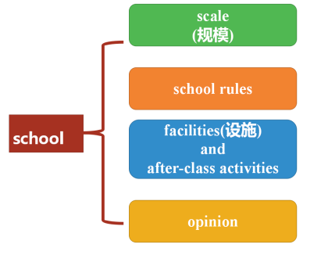

Slide 16
Homework: 1.报纸21期B2版 2.专项训练二代词

