Slide 1
Unit 10
You are supposed to shake hands.
Section A Period 2 3a-4c
WWW.PPT818.COM
Notes:
1
1

Slide 2
3a
Read the following opinions of a
Colombian and a Swiss student . In which
Country is it OK to be 15 minutes late for
dinner?
Colombia
Switzerland

Slide 3
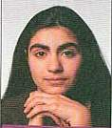
Teresa Lopez
Cali, Colombia
Where I’m from, we’re pretty relaxed about time. We don’t like to rush around, so we don’t mind if people are a little late sometimes. If you tell a friend you’re going to their house for dinner, it’s OK if you arrive a bit late. We like to enjoy our time slowly. We value the time we spend with our family and

Slide 4
friends in our everyday lives. We often just drop
by our friends’ homes if we have time. We don’t
usually have to make plans to meet our friends.
When we see each other, it’s polite for boys to
shake hands and for girls to kiss each other on
the side of the face. We often just walk around
the town center, seeing as many of our friends
as we can!

Slide 5
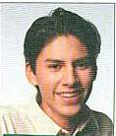
Marc LeBlanc
Lausanne, Switzerland
In Switzerland, it’s very important to be on time.
We’re the capital of clocks and watches, after all! If someone invites you to meet him or her at noon, then you’re expected to be there at noon. If you’re even 15 minutes late, your friend may

Slide 6
get mad. So I make an eﬀort to be on time when I meet my friends. I always leave the house early to avoid heavy traﬃc because I think it’s impolite to keep others waiting. Also, we never visit a friend’s house without calling first. We almost always make plans to see friends. We usually plan seeing as to do something interesting, or go somewhere together.

Slide 7
3b
Attitude towards… | Colombia
being on time
visiting a friend’s house
making plans with friends
We are pretty relaxed about
time.
We often just drop by
our friends’ homes.
We don’t have to make
plans when we get
together with friends.

Slide 8
Attitude towards… | Switzerland
being on time
visiting a friend’s house
making plans with friends
It’s very important to be
on time.
We never visit a friend’s
house without calling first.
We usually make plans to
meet friends.

Slide 9
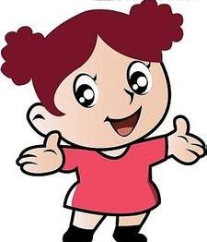
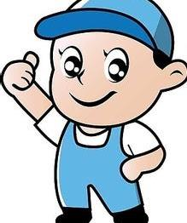
3c
Role-play the conversation.
Teresa, you’re
10 minutes late!
Hi, Marc. Sorry
I’m a little late.

Slide 10
It’s just 10
minutes! It’s
no big deal!
Well, in Switzerland,
you’re supposed to …

Slide 11
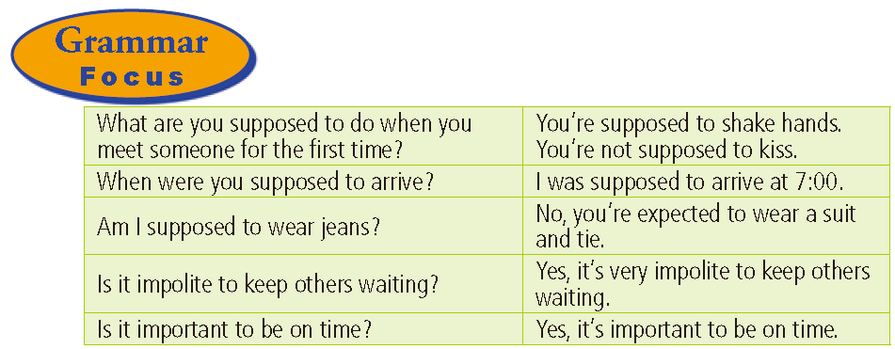
It’s impolite (for sb.) to do sth.(对于某人)做某事是不礼貌的
It’s important （for sb.） to do sth.
（对于某人 ）做某事是重要的

Slide 12
Complete the sentences with the
phrases in the box.
4a
be supposed to
be expected to
be important to
1. When you go abroad, it ______________ bring your
passport.
2. After class, students _______________ clean the chalk off the blackboard.
is important to
are supposed to

Slide 13
3. If you visit the northern coast of Norway during the
winter season, it ____________ pack warm clothes.
4. If there are people in the meeting room, you
___________________________ knock before entering.
5. In many eastern European countries, you
_____________________________ take off your
gloves before shaking hands.
is important
are supposed to / are expected to
are supposed to / are expected to

Slide 14
4b
Fill in the blanks with the correct forms
of the words in brackets.

Slide 15
Each country has different rules about social situations. A traveler ______________________ (not expect; know) all of these, but it is helpful ____________(learn) as many of these customs as possible. One of the best ways to be accepted in a foreign country is to try _____________ (understand) how people think. Learning what you _____________________(suppose; do) and ________________________ (not suppose; do) in social situations may be difficult, but it is worth the trouble if you want to understand another culture.
isn’t expected to know
to learn
to understand
are supposed to do
aren’t supposed to do

Slide 16
4c
Make a list of advice for someone coming to
your country as an exchange student for the
first time. Work with your group to give advice
about.

Slide 17
Time
meeting people
table manners
what to do for someone’s birthday
visiting someone’s home
giving gifts

Slide 18
HOMEWORK
1. Recite the new words.
2. 根据小组对4c讨论的结果，写一篇短文。
Notes:
18
18

Slide 19
Thank you!

