Slide 1
Unit 7
Seasons
Grammar 1
WWW.PPT818.COM

Slide 2
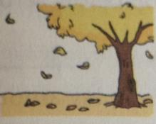
The leaves fall.
S
V
The temperature drops.
S
V
The snowy season will begin.
S
V
Intransitive verbs

Slide 3
The flowers are beautiful.
V
P
S
Autumn leaves turn brown.
S
V
P
The weather becomes cool.
S
V
P
be
become
get
look smell
taste sound
feel …
linking verbs

Slide 4
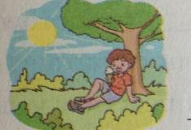
He is eating ice cream.
S
V
O
Farmers harvest crops.
S
V
O
White snow covers the whole earth.
S
V
O
transitive verbs

Slide 5
the structure of the sentences
We have four seasons.
They are quite different.
Sprig is warm and sunny.
We fly kites.
We like summer.
Ice cream tastes nice.
Autumn arrives.
Snow falls.
S
V
O
S
V
P
S
V
P
S
V
O
S
V
O
S
V
P
S
V
S
V

Slide 6
Thank you!

