Slide 1
Unit4 At the Sports Meeting
陕旅版六年级下册
第一课时
WWW.PPT818.COM

Slide 2
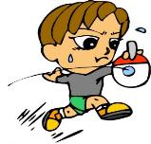
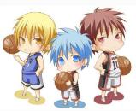
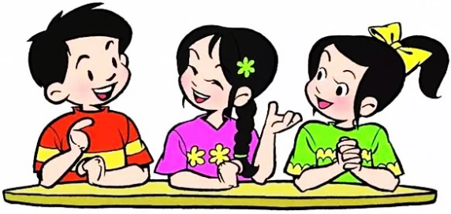
>>Warm-up
Free talk
What kind of exercise do you like?

Slide 3
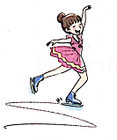
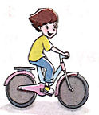
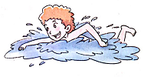
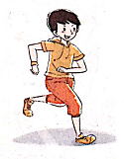
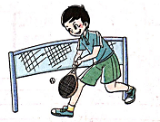
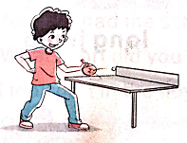
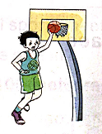
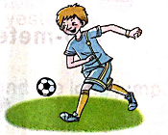
>>Lead-in
Look and tick
What are you good at?

Slide 4
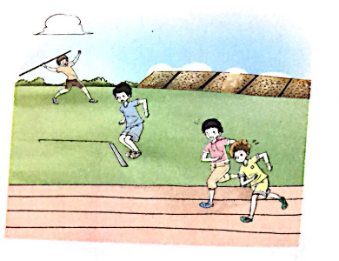
>>Presentation
Let’s learn
We have a sports meeting in our school.
have a sports meeting

Slide 5
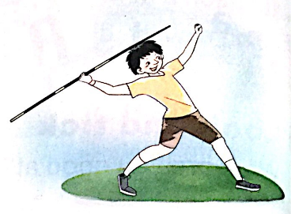
>>Presentation
Let’s learn
-Who is good at throwing in our class?
-Lin Lin is good at throwing.
throwing
th + row + ing

Slide 6
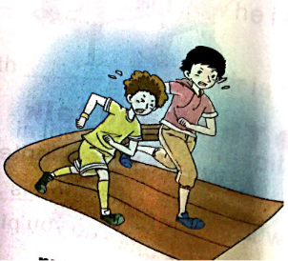
>>Presentation
Let’s learn
-Are you good at 100-meter race?
-No. I’m good at running race.
100-meter race
running race

Slide 7
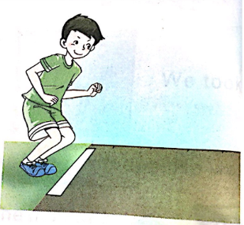
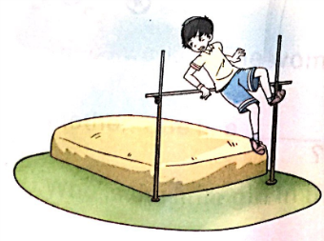
>>Presentation
Let’s learn
-Do you like long jump or high jump?
-I like high jump. I’m good at it.
long jump
high jump

Slide 8
>>Practice
Magic fingers
throwing
long jump
100-meter race
running race
high jump
have a sports meeting

Slide 9
>>Practice
Play a game
high
jump
have a
sports
meeting
throwing
running race
What’s missing?
100-meter
race
long jump

Slide 10
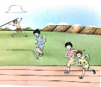
>>Summary
本课所学的重点单词：
running race
throwing
100-meter race
long jump
high jump
have a sports meeting

Slide 11
>>Homework
1.听课文录音并跟读，按照正确的语音、语调朗读并表演课文对话。 2.同伴之间互相提问本节课所学的新单词，并默写一遍。
3.预习 Unit4 A Let’s talk。
close

