Slide 1
Unit 2
How often do you exercise?
Section A1a-2c
WWW.PPT818.COM

Slide 2

Words review
housework
hardly
ever
hardly ever
once
n. 家务劳动；家务事
adv. 几乎不；几乎没有
adv. 在任何时候；从来；曾经
几乎从不
adv.一次；曾经

Slide 3
Words review
twice
Internet
program
full
swing
swing dance
adv. 两次；两倍
n. 互联网；因特网
n. 节目
adj. 忙的；满的；充满的
n. 摆动；秋千
v. (使)摆动；摇摆
摇摆舞

Slide 4
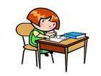
Group work
What do you usually do on weekends?
does she
She
I usually
…
on weekends.
PPT模板：www.1ppt.com/moban/ PPT素材：www.1ppt.com/sucai/
PPT背景：www.1ppt.com/beijing/ PPT图表：www.1ppt.com/tubiao/
PPT下载：www.1ppt.com/xiazai/ PPT教程： www.1ppt.com/powerpoint/
资料下载：www.1ppt.com/ziliao/ 范文下载：www.1ppt.com/fanwen/
试卷下载：www.1ppt.com/shiti/ 教案下载：www.1ppt.com/jiaoan/
PPT论坛：www.1ppt.cn PPT课件：www.1ppt.com/kejian/
语文课件：www.1ppt.com/kejian/yuwen/ 数学课件：www.1ppt.com/kejian/shuxue/
英语课件：www.1ppt.com/kejian/yingyu/ 美术课件：www.1ppt.com/kejian/meishu/
科学课件：www.1ppt.com/kejian/kexue/ 物理课件：www.1ppt.com/kejian/wuli/
化学课件：www.1ppt.com/kejian/huaxue/ 生物课件：www.1ppt.com/kejian/shengwu/
地理课件：www.1ppt.com/kejian/dili/ 历史课件：www.1ppt.com/kejian/lishi/
does her
do my homework

Slide 5


What do you usually do on weekends?
does she
She
I usually
…
on weekends.
read books
reads
read books: 读书
= do some reading

Slide 6


What do you usually do on weekends?
does she
She
I usually
…
on weekends.
go shopping
goes
go shopping: 购物
= do some shopping
= shop

Slide 7
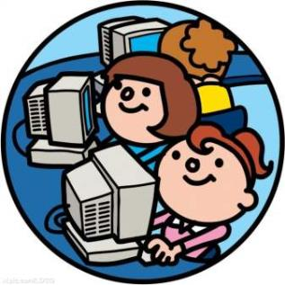

What do you usually do on weekends?
does she
She
I usually
…
on weekends.
surfs
surf the Internet
surf: v. 冲浪 Internet: 因特网
surf the Internet: 上网

Slide 8
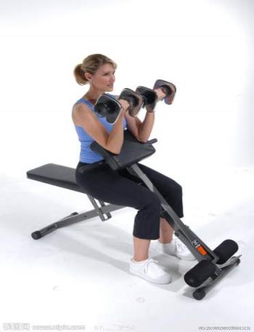

What do you usually do on weekends?
does she
She
I usually
…
on weekends.
exercises
exercise
exercise: v. 做运动

Slide 9
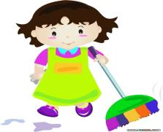


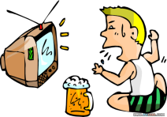
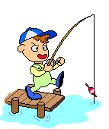
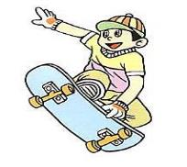
I always do some reading on weekends.
always
usually
总是
通常
often
sometimes
常常
有时
hardly ever
never
几乎不
从不

Slide 10
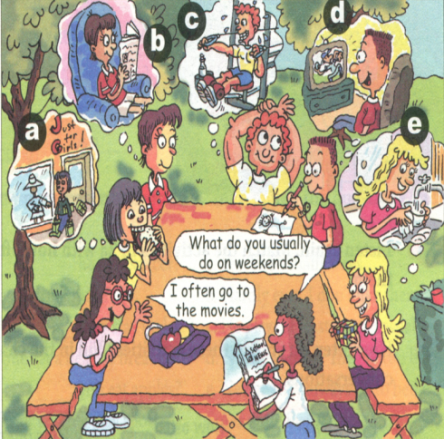
1a. Look at the picture. Make a list of the
weekend activities.
help with housework
1. __________________
2. __________________
3. __________________
4. __________________
5. __________________
read
exercise
watch TV
go shopping

Slide 11
1b Listen and write the letters from the picture above on the lines below.
always(100%) ______________
usually ______________
often ______________
sometimes ______________
hardly ever ______________
never(0%) ______________
exercise, read
watch TV
help with homework
go shopping
watch TV
go shopping

Slide 12
频率副词
always意为 “总是”，表示动作的重复或状态
的延续。
usually意为 “通常”，表示很少有例外。
often意为 “经常”，表示动作的重复，但不如
usually那么频繁，中间有间断。
sometimes意为 “有时”，表示动作偶尔发生。
hardly意为 “几乎不”，常和ever连用表示强调。
never意为 “从未”。

Slide 13
0%
never
从不, 从未
hardly ever
很少, 几乎不
sometimes
有时
often
经常, 常常
usually
通常, 一般
always
100%
总是

Slide 14
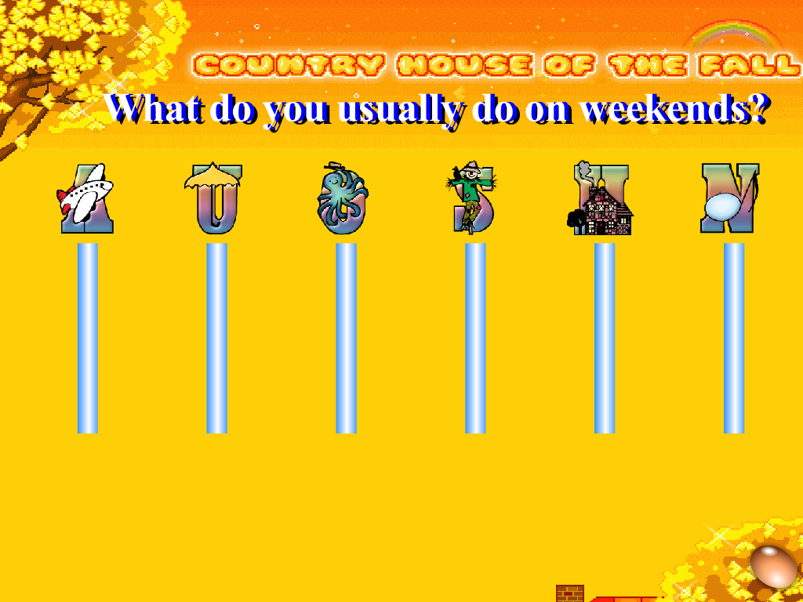













Slide 15
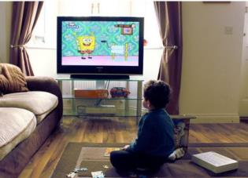

1c Talk about the people in the picture above. What do they do on weekends?
A: What does he do on weekends?
B: He usually watches TV.
A: Does he go shopping?
B: No, he never goes shopping.

Slide 16
2a Listen and Number the activities
you hear.
How often
every day
once a week
twice a week
three times a week
once a month
twice a month
Activities
a. go to the movies
b. 1 watch TV
c. shop
d. exercise
e. red
3
5
4
2

Slide 17


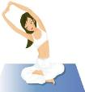
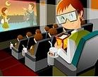
2c How often do you do these activities?
Fill in the chart and then make conversations.
Activities | How often
watch TV | every day
use the internet
read English books
go to the movies
exercise

Slide 18
本课时我们学习的主要语法点是由 wh- 和 how 引导的特殊疑问句以及对应的答语。如: What do/does …?
How often do/does …? 等。
What do you usually do on weekends?
你通常周末做什么？
I usually listen to music.
我通常听音乐。

Slide 19
疑问词 how often 是问频率 (多久一次？),（在这里助动词 do (does或did) 是起帮助构成疑问的作用）与一般现在时或一般过去时连用, 回答一般是用表示频率的副词。
如：once, twice, three times…, sometimes, quite, often, never, every day, once a week, twice a month, three times a month, three or four times a month 等。

Slide 20
How often + 助动词 do (does 或 did) + 主语 + do sth.?
用来询问（主语）多久进行一次某个（活动）
How often does your brother go shopping?
你哥哥多久会去一次购物？
He goes shopping every Friday.
他每周五去购物。
How often does Lily do her homework?
Lily多久会做一次作业？
She does her homework every day.
她天天做作业。

Slide 21



I like reading.
She reads books every day.
She always(总是) reads books.
Sun. Mon Tues. Wed . Thurs. Fri. Sat.
read
read
read
read
read
read
read

Slide 22


I often play soccer.
He plays soccer five times(次数) a week.
He usually(通常) plays soccer.
Sun. Mon. Tues. Wed . Thurs. Fri. Sat.
go
go
go
go
go

Slide 23

I like doing exercise.
He does exercise twice(两次) a week.
He sometimes(有时) does exercise.
Sun. Mon. Tues. Wed . Thurs. Fri. Sat.
do
do

Slide 24
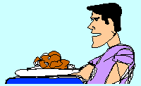
I don’t like swimming. I like eating.
He never(从不) goes swimming.
He always eats.
Sun. Mon. Tues. Wed . Thurs. Fri. Sat.

Slide 25
练习：补全单词
1. --What do you usually do on
w_________?
--I often watch TV.
2. --How often does she shop?
--O_____ or t_____ a week.
3. Grandpa is pretty healthy because
he e_________ every day.
4. Animal World is my favorite TV
p___________.
eekends
nce
wice
xercises
rogram

Slide 26
5. The weather here is so cold,
I can h______ stand it.
6. These two pictures have
no __________(区别).
ardly
differences

