Slide 1
11111111
Unit 3 Writing Home
五年级下册
Lesson13 Let‘s Buy Postcards!
WWW.PPT818.COM

Slide 2
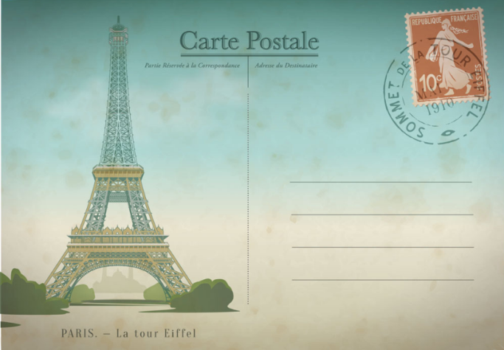
This postcard has a picture of The Eiffel Tower on it.

Slide 3
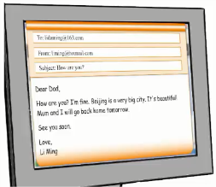
1. Postcard, letter and email
These are postcards.
A postcard has a picture on it.
This is a letter.
We write a letter on paper.
This is an email.
We write an email on a computer.

Slide 4
2. In the shop
Jenny，Danny and Li Ming want to buy some postcards. They are in the shop.
Jenny: This postcard has a picture of the Palace Museum!
Liming: This postcard has the Great Wall.
Jenny: I want to send this postcard to my mum and dad.
Danny: May I see that postcard，please ?
Seller: Sure!
Danny: How much is this postcard ?
Seller: It’s two yuan.
Danny: I’ll take nine, please.

Slide 5
知识点1
a picture of… 一幅……的图画
a picture of + 某人/ 某物意为“ 一张某人/ 某物的图片/ 照片”，它通常表示图片/ 照片上有某人或某物。
a picture of Lucy a picture of a dog
一张露西的照片 一张狗的图画

Slide 6
知识点 2
send /send/ v. 邮寄；发送
I want to send a postcard to my friend.
我想要给我的朋友寄一张明信片。
例句：
bend 弯曲 lend 借给 sand 沙子
形近词：
send（原形）→ sent（过去式）
词形变化：

Slide 7
send sth. to sb.= send sb. sth.
把某物寄给某人
短语：
want to send a gift to my father.
＝ I want to send my father a gift.
我想要寄给我爸爸一份礼物。
例句：

Slide 8
知识点 3
May I see that postcard，please?
请问我可以看看那张明信片吗？
句型：
May I + 动词原形（+ 其他），please ？
请问我可以……吗？用来礼貌地提出请求。
Sure./ Certainly./Of course. 当然可以。
肯定回答：
—May I have a look at your new book ？
我可以看下你的新书吗？
—Of course. 当然可以。
例句：

Slide 9
知识点 4
How much is this postcard? 这张明信片多少钱？
句型：
How much is / are ... ? ……多少钱？用来询问物品的价钱。how much 也可单独使用，意为“多少（钱）”。
It’s/They’re + 基数词+ 货币单位。
答语：
—How much are these apples ？这些苹果多少钱？
—They are 15 yuan. 十五块钱。
例句：

Slide 10
how much 还可以用来提问不可数名词的数量。
其结构为“How much + 不可数名词+ 其他？”。
拓展
How much water is there in the bottle ？
瓶子里有多少水？
例句：

Slide 11
I’ll take nine, please. 我要买九张。
知识点 5
I’ll take... 句式常用来表示“我要买……”。
I’ll 是I will 的缩写形式。take 在这里是动词，
“买”的意思。
用法：
I’ll take it ！我买下它了！
例句：

Slide 12
3. Let’s do it!
1．Look, write and draw.
a
Li Ming：I want to send a letter to my uncle.
b
Steven：________________________________
c
Danny：________________________________
d
I： ________________________________
I want to send a postcard to Danny.
I want to send an email to my mum.

Slide 13
3. Let’s do it!
2．Talk and write.
Jenny：How much is the postcard ？
Kim：It’s three yuan.
How much is the postcard ？ It’s three yuan.
___________ is the cap ？ It’s ___________ .
____________________ ？ _________________ .
____________________ ？ ___________________ .
_______________________ ？ ______________ .
How much ten yuan
How much is the T­shirt It's fifteen yuan
How much is the book It's twenty­three yuan
How much is the toy panda It's thirty yuan

Slide 14
一、单项选择。
1. This is a picture ______ Mount Tai.
A. with B. to C. of
2. — ______ I see that toy car ？
—Sure.
A. can B. May C. may
3. I’ll ______ this bag.
A. take B. took C. taking
C
B
A

Slide 15
二、用所给单词的适当形式填空。
（ 1）The postcard _______（ have）a picture on it.
（ 2）How much _______ （ be）these oranges ？
（ 3）I want _______ （send）this letter to my friend.
has
are
to send

Slide 16
三、选择合适的选项补全对话。
John: Look at this postcard.______
Jason: Oh，it’s great ！ I want to send this postcard to Mum.
John: It’s good. ______
Shop assistant: Sure ！
John:______
Shop assistant: They are twelve yuan.
John: OK. ______
C
A
D
B
A. May I see these postcards，please ?
B. I’ll take them.
C. It has a picture of the Great Wall.
D. How much are these postcards ?

Slide 17
本节课我们学习了以下知识，请同学们一定加强巩固，以便能和同学们进行灵活交流哦！
重点词汇：send➢
重点短语：a picture of…
重点句式：May I see that postcard，please?
How much is this postcard?
I’ll take nine, please.

Slide 18
1 熟记本节课所学的句型、短语和单词，必须会听、说、读、写。
2 将In the shop的对话朗读流利。
3 完成配套的课后作业。

