Slide 1
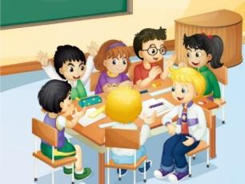
Unit 3 We should obey the rules.
人教精通版英语五年级下册
WWW.PPT818.COM

Slide 2
>>Warm-up
Review
Class Rules
Listen carefully and talk actively.
Hand in your homework on time.
Don’t be late for school.
Don’t make noise in class.

Slide 3
>>Lead-in
What rules should we obey at school?
Who obey the school rules very well in our class?

Slide 4
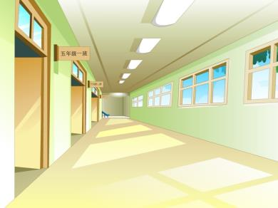
>>Presentation
class
We are making a list of class rules.

Slide 5
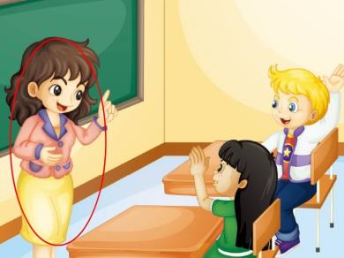
>>Presentation
ask
The teacher is asking questions.

Slide 6
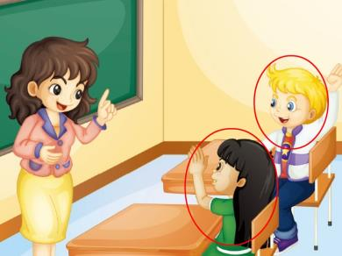
>>Presentation
answer
They answer questions actively.

Slide 7
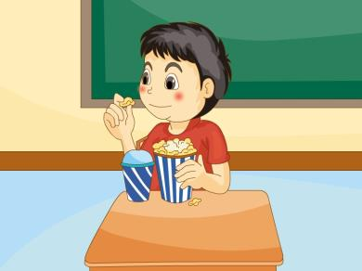
>>Presentation
eat
Please don’t eat in class.

Slide 8
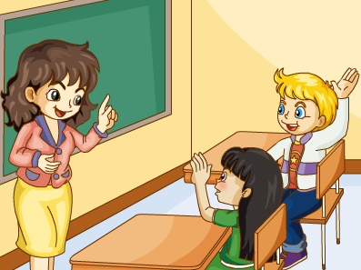
>>Practice
Just practice

Slide 9
>>Practice
Just write
o
o
s
k
a
w
e
a
n
as__
ans__er
e__t
mak__
thi__k
l__te
clas__
sch___l

Slide 10
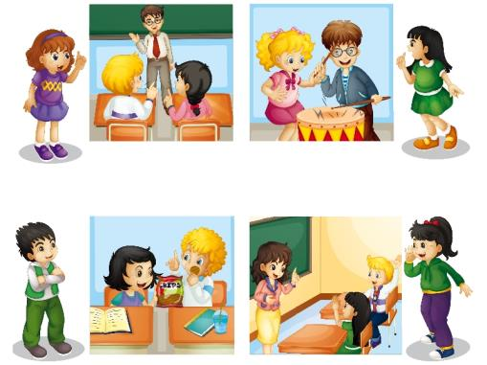
>>Practice
Let’s act
Don’t make noise.
Be quiet.
Don’t eat in class.
Ask and answer questions actively.

Slide 11
>>Practice
Group Work
Class Rules
Let’s make a new list of class rules together!

Slide 12
>>Presentation
Let’s chant

Slide 13
>>Summary
四会单词：
ask
answer
eat
make
think
late
class
school
还有哪些课堂上应该和不应该做的事情？
Ask and answer questions actively.
Be quiet.
Don’t make noise.
Don’t eat in class.

Slide 14
>>Homework
1. 观看课文动画，按照正确的语音、语调朗读课文。
2 . 朗诵并熟读Let’s chant部分。
3 . 预习Lesson15。
close

