Slide 1
Unit 12
Christmas
WWW.PPT818.COM

Slide 2
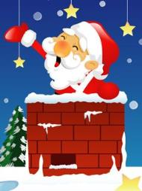
Christmas day falls on 25 December.
It is a festival in the West.

Slide 3
圣诞节的由来
The word“Christmas”is a combination of the words“
Christ”and“Mass”。“Christmas”这个词是“基督”和“弥撒”
的缩写，弥撒是教会的一种礼拜仪式。
耶诞节是一个宗教节日，
世人把它当作耶稣的诞辰来庆祝，
因而又名耶诞节。这一天，世界所有的基督教会都举行特別
的礼拜仪式。但是有很多圣诞节的欢庆活动和宗教并无半点
关联。又有人说耶稣诞生是在夏末秋初，并非圣诞之日。然
而，圣诞节究竟是否耶稣诞辰之日对于现代人来说已经不那
么重要，它就像我们的春节一样，大家相聚一堂，交换礼物，
寄圣诞卡，吃火鸡大餐，圣诞节是一个普天同庆的日子。

Slide 4
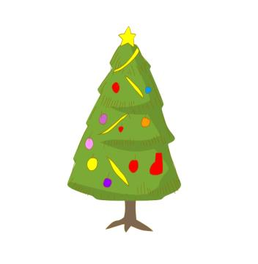
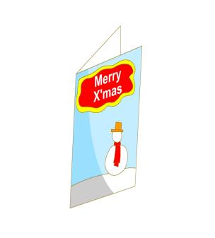
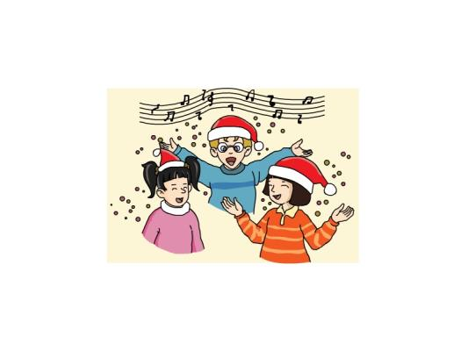
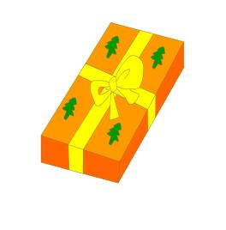
Christmas/ˈkrɪsməs/
tree圣诞树
Christmas card
圣诞贺卡
Present/ˈpreznt /
礼物
Celebrate/ˈselɪbreɪt /
庆祝

Slide 5
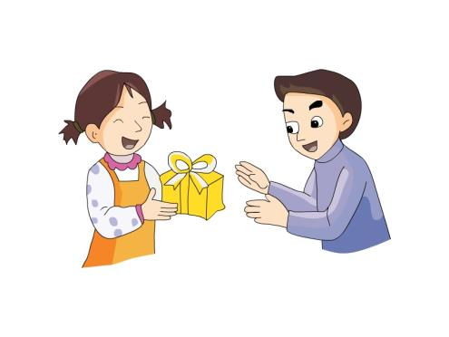
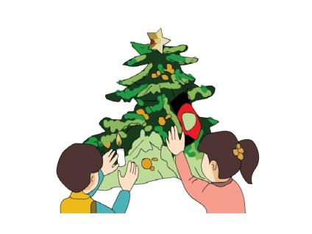
receive/rɪˈsi:v /
收到
People send Chritsmas cards to their friends.
人们送圣诞卡片给他们的朋友。
decorate/ˈdekəreɪt /
装饰

Slide 6
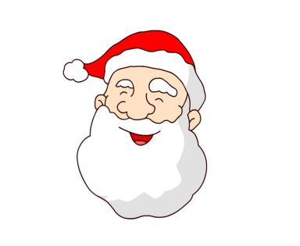
Santa Claus gives out
presents to children.
圣诞老人分发礼物给孩子们。
Santa/ˈsæntə /Claus/klɔ:z /
圣诞老人
Christmas/ ˈkrɪsməs / father
greet/gri:t /
问候
Merry/ˈmeri / Christmas
to you
祝你圣诞快乐

Slide 7
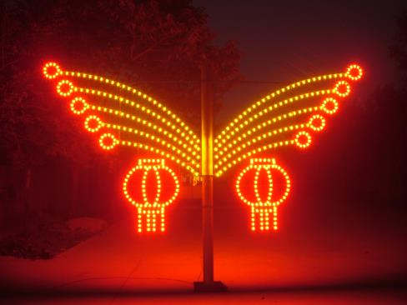
colourful/ˈkʌləfl /
light/laɪt /彩灯
decorate Christmas trees with colourful lights
and balls. 用彩灯和彩球来装饰圣诞树。
dress/dres / up 装扮；穿上盛装
dress up like Santa Claus 装扮成圣诞老人

Slide 8
New words
Christmas/ˈkrɪsməs / greet/gri:t /问候
decorate/ˈdekəreɪt /装饰
Christmas/ˈkrɪsməs/ tree圣诞树
colourful/ˈkʌləfl /light/laɪt /彩灯
present/ˈpreznt /礼物
dress/dres / up 装扮；穿上盛装
Santa/ˈsæntə /Claus/klɔ:z /圣诞老人
receive/rɪˈsi:v /收到
Merry/ˈmeri / Christmas圣诞快乐

Slide 9
Christmas decorate card
present Santa claus tree
Magic Eyes火眼金睛
Christmas
decorate
card
present
Santa Claus
tree

Slide 10
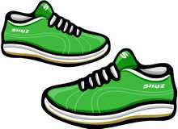
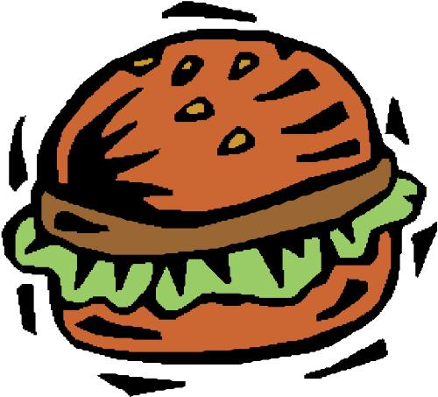
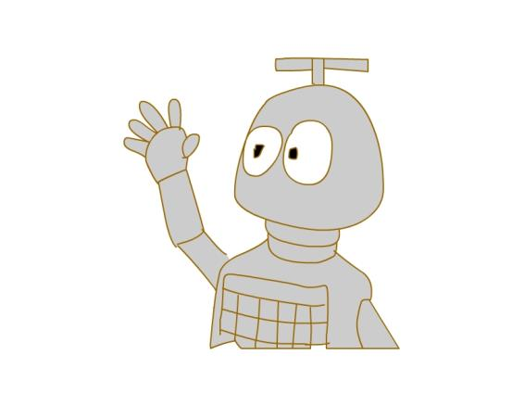
What present can you see?

Slide 11
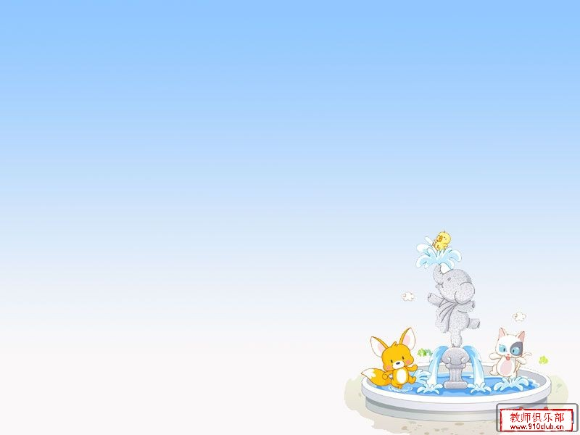
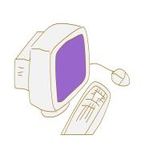
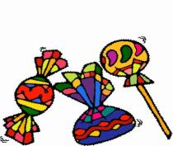
What present do you want?
I want a/some _________.
computer
robot/ˈrəʊbɒt /
toy plane
sweets
scarf
hat
football
hamburger

Slide 12
Here is present for you.
Here is a computer for you .

Slide 13
一,Read A quickly, then answer questions:
When is the Christmas Day?
Christmas falls on 25th December.

Slide 14
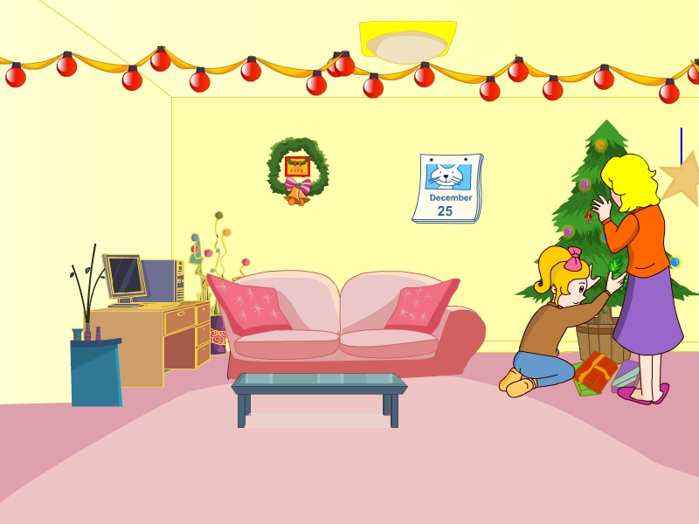
在
放置
Christmas day falls on 25 December. People put up a
Christmas tree in their home.

Slide 15
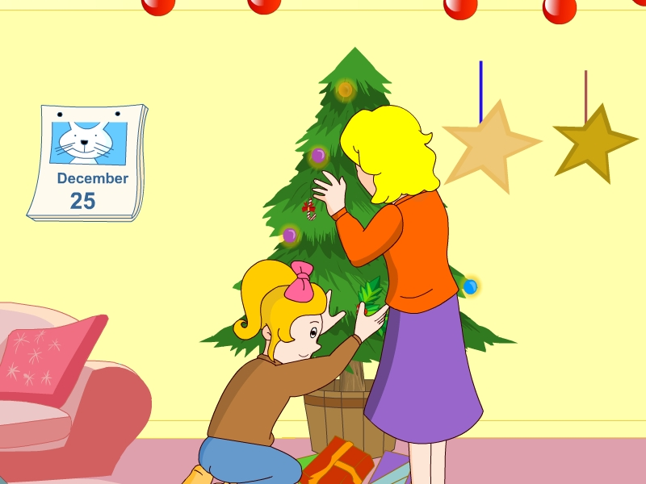
礼物
They put presents
for family and friends
under the Christmas
tree.

Slide 16
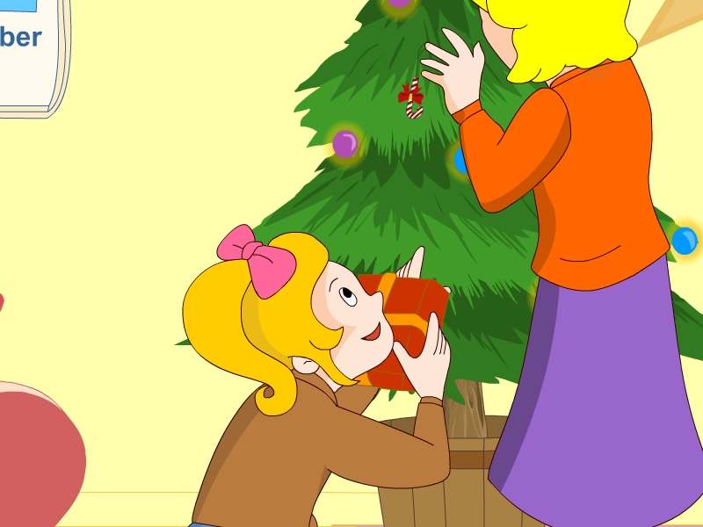
又
It’s Christmas again!
I can’t wait to open my present.
等待
You can open it on Christmas day.

Slide 17
1 Which day is Christmas Day?
A:It falls on 25th of December
B:It falls on 24th of December
2 People ________ a Christams tree in their
home.
A:放置 B:拾起
3 Where do People put present
for their family and friends?
A: on the Christmas tree.
B: under the Christmas tree.

Slide 18
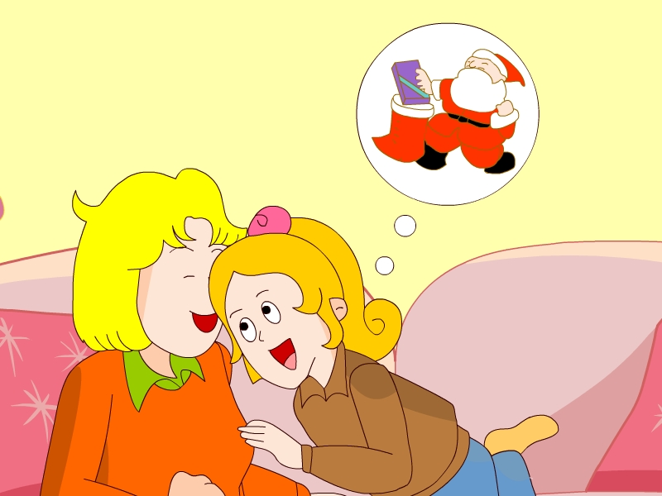
Santa Claus or Father Christmas
will go to each house. He leaves
Presents for the children in their
Stockings.
长筒袜

Slide 19
1 Who is Father Christmas?
Santa claus.
2 What will the Santa Claus do ?
He will go to each house.
3 Santa claus leaves presents for the children
in their __________
A: school bags
B: stockings

Slide 20
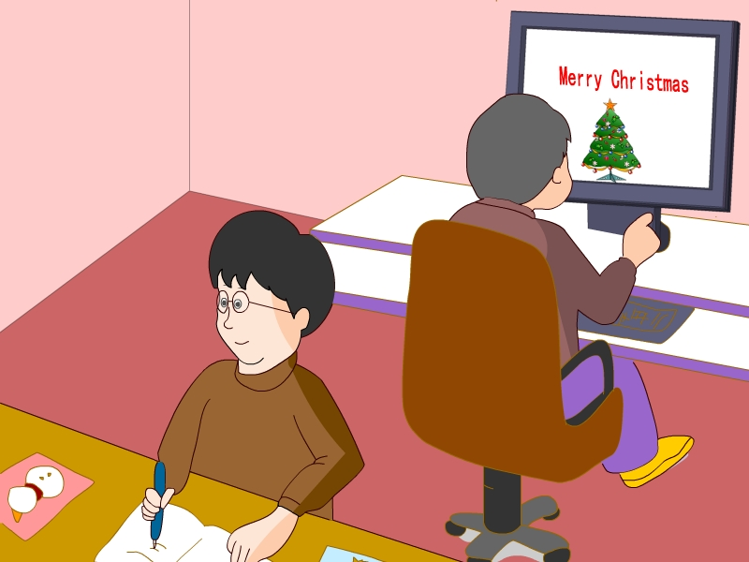
People send Christmas cards to
their friends to wish them a
“Merry Christmas”.

Slide 21
1 How do People wish each other?
Send cards to their friends.
2 On Christmas, you should
say ________________
to others.
Merry Christmas!

Slide 22
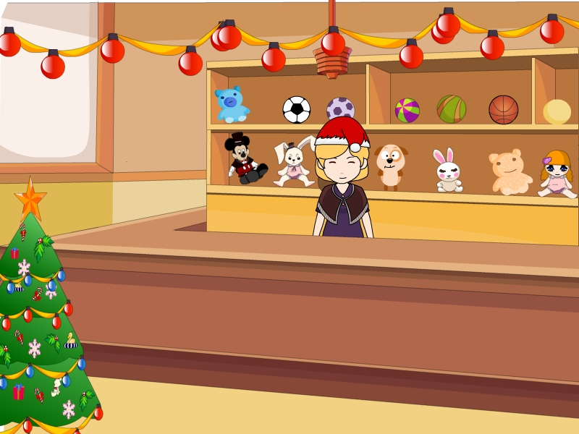
People buy a lot of things for Christmas.
in big shopping centers, Father Christmas
gives gifts to children.

Slide 23
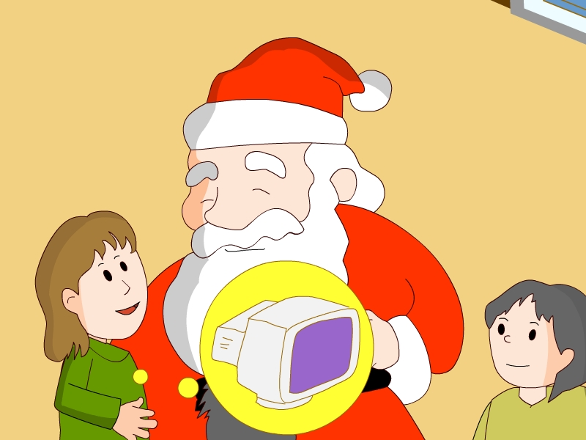
What present do you want?
I want a computer
I want a bike.
I want a robot.

Slide 24
Watch A carefully, then finish part C:
1 When do People celebrate Christmas?
2 What does Father Christmas do in the shopping centre
at this time of the year?
What does Father Christmas do at Christmas?
Who is Father Christmas?

Slide 25
Let' learn

Slide 26
Homework
1 熟读A部分。
2 抄写单词4遍，中文一遍。
3 准备好一份圣诞小礼物。

