Slide 1
Lesson 45
Let’s Sort Garbage
WWW.PPT818.COM

Slide 2
【知识回顾】 1. Don’t forget to turn the light ____ when you leave. A on B off Cup Ddown 2.We shouldn’t ___________ the waste paper ______ (扔掉) 3.Nobody ____________(come)to school in a car. 4.I saw you _________(play) football when I came to school. 5.He can sing the English song(被动) The English song ______ ______ ______ by him
B
throw away
comes
playing
can be sung

Slide 3
一、认知学习目标
New words
sort v &n 分类，整理
empty v & adj 把…倒空， 空的
metal n 金属
plastic n & adj 塑料
recycle v 回收再用，再循环 amount n 数量
litter n & v 垃圾，乱扔

Slide 4
Phrases
do with = deal with 处理
throw away 扔掉
take out 拿出去、带出去
make into 制成
two bags of garbage 两袋垃圾
more than 超过，多于
less than 少于

Slide 5
二、预习成果展示
rubbish litter
1.garbage(近义词)__________/___________
2.little(比)________(最高级)_________
3.break(过去式)_________(过去分词) ________ (adj.)__________
4. empty（反义词）________
5. throw away _________
6.处理 ______________ = ______________
7两袋垃圾____________
8.make into ___________
less least
broke broken
broken
full
扔掉
do with deal with
two bags of garbage
制成

Slide 6
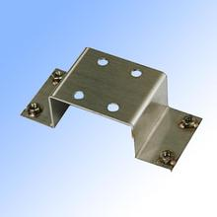
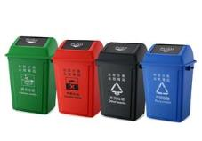
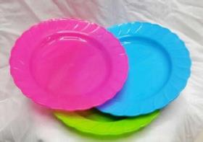
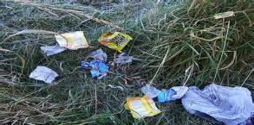
三、课堂研讨助学
活动一：Learn some new words
sort[sɔːt]
分类，整理
metal [‘metl]
金属
empty ['empti]
把…倒空， 空的
recycle [riː‘saɪkl]
回收再用，再循环
litter [ lɪtə]
垃圾
plastic [‘plæstɪk]
塑料

Slide 7
Free talk
What do you do with your garbage?
What kinds of things can be recycled and reused?

Slide 8
活动二：Listen to the dialogue and write true（T） or false (F)
1. There is a lot of garbage: glass, metal, plastic and paper. ( )
2. There is the most amount of glass and the least amount of paper. ( )
3. Danny found Debbie’s toy car in the garbage. ( )
4. Danny once cut his foot on a piece of broken glass. ( )
T
F
F
T

Slide 9
1.Why are Danny and Jenny surprised after sorting the garbage?
2.How do people waste paper?
3.What will Danny do with the broken toy car?
4.Why is it dangerous to drop litter / rubbish carelessly?
活动三：Read the dialogue and answer the following questions
Because almost all of it can be reused or recycled! They need to throw only one small bag of garbage.
They use paper only on one side.
He will take it home and clean it. Then he will fix the broken wheel. Finally he will give it to Debbie.
Because litter can hurt people.

Slide 10
活动四：Language points
1.Read the dialogue and find out other sentences with it
It is dangerous to leave broken glass on the ground.
It is not right to waste things.
It is a waste to use paper only on one side.
“It”
可以指时间、天气、距离、和前面提到的事情

Slide 11
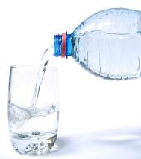
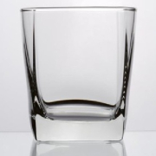
2.Danny empties two bags of garbage onto the floor
【点拨】此句中的empty为及物动词，意为“倒空；使……成为空的”，常和from, onto等介词搭配使用。empty...from…把……从……倒出；
empty…onto…把……倒在……上
1
Empty the bottle.
The bottle is empty.

Slide 12
3. Almost all of it can be reused or recycled.
情态动词的被动语态，其结构为“情态动词 + be + 动词的过去分词”，
否定句在情态动词后加not, 疑问句把情态动词提前。
如：Must the work be done at once?
(2) almost=nearly 作副词，意为“几乎；差不多”。
Exercises:
1.We can plant trees every year. (被动）
Trees ________ ________ _______ by us every year.
2.The bike can be fixed(否定句）
The bike _______ _______ fixed.
3.Tom will clean the classroom.(被动)
The classroom ______ _______ _______.
can be planted
can be
will be cleaned

Slide 13
1.It’s not right ____________(waste) things 2.Danny , _______________(not throw) away the garbage. 3.It took him half an hour _______(finish) _______(repair) the computer 4.It is a waste __________(use) paper only on one side. 5.One of the wheels ________(be) broken. 6.It’s dangerous _______(leave) broken glass on the ground . 7.Danny cut his foot on a piece of __________(break) glass. 8.We should plant many trees in spring (改为被动语态) Many trees ___________ _____ _________ in spring by us. 9.You needn't do it now. (被动) It _________ ______ _________ by you now 10. What do you do with the problem?(同) _______ do you ________ ________ the problem?
四、当堂训练检测
to waste
don’t throw
to finish repairing
to use
is
to leave
broken
should be planted
needn’t be done
How deal with

Slide 14
Homework
1. Finish exercises of Lesson 45.
2. Preview lesson 46.

Slide 15
Thanks!

