Slide 1
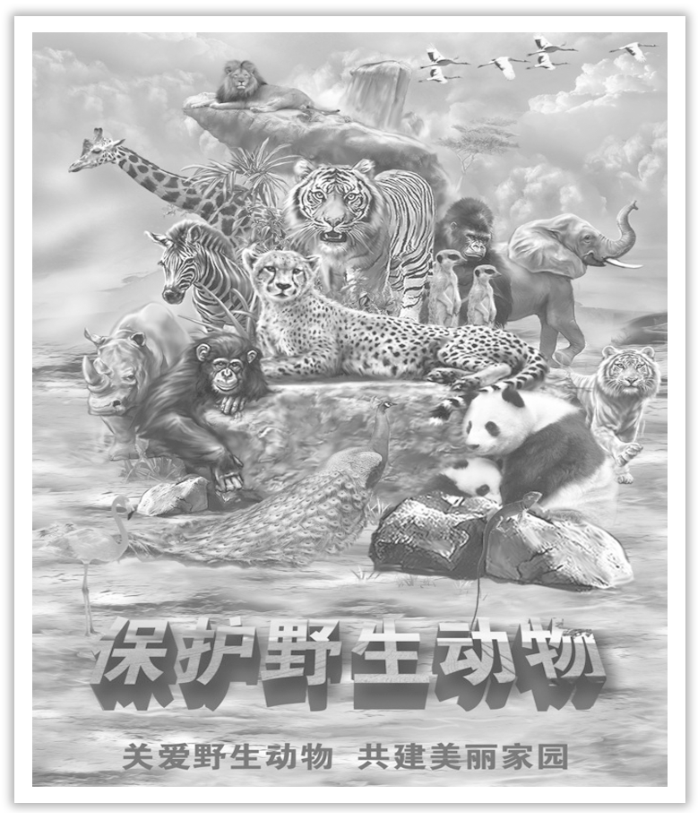
Unit 2 Wildlife Protection
Section Ⅶ Reading for Writing
WWW.PPT818.COM

Slide 2
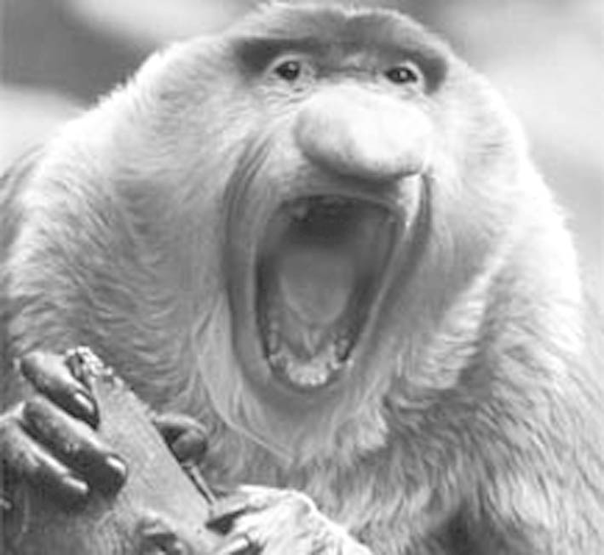
有关濒危动物的海报
本单元的写作任务是读两则有关动物保护的海报，然后写一则有关濒危动物的海报。
Ⅰ.Pre-reading
(Ⅰ)Learning to write after the model
Give Ugly a Chance!
When it comes to wildlife protection, all species—the good, the bad, and the ugly—should be treated equally.Pandas, dolphins, and other cute wildlife are important, but we must pay attention to less cute animals, too.The world needs all kinds—without variety, our planet cannot survive.So if you want the future to be beautiful, you have to give ugly a chance.

Slide 3
(Ⅱ)Preparation for writing—words and phrases
①____________ n. 环境 ②____________ n. 污染
③____________ n. 种群 ④____________ v. 保护
⑤____________ n. 栖息地 ⑥____________ n. 平衡
⑦____________ adj. 珍稀的 ⑧____________ v. 融化
⑨____________ v. 消失 ⑩____________ 关爱
⑪____________ 人类 ⑫__________________ 与……和谐相处
environment
pollution
population
protect
habitat
balance
rare
melt
disappear
care for
human beings
live in harmony with

Slide 4
篇章结构
The title：Give Ugly a Chance!
The image：an ugly animal
The body：the reasons for protecting ugly animals & calling on protecting the ugly animals

Slide 5
常用词汇
animal, live, warm, cold, sea，ocean, ocean, forest, mountain, ice, bear, elephant, panda, tiger, dolphin, bird, eat, kill, catch, hunt, fur, protect, balance, human beings, planet, equal, nature, harmony, responsibility, product, cherish, environment, wildlife, danger, extinct, treasure, species, raise, awareness, damage, destroy, as long as, because, indeed...

Slide 6
Ⅱ.While-writing
请根据下面有关白鳍豚的信息写一则有关保护白鳍豚的80词左右的海报。
Yangtze River Dolphin
Why is it endangered? Habitat loss and pollution
Population：1，000-1，800
What is being done? The dolphins are being moved to a clean and
safe habitat.
What can we do? Clean up the rivers!

Slide 7
Step 1 Organize the poster.
①The title：____________________________________________________________
②The image：Use a powerful image of a dolphin to attract the readers’ attention.
③The body：Make a brief introduction of dolphin and tell the readers _______________________________________________________________________.
We Are In Danger! Do You Want to See Us Again?
how to protect the dolphins

Slide 8
Step 2 List the words，phrases and sentences.
1.Words and phrases
①____________ n. 水域 ②____________ n. 栖息地
③____________ v. 减少 ④____________ adv. 迅速地
⑤____________ adv. 不幸地 ⑥____________ 由于，因为
⑦____________ 为了 ⑧____________ 清洁
⑨____________ 处在危险中 ⑩_________________________ 中下游
waters
habitat
reduce
rapidly
unluckily
due to
in order to
clear up
in danger
the middle and lower reaches

Slide 9
2.Sentences
①我们被叫作白鳍豚，主要生活在长江中下游。(被动语态)
________________________________________________ the middle and lower reaches of the Yangtze River.
②由于污染，我们的栖息地变得越来越小，所以我们的数量也在迅速减少。(due to，reduce)
Our habitats ______________________________________________________, so our population ___________________________.
We are called Yangtze River dolphins and mainly live in
are becoming smaller and smaller due to pollution
is also reducing rapidly now

Slide 10
③为了防止我们被捕杀，我们正被转移到一个干净安全的栖息地。(in order to，be being done)
________________________________， ________________________ a clean and safe habitat.
In order to stop us being killed
we are being moved to

Slide 11
Step 3 Draft the poster by using the following words and phrase.
We Are In Danger! Do You Want to See Us Again?
We are called Yangtze River dolphins and mainly live in the middle and lower reaches of the Yangtze River and Dongting Lake, Poyang Lake, Qiantang River waters, etc.Our habitats are becoming smaller and smaller due to pollution，so our population is also reducing rapidly now.Unluckily, our numbers are only between 1，000 and
1，800.In order to stop us being killed, we are being moved to a clean and safe habitat.Do you want to see us again? Clean up the rivers now!

Slide 12
Ⅲ.Post-writing—polishing the passage
Exchange your passage with your partner and pay attention to the following points.
□1.Does the poster include key information about the animal?
□2.Does the poster explain why the animal is endangered?
□3.Does the poster support its information with facts?
□4.Is the message of the poster clear, i.e.can you tell clearly what the designer wants the reader to think or do?
□5.Is the image on the poster effective？

Slide 13
亮点表达
1.Stop killing and protect wild animals.
停止杀戮，保护野生动物。
2.It’s wrong for people to hunt animals for their meat and feather.
人们为了肉和羽毛而猎杀动物是错误的。
3.We should protect them instead of killing them.
我们应该保护它们而不是杀害它们。
4.Giant pandas, which are one of the endangered animals, live in the forest and live on bamboo.
大熊猫是濒危动物之一，它们生活在森林里，以竹子为食。

Slide 14
5.We shouldn’t pollute water and environment or cut down so many trees.
我们不应该污染水和环境或砍伐这么多的树木。
6.Love animals, so that human beings are not alone!
爱护动物，让人类不孤单！
7.Protecting wild animals is a better choice for human beings!
保护野生动物是人类更好的选择！
8.Is it right to make animals homeless so that humans can have more paper?
为了让人类有更多的纸而让动物无家可归，这样做对吗？

Slide 15
写作技巧
海报(poster)是一种带有装饰性的宣传广告。它们常常配上较为醒目的绘画图案和大字标题。内容以公益宣传、影讯、展览、演出信息、友谊赛等为主。
海报的语言多以说明为主，有时加以简单的描写。有时以简单的条目展示为主，并配上数字说明。海报的正文最后常带上劝说性的文字，以提醒人们注意。

