Slide 1
Unit 1 Topic 1
Welcome to China! Section B
WWW.PPT818.COM

Slide 2
Warm-up Fellow me!
T: Good morning.
S（s）: Good morning.
T: I’m ...， Are you ...?
S: Yes, I am.
T: How do you do?
S: How do you do?

Slide 3
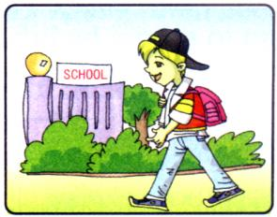
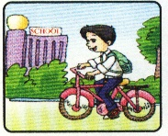
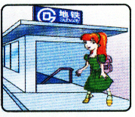
This is Michael.
This is Kangkang.
This is Jane.

Slide 4
1b Introduce your new classmates to others, using This is … Then make your own conversations according to 1a.
A: This is …
This is …
B: Nice to meet you!
C: …

Slide 5
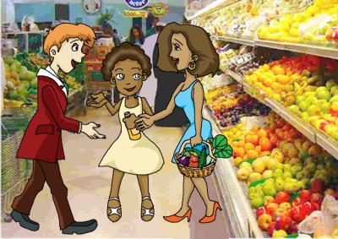
3a Look, listen and say
Maria: Hi, Mr. Lee! Nice to
see you.
Mr. Lee: Hi, Maria ! Nice to
see you, too.
Maria: Mr. Lee, this is my mom.
Mom, this is my teacher,
Mr. Lee.
Mom: How do you do ?
Mr. Lee: How do you do ?
How do you do?
How do you do?

Slide 6
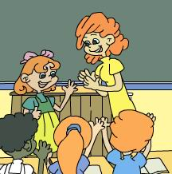
T: Hello, class. This is …
T: …, this is …
S1: How do you do?
S2: How do you do?
(shake hands 握手)

Slide 7
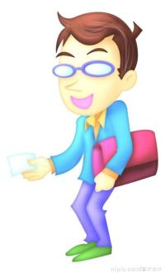
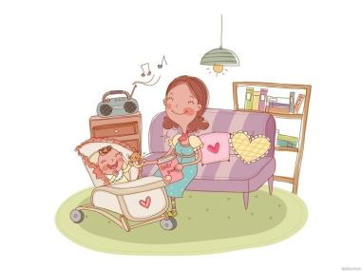
Mr. +姓
Miss +姓
Mrs.+姓
Ms. +姓

Slide 8
你知道吗?
英语国家常把男士称Mr., 女士称为Miss(未婚)或Mrs.(已婚)。如果在不明对方是否已婚的情况下, 可用Ms.,这是英国女权运动的产物。需要注意的是:Miss可单独用以称呼女性, Mr.或Ms.通常是与自己的姓名或姓连用, 而不能单独与名连用; Mrs.只能与夫姓或自己的姓加夫姓连用。

Slide 9
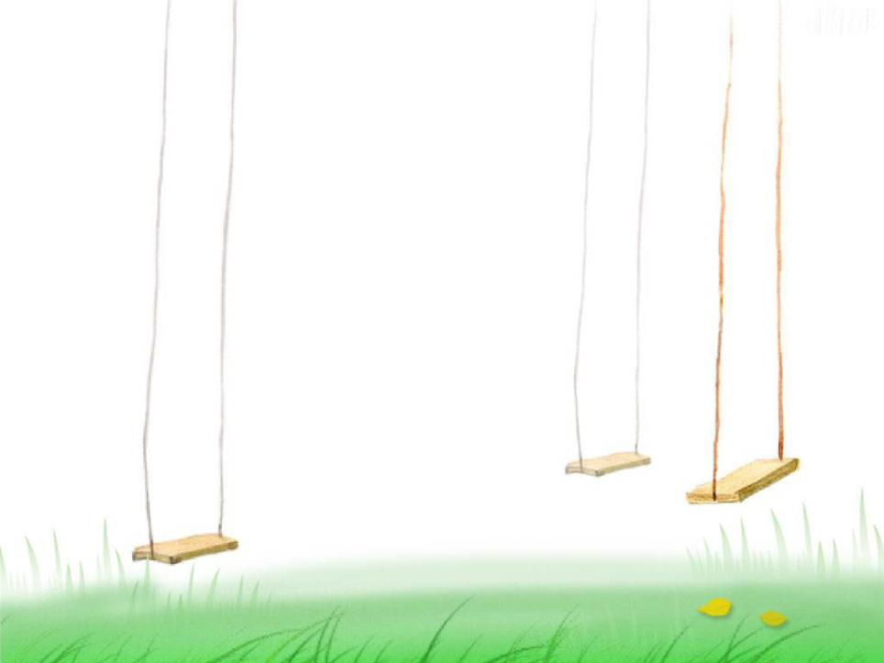
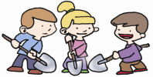
Make a dialog with three students like this:
Ss: Good morning, Miss/ Mr. ... T: Good morning. Nice to see you，
Jane, Maria and Kangkang. Ss: Nice to see you, too.
Do you know the difference between “Nice to meet you ”and“ Nice to see you” ？

Slide 10
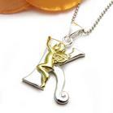
Look, say and write

Slide 12
Work alone
Listen and circle the letters you hear. Then try to find the rule.
A a G g H h Mm B b
L l D d J j I i K k

Slide 13
2c
Work alone
Rewrite the words using small or capital letters.

Slide 14
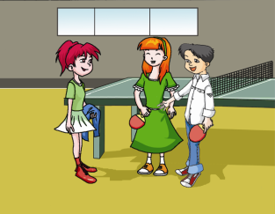
3b Group work
Kangkang: Hi , Jane! ______________
Jane: _______ , Kangkang! Nice to see
you, too.
Kangkang : Jane, this is Helen.
Helen, ___________.
Jane : How do you do ?
Helen:________________?
Nice to see you.
Hi
this is Jane
How do you do ?
Notes:
14

Slide 15
Match them together.
How do you do?
Good morning!
Welcome to Beijing!
How do you do?
Nice to meet you.
Thank you.
Are you Jane?
Nice to meet you, too.
Good morning!
Yes, I am.

Slide 16
5 Listen, read and understand
BBC NBA CD ID
kg km ml cm

Slide 17
Sum up
INTRODUCTION:
This is …
GREETING:
Nice to see you!
Nice to meet you!
How do you do?

Slide 18
Use your own names to complete the dialog.
A: Hi! __________.
B: Hi! ___________.
A: ______. This is _______.
______ . This is ______.
B: Nice to meet you .
C: Nice to meet you , too.
Group work

Slide 19
Homework
Please find out the famous persons in every kind of textbooks and use“This is …” to introduce them.

